Slide 1


Day 3
Week 1

Slide 2
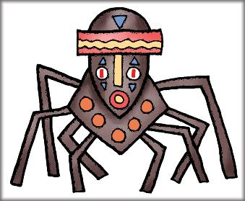
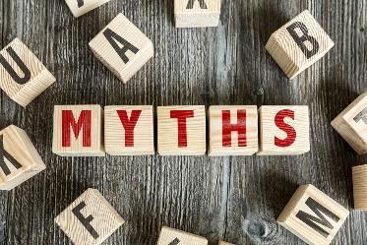
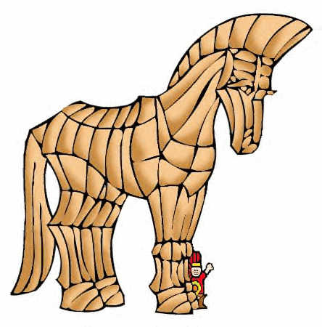
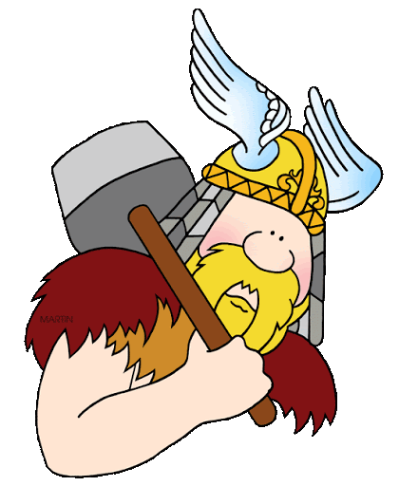
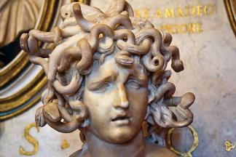
Myths
What are myths?
Can you name any?

Slide 3
Myths
What are myths?
Myths and legends are not simple stories, but a representative of the society that created them.
Myths are fictional explanations of how and why something happened – like how a particular animal came to be, or the
origins of a natural phenomenon like rain.
Many myths include a lesson on why people should behave in certain ways. Good or clever behaviour often gets rewarded, while bad or foolish actions are punished. The only thing a myth can’t be about is science.

Slide 4
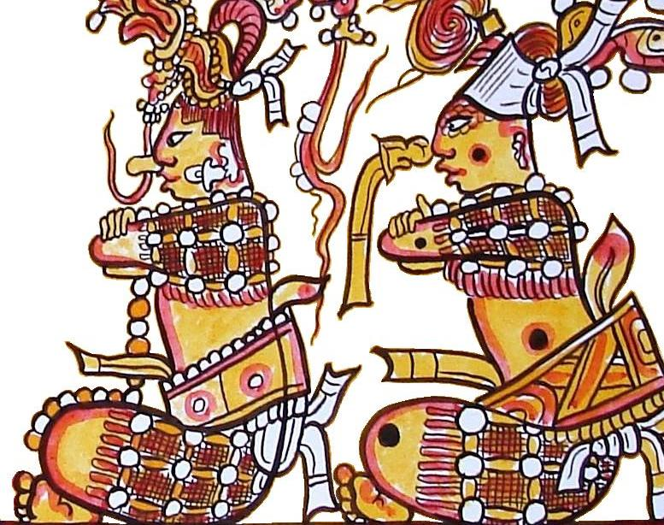
Maya Myths
The ancient Maya has a detailed and complex mythological system which survives in the Popul Vuh. The stories in the Popul Vuh have allowed archaeologists a glimpse of the Maya ways of thinking, and provided insight into their society as a whole.
Mythalogical
adjective
relating to, based on, or appearing in myths or mythology.

Slide 5
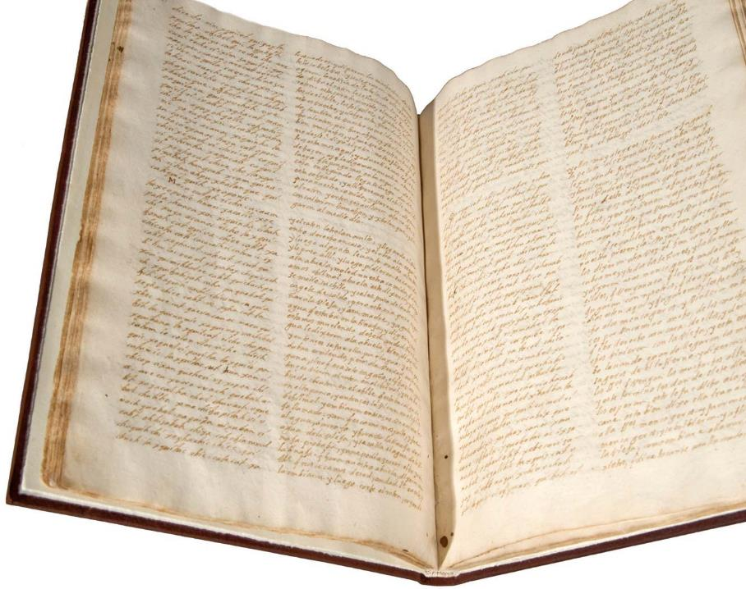
Maya Myths
Popol Vuh, Maya document, an invaluable source of knowledge of ancient Mayan mythology and culture. Written in K’iche’ (a Mayan language) by a Mayan author or authors between 1554 and 1558,
It chronicles the creation of humankind, the actions of the gods, the origin and history of the K’iche’ people, and the chronology of their kings down to 1550.
The original book was discovered at the beginning of the 18th century by Francisco Ximénez (Jiménez), parish priest of in highland Guatemala. He both copied the original K’iche’ text (now lost) and translated it into Spanish.

Slide 6
Myths
Are myths important?
First let’s look at the question, what is the role of myths in a culture?
They explain how a people came to be and what happens when they die; explains natural phenomena; how to behave in society; teaches a lesson.
Some myths have happy endings but unlike fairy tales they don’t always have a happy ending.
Are myths important?
What do you think?
They help people make sense of the world and explain things that otherwise would be unable to explain.

Slide 7
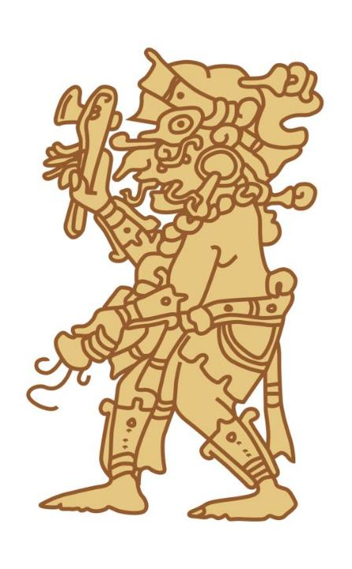
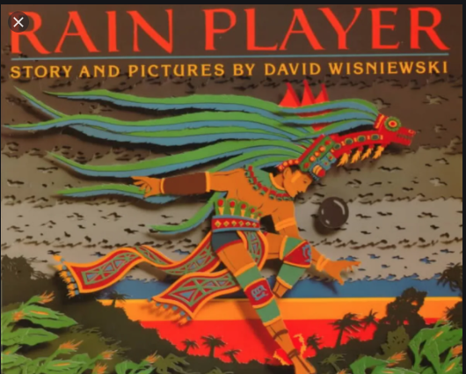

Slide 8
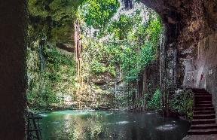
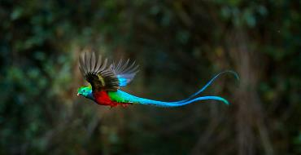
Speed Words
Cenote is a natural pit, or sinkhole, resulting from the collapse of limestone bedrock that exposes groundwater.
Quetzals are strikingly coloured birds.
Hetzmek
The “Hetzmek” ceremony welcomes a newborn child into the community. (Its name from the way the child is held on the left hip of the godfather or godmother.)
The godparents present the child with nine items that will be used later in life.
The ceremony is still common throughout the Yucatán peninsula today, and is ideally held during the full moon.
Ah Kin Mai is the name given to the chief priest.
Otzilen roughly translates as “I have need” or “I am poor”.

Slide 9
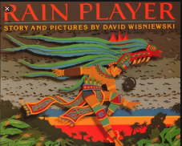
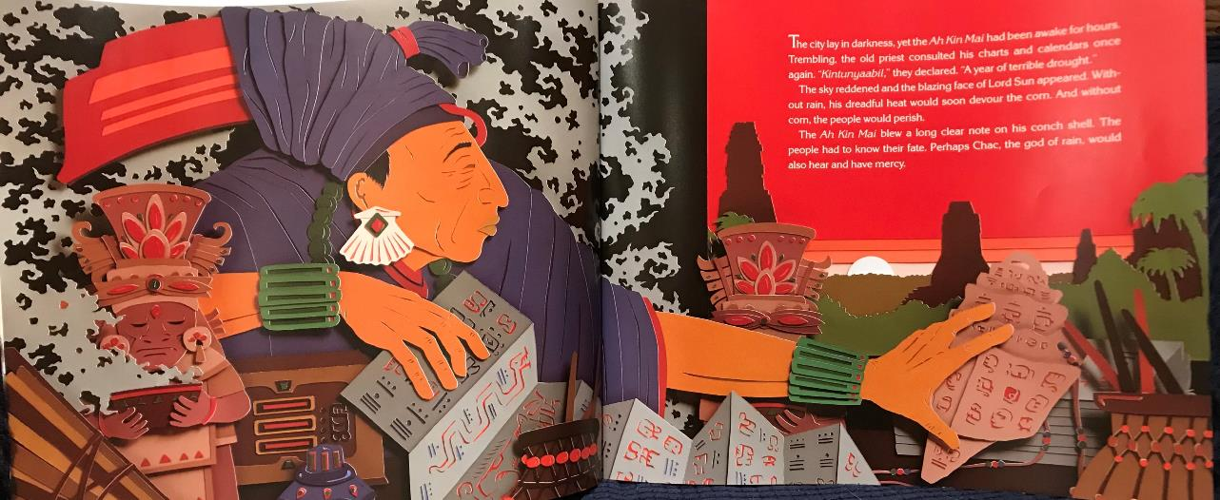

Slide 10
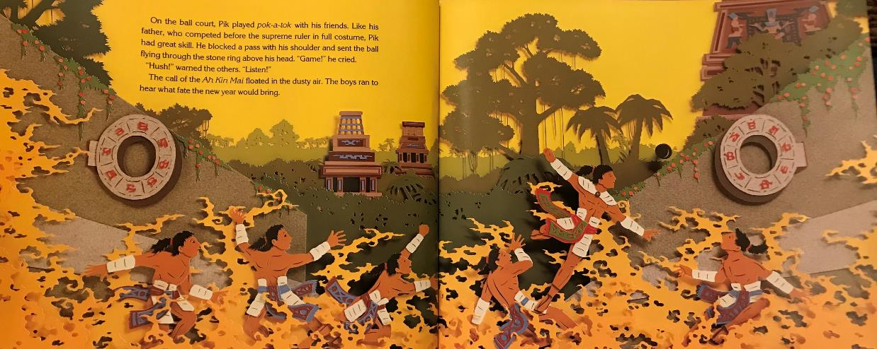

Slide 11
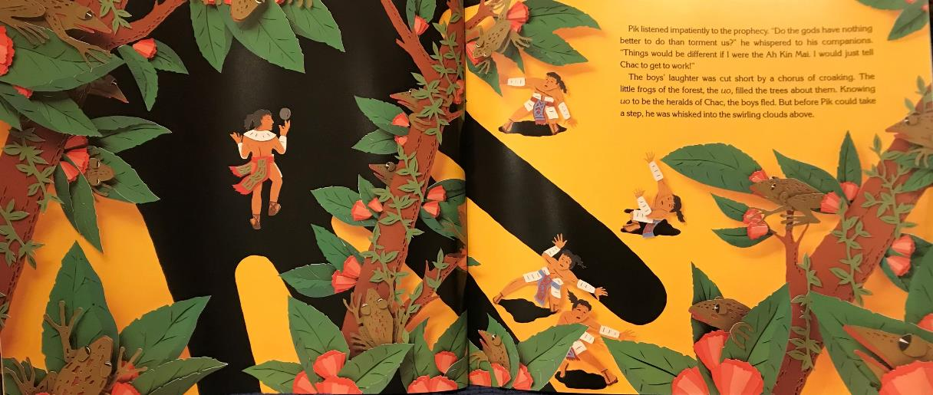

Slide 12
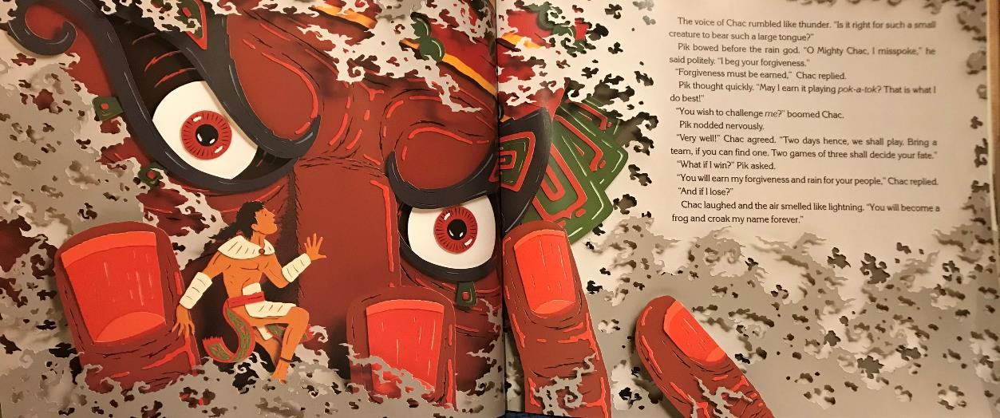

Slide 13
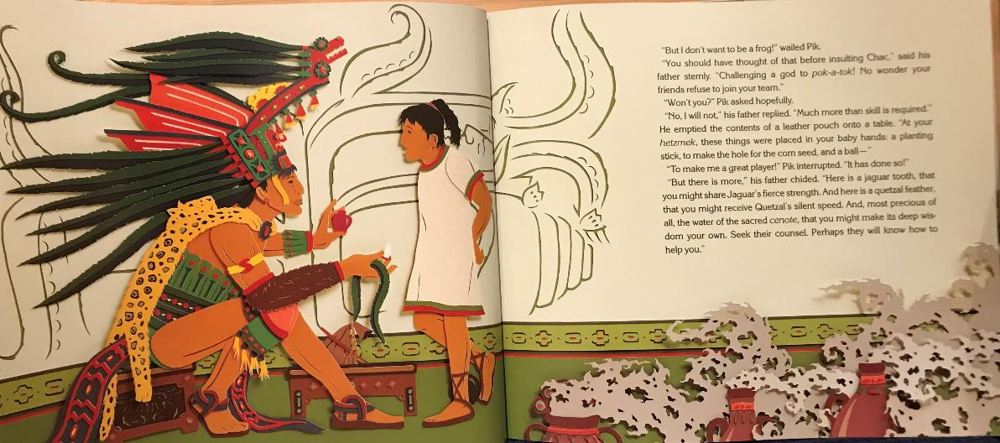

Slide 14
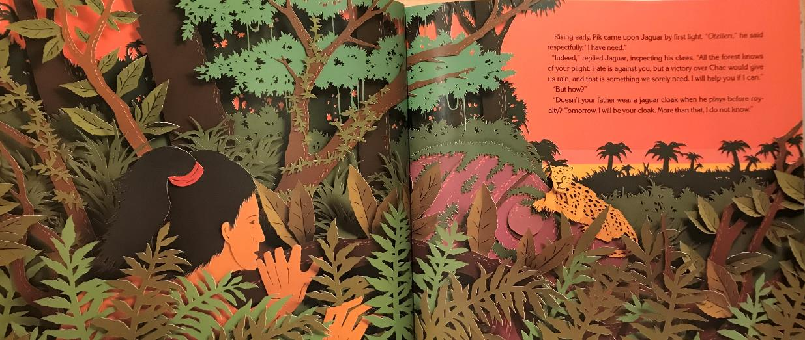

Slide 15
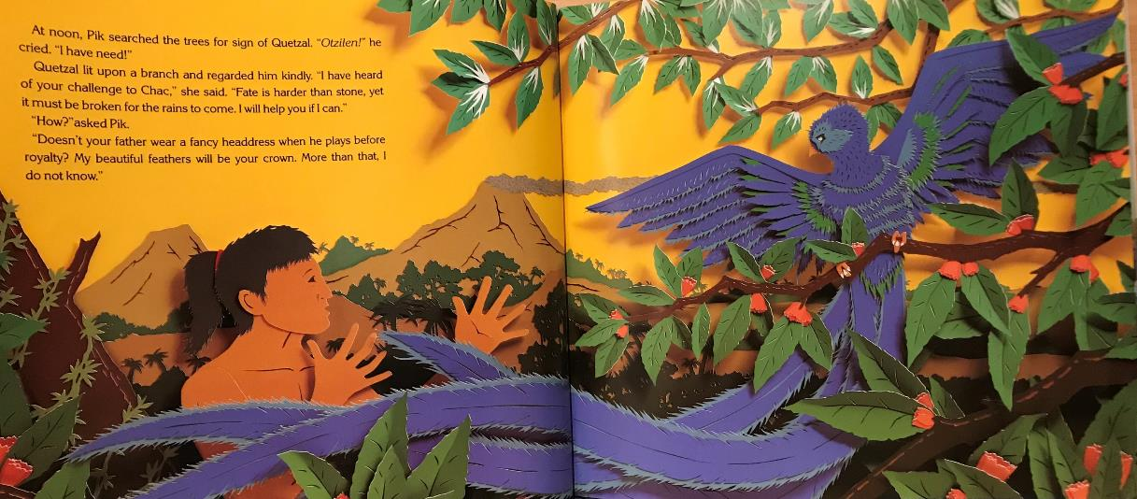

Slide 16
Please carry on the next PPT 2
Year 5 Home School Learning English Part 2 24th Feb 2021

