Slide 1
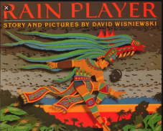
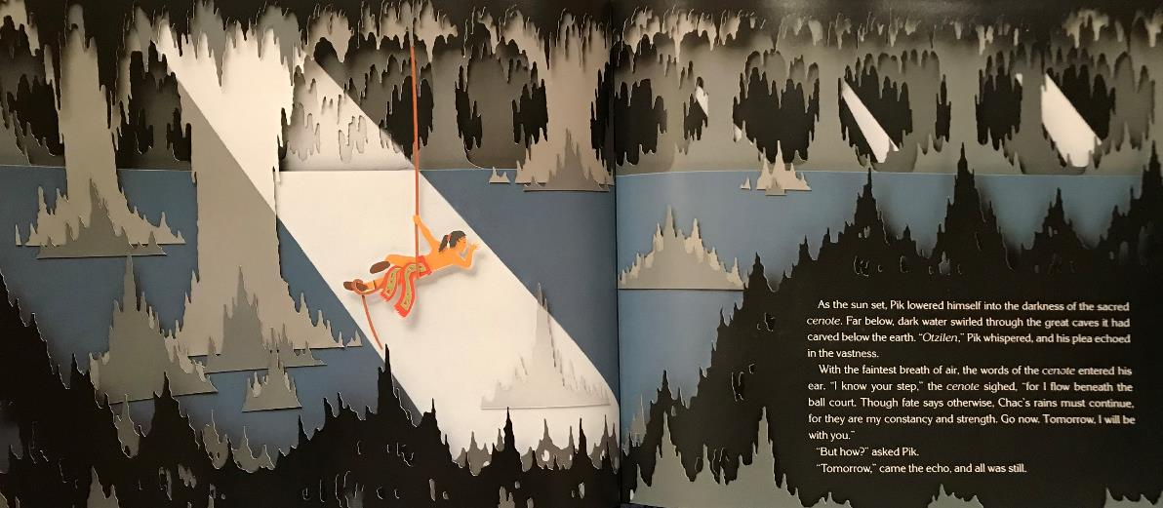


Slide 2
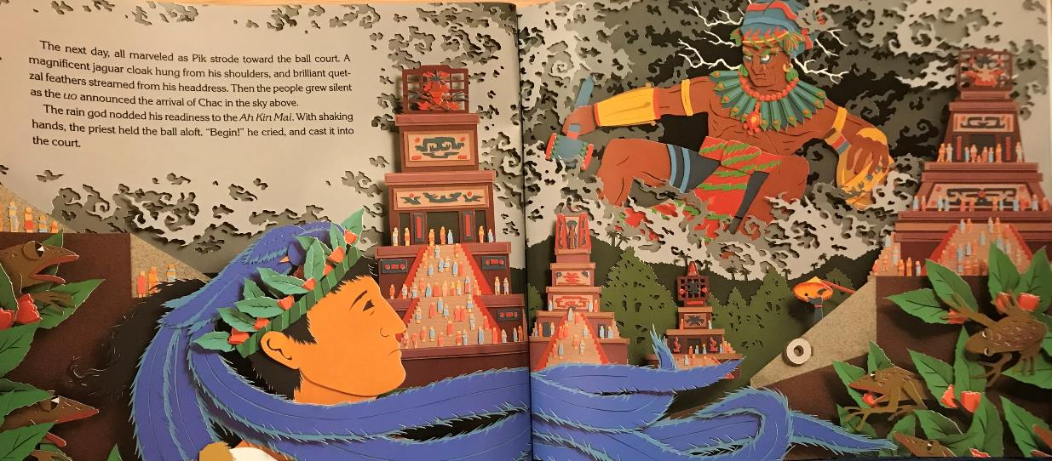

Slide 3
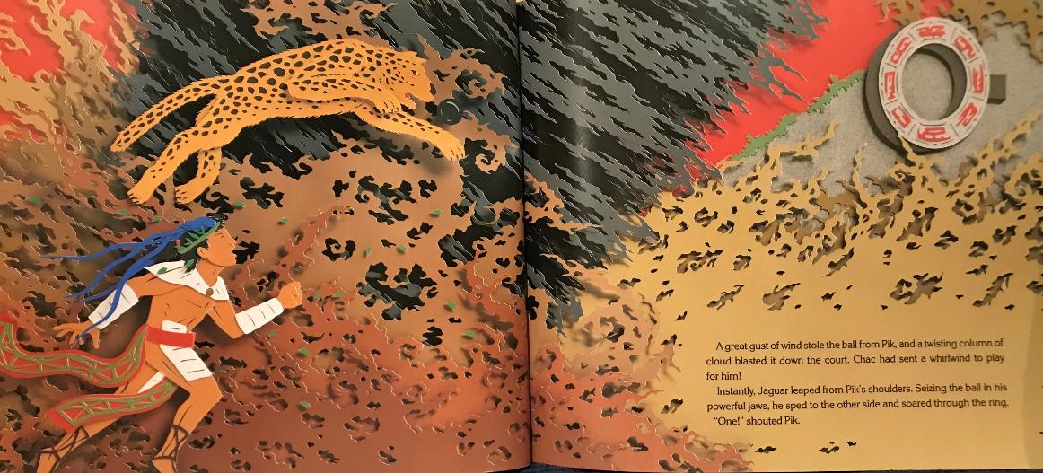

Slide 4
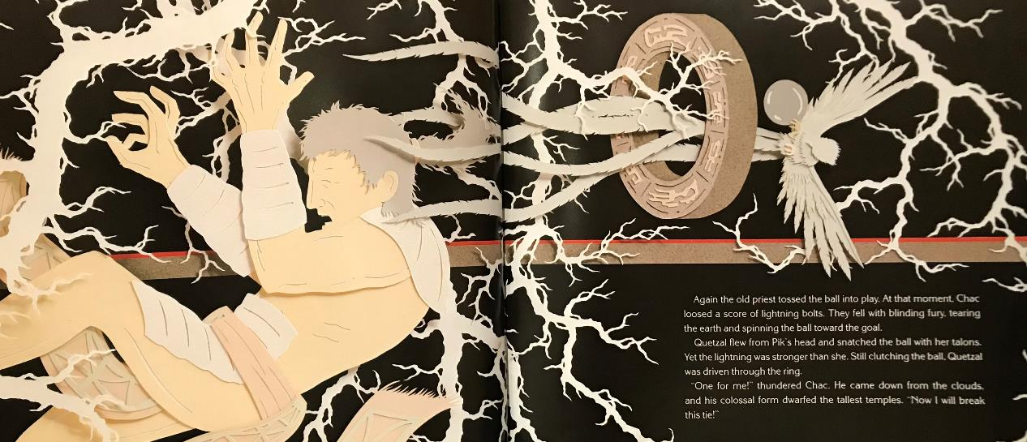

Slide 5
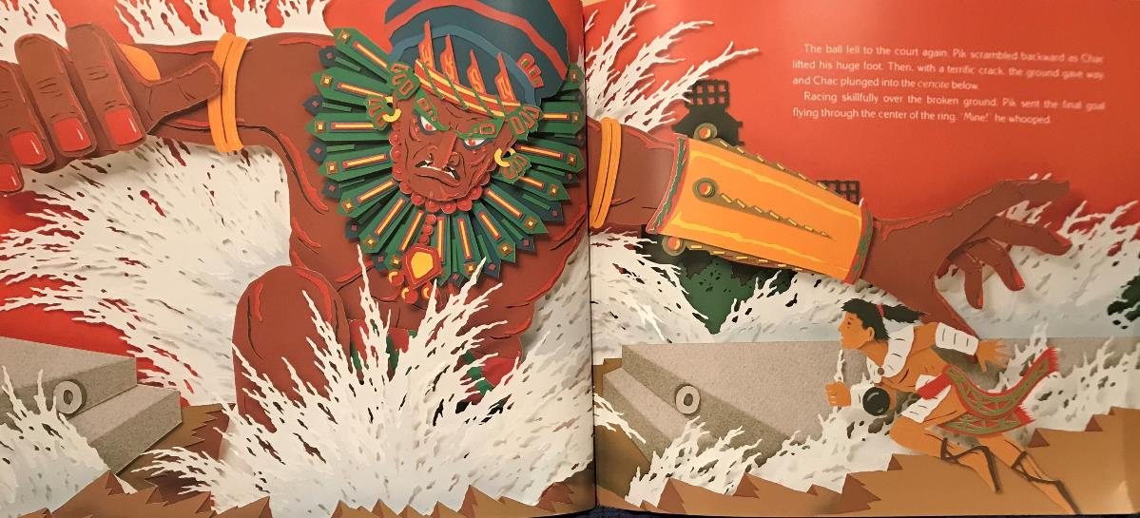

Slide 6
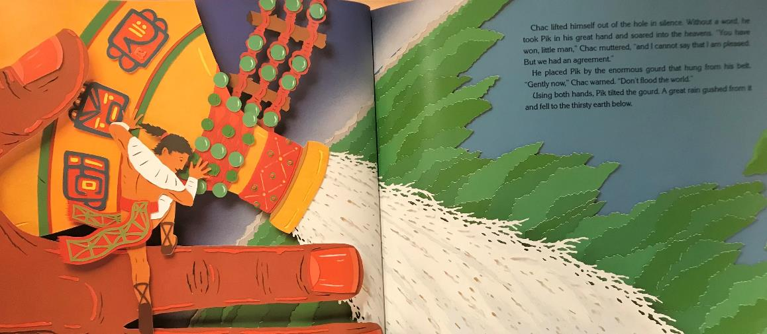

Slide 7
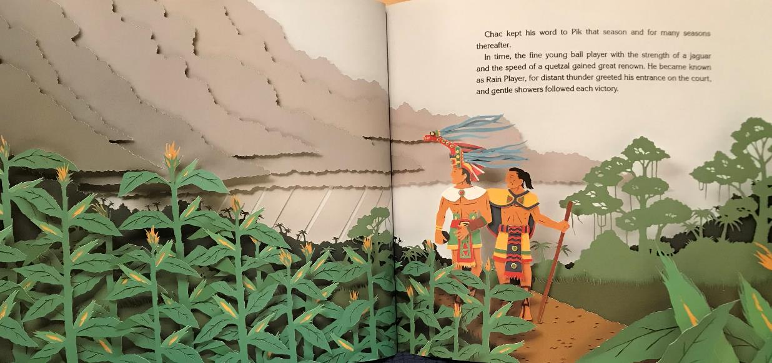

Slide 8
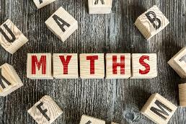
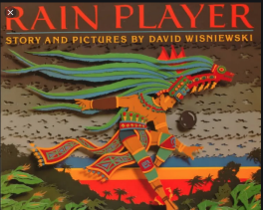
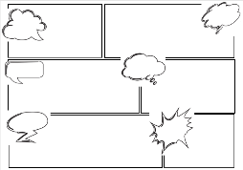
L.O:I can explain the role of myths.
S.C:To summarise the rain player myth
To explain the purpose of the rain player myth.
Give my opinion on the importance of myths.
Activity:
1. Summarise the story in a comic strip.
2. What is the purpose of the story? Does it teach a lesson?
3. Are myths important?
Question 1 either on your own piece of paper or use the sheet provided.
Record questions 2 and 3 on a piece of paper

Slide 9


