Slide 1


Slide 2





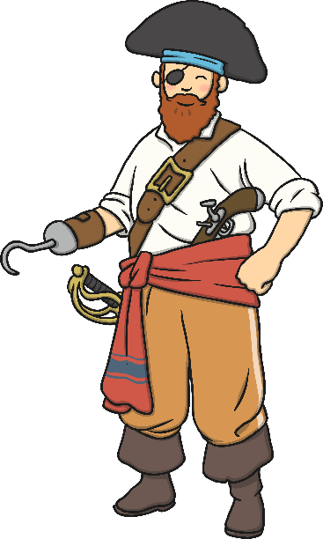




Help Pirate Pete find the treasure!
The real treasure has real words on it.
The fake treasure has got made up words on it.
Can you find the real treasure?

Slide 3


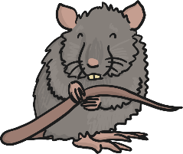





Can you hear the initial sound?
Say the names of the pictures out loud. What sound do they start with?
Now can you sort them into 3 lists? Draw the pictures under the correct sound.
e u r

Slide 4



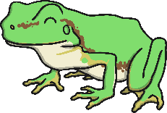






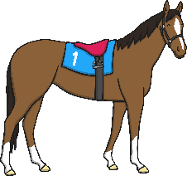

Can you hear the initial sound?
Say the names of the pictures out loud. What sound do they start with?
Now can you sort them into 3 lists? Draw the pictures under the correct sound.
h b f l

Slide 5
Read the words:
Now write a sentence using one of the words.
it
to
got
and

Slide 6



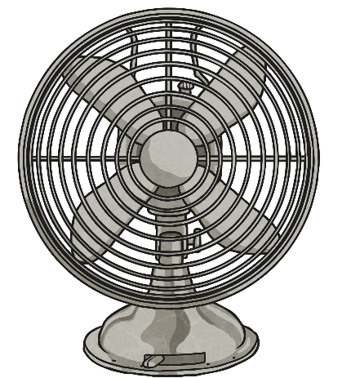
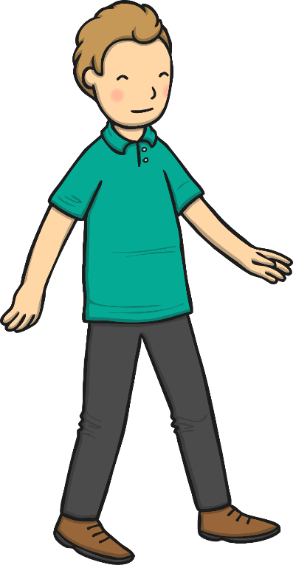



Write the words that rhyme:

Slide 7

Read the sentence and draw the picture:
The cat and the rat ran up the hill.

Slide 8
Read the words:
Now write a sentence using one of the words.
him
no
at
mum

