Slide 1
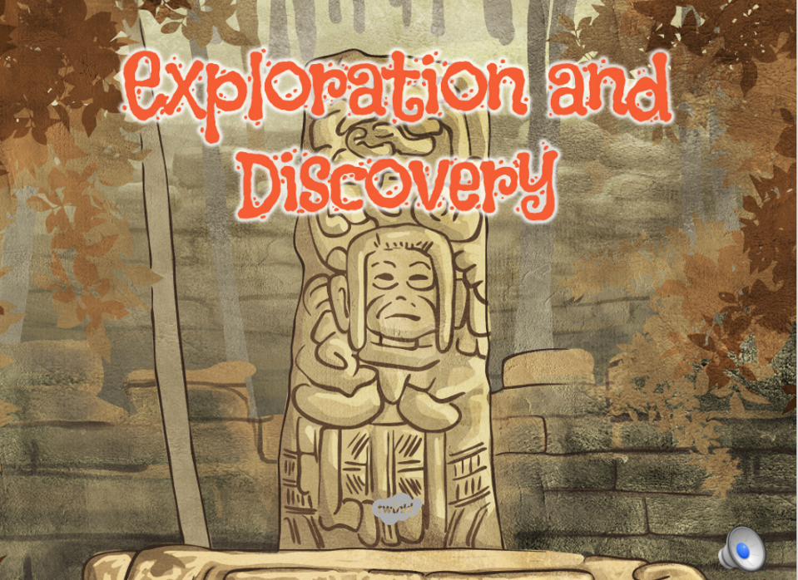



Slide 2
Aim
I can find out what we know about the Maya from the drawing of Frederick Catherwood
Success Criteria
I can identify at least three sources of evidence about the Maya and explain what they tell me.
I can examine a historical picture and answer questions about an aspect of the Maya civilisation.

Slide 3
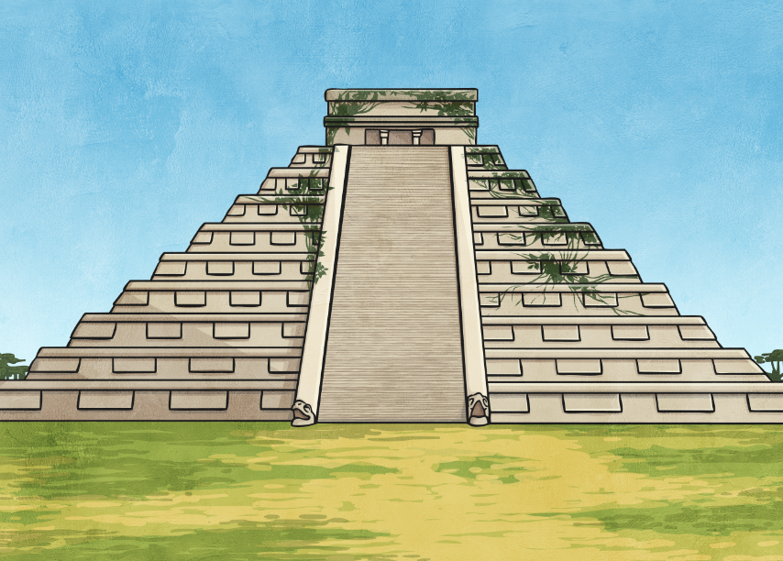

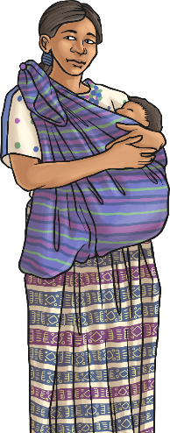
Understanding History
Think about the following questions.
How do we know about the history of the world?
Who finds out?
Where does this information come from?
How accurate do you think our interpretation of the past is?
How do we know about the ancient Maya?

Slide 4



Using Sources of Evidence
In order to paint an accurate picture of life in ancient Maya, historians have to use a range of evidence sources to piece together a number of details, a bit like doing a jigsaw puzzle with each new piece of the puzzle revealing more information.
Sources of evidence can be primary sources or secondary sources:
Primary sources come directly from the time of the event e.g. a photograph or an artefact.
Secondary sources are created after the event and are often created using primary sources e.g. a textbook.
How many different types of evidence can you think of that could help us to understand the Maya better?
What do these sources of evidence tell us?
Are they primary or secondary sources?
How reliable are they?
Complete the table with your ideas.

Slide 5
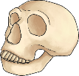

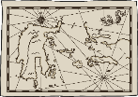




Parts of the Puzzle
What parts of the Maya evidence puzzle did you think of?
Here are just a few suggestions you may have thought of:
Archaeological: actual remains from the past dug up, analysed and interpreted.
Written: evidence from written records either from the time or recorded later.
Maps: written at the time or created later.
Artwork: e.g. paintings or sculptures, either from the time or later in history.
Films and documentaries: created to piece together information about the past or to tell a story.
Letters and diaries: e.g. explorers or archaeologists documenting their findings.
Did you think of any other sources of evidence?
Do you think they are primary or secondary sources?
Could any be both primary and secondary sources?
Stories, myths and legends: either written at the time or later in history.

Slide 6
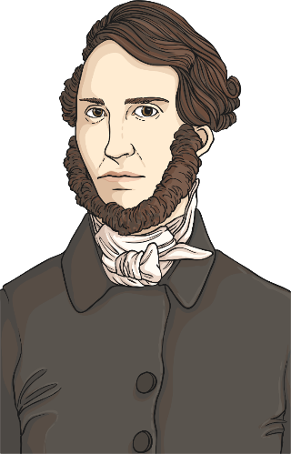
Maya Explorers
American explorer and travel writer, John Lloyd Stephens and British artist, Frederick Catherwood are credited with re-igniting interest in the ancient Maya civilisation from 1839 onwards.
The ruins and lost cities of Mesoamerica had been explored and recorded earlier in history, but detailed documentation by Catherwood brought attention back to the Maya and their fascinating civilisation.
Numerous archaeological expeditions of the Maya region were launched following the work of Stephens and Catherwood.

Slide 7
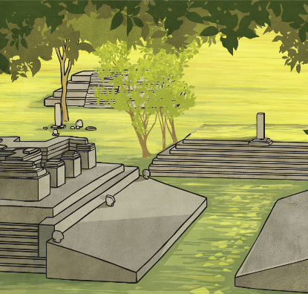
Copan
The Maya city of Copan was the first to be explored by Stephens and Catherwood in 1839. in 1841, they published a book called Incidents of Travel in Central America, Chiapas and Yucatán which detailed their findings in Copan and other places. The book contained maps, detailed drawings by Catherwood and text by Stephens.
Copan Facts:
Copan is in West Honduras near its border with Guatemala.
Some of the most detailed architecture and artwork of the ancient Maya was discovered in Copan.
Copan first began to thrive under the rule of a warrior prince who declared himself as the King of Copan in AD 426. he was called K’inich Yax K’uk Mo’, which means Blue-Green Quetzal Makaw.
One of Copan’s kings was called 18 rabbit!

Slide 8
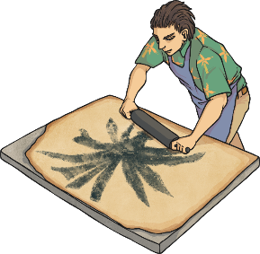
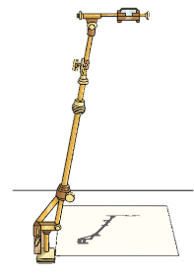
Catherwood’s Drawings of Copan
Frederick Catherwood produced many detailed drawings of what he and Stephens had discovered in Copan. He used a camera lucida which uses mirrors and prisms to superimpose the image to be drawn around. This helps to produce drawings that are accurate in proportion and perspective.
Several years later, Catherwood used a technique called lithography to produce prints of his work.
camera lucida
lithography

Slide 9
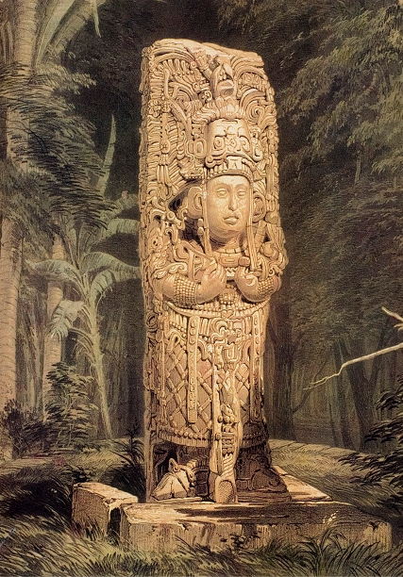
Idol at Copan
This stone statue is more than three metres high and dates back to around AD 720.
It is thought to be one of Copan’s most famous rulers, King Waxaklajun Ub’aah K’awiil, in the guise of a maize god.

Slide 10
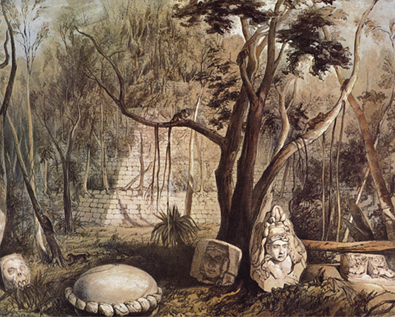
Pyramidal Building and Fragments of Scultpure at Copan
The remains of the sculptures weren’t found in exactly this location in front of the pyramid, but Catherwood did some more drawings back in London, he used the sketches he had made to draw new compositions.

Slide 11
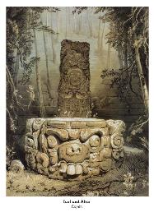
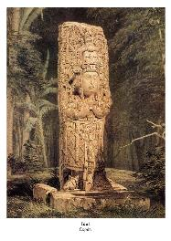
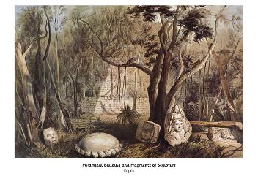
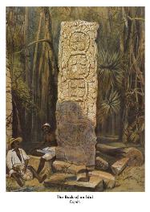
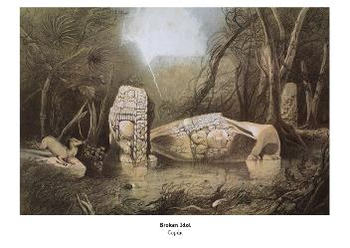
Historical Picture Study
Look at one of the pictures in the photo pack.
Answer the questions on your activity sheet in as much detail as you can, then carefully draw your own version of the picture.

Slide 12

More Maya Cities
Stephens and Catherwood went on to explore, document and draw scenes from a number of other Maya cities including Chichen Itza, Palenque, Uxmal and Tulum. Subsequent exploration of Mesoamerica has resulted in many more exciting discoveries.
In fact, exploration of the Maya continues to this day, and new discoveries are still being made. In August 2014, two more Maya cities were re-discovered in Campeche, Mexico. The existence of these cities, named Lagunita and Tamchen, was first known in the 1970s but their location wasn’t logged accurately enough. So they were soon lost again, hidden beneath the thick rainforest vegetation.
Since they have been re-discovered, the ruins of a palace, temple, ball court and altar have all been found along with a huge doorway, described as ‘monster mouth’.
It proves that history is all around us, waiting to be discovered! Why don’t you see what else you can find out about the fascinating lost cities of the Maya?

Slide 13

Your turn
LO I can explain up to three forms of historical sources about the Maya
Success Criteria
I can identify up to three sources of evidence about the Maya and explain what they tell me.
I can examine a historical picture and answer questions about an aspect of the Maya civilisation.
(Extension: Explain how the same evidence can be interpreted in different ways)

