Slide 1
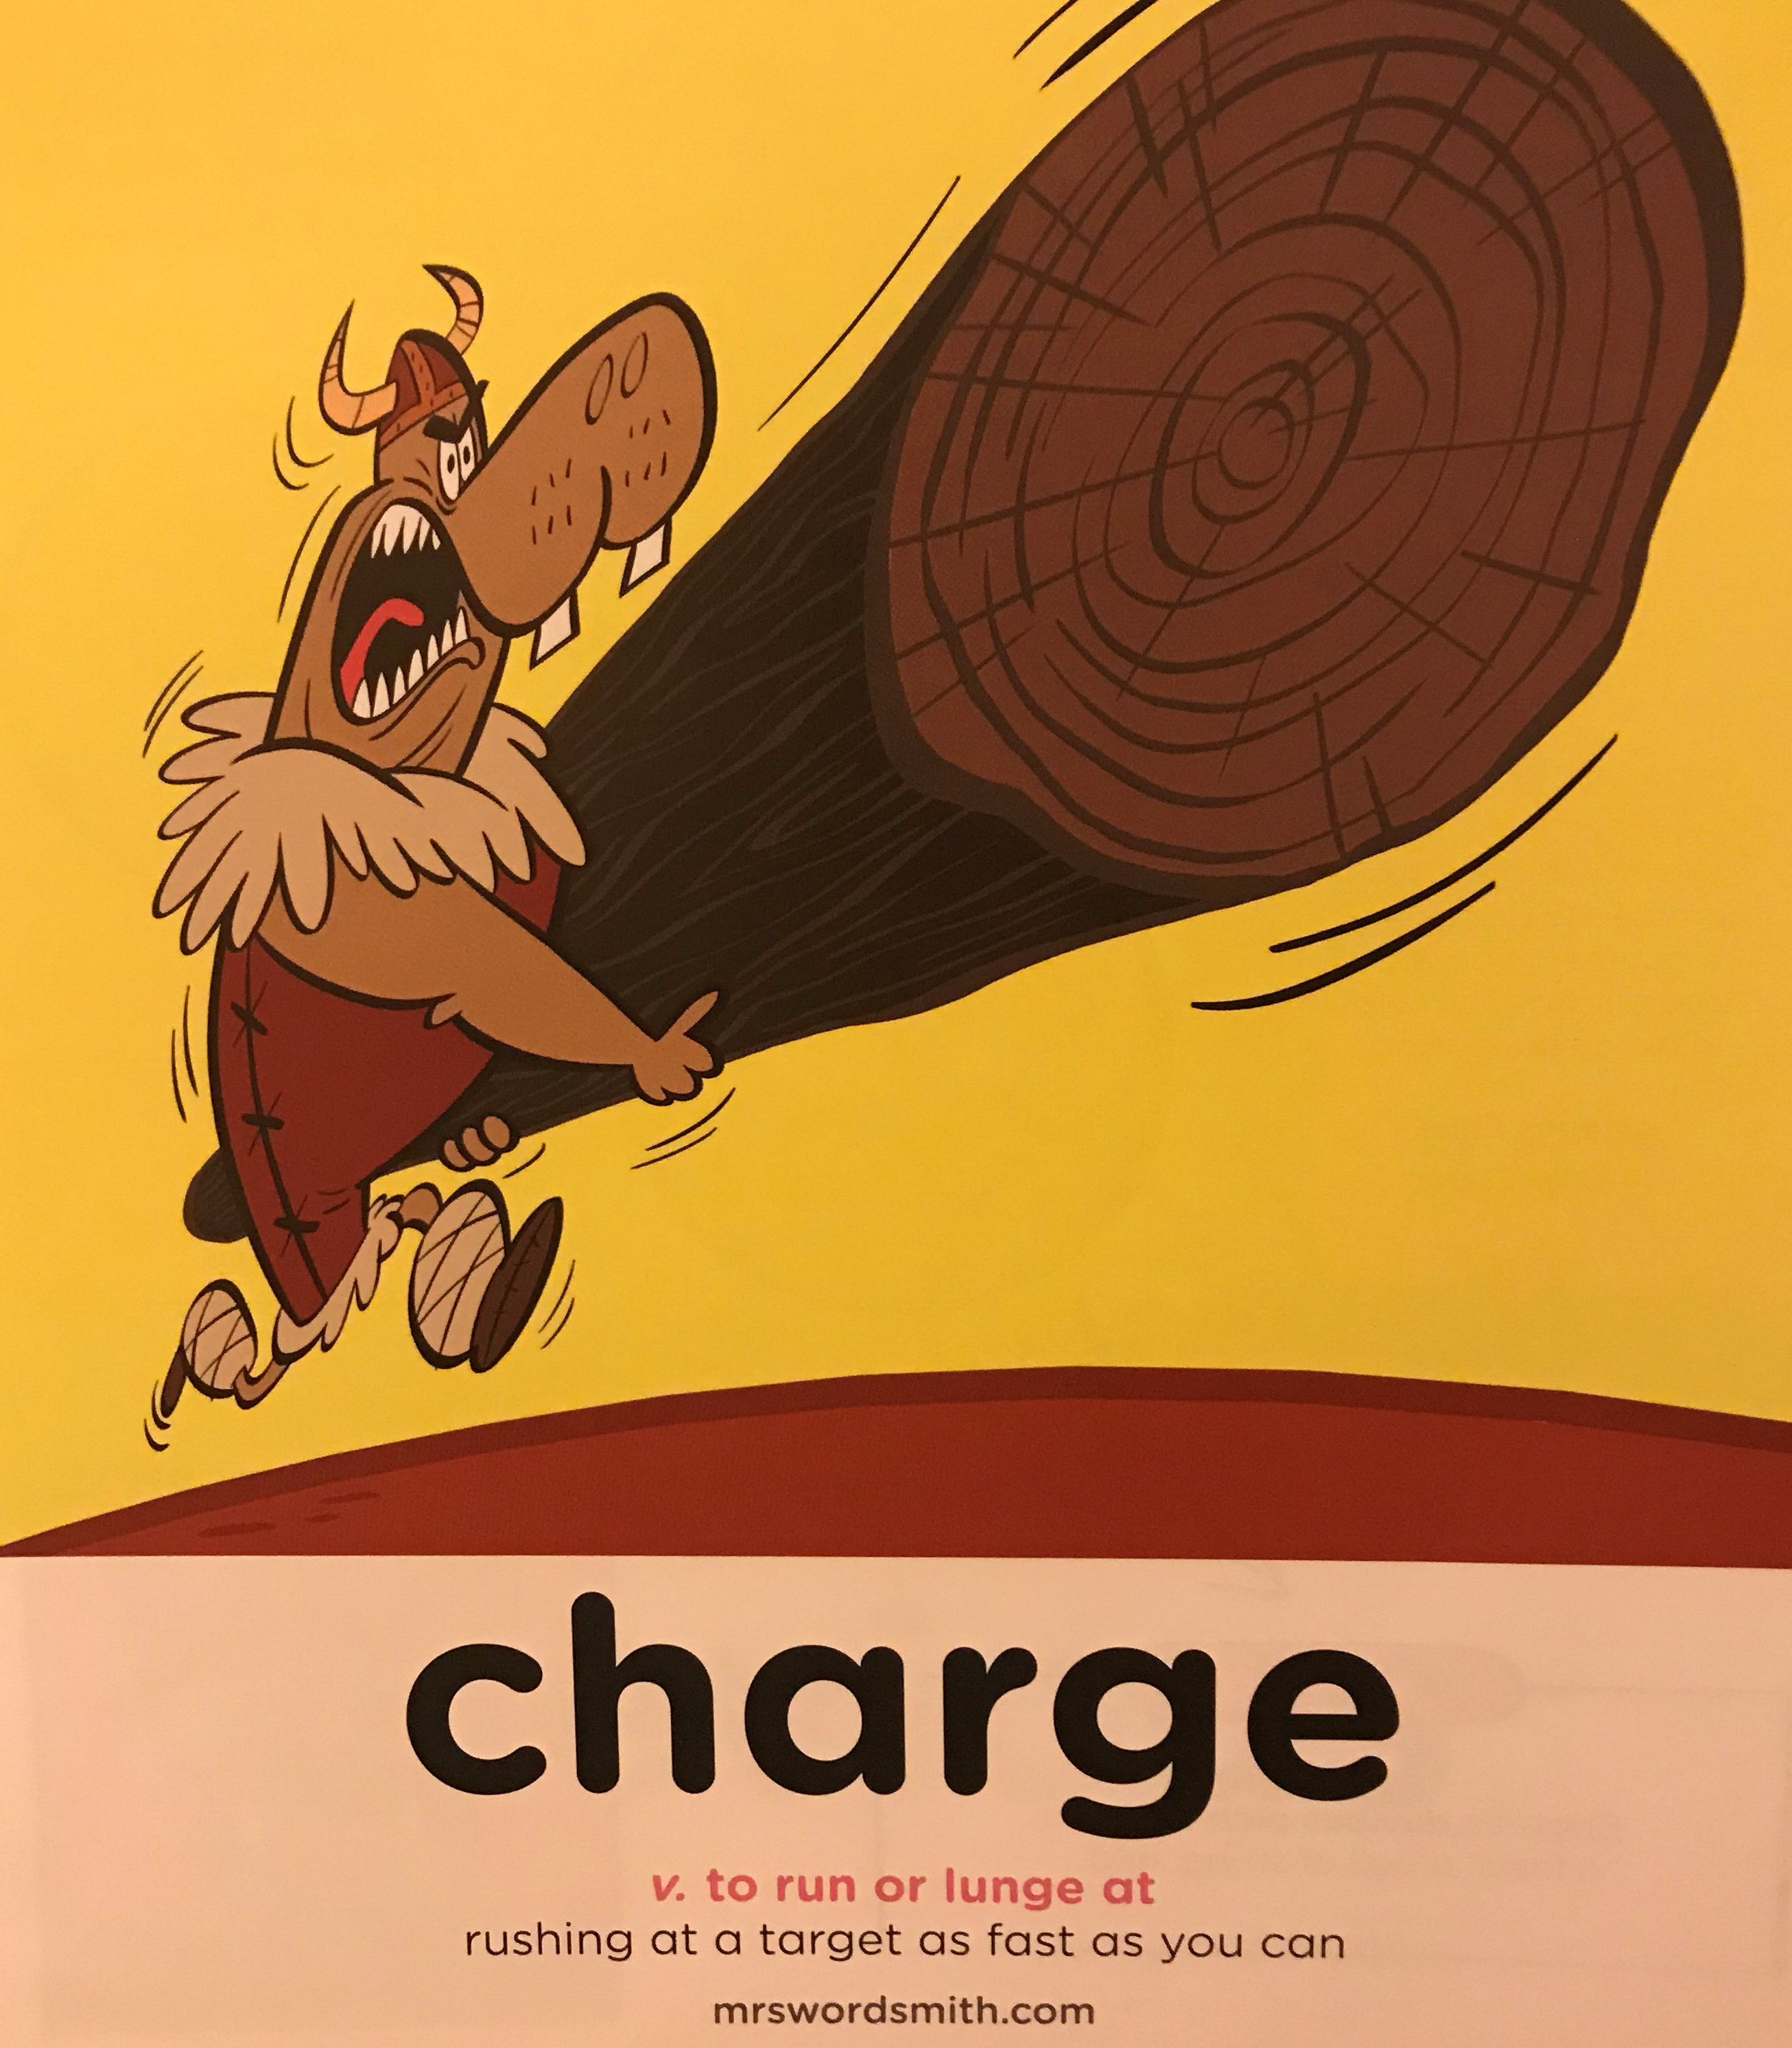

Day 2
Week 1

Slide 2

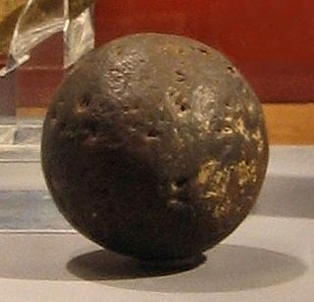
Do you dare to play the most dangerous and deadly ball game of all time?
Speed, accuracy and teamwork are paramount to the success of Pok-A-Tok, this Ancient Maya game.
Let it be known that, stakes are high: Win and you’ll be treated like royalty.
Lose and you’ll be sacrificed to the gods

Slide 3

Watch the two videos (which can be found at Year 5 January 2021 Home School Learning Video Support | Datchet St Mary's CofE Primary Academy (primarysite.media) ) and read the next few slides on the Mayan ball game pok-a-tok / pok-ta-tok /pik. (It is know by all three names.)
Make notes on a piece of paper on what you notice.
Think about
  What is the aim of the game?
  What are the rules?
  How do you win?

Slide 4
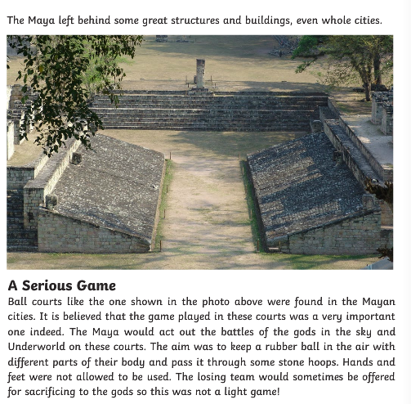

Slide 5
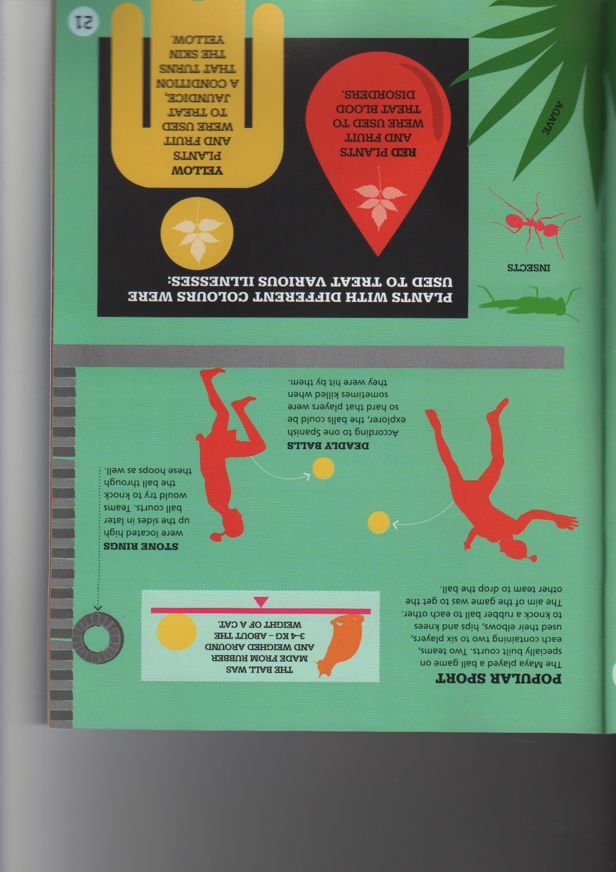
History in infographics: The Maya By Jon Richards and Jonathan Vipond

Slide 6
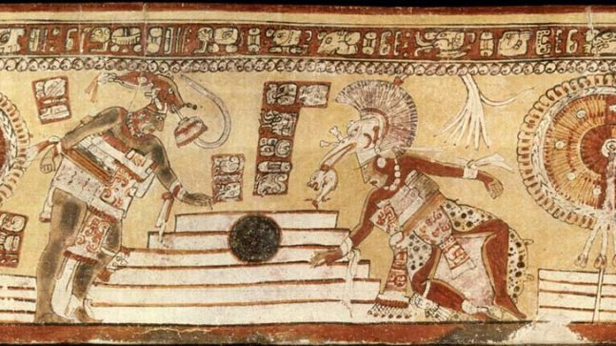
Source: mayavase.com

Slide 7
The rubber ball was made from Latex: the milky sap of certain trees and plants (including the rubber tree) that hardens on exposure to air. This process of turning sticky latex into hardened, resilient rubber is called vulcanization.
Source: mayavase.com
Yoke: heavy padded belt worn by ball players.

Slide 8
L.O:To research and write a set of instructions
S.C:I can use subheadings to organise information
I can use a colon to introduce a list
I can use a semi-colon to separate items within a list

Slide 9
Subheadings
• Equipment • Object of the game • How to play • How to win

Slide 10
Subheadings
• Equipment • Object of the game • How to play • How to win
Use hips, elbows and knees
Not your hands or feet
Pass the ball to other members of your team and through the hoop
Use your hips, elbows and knees but not your hands or feet to pass the ball to other members of your team and get the ball through the hoop.
Some believe that if you didn’t win you might be sacrificed to the gods.
a rubber ball
two goal hoops
protective padding
a playing large court
Get the ball through the hoop

Slide 11
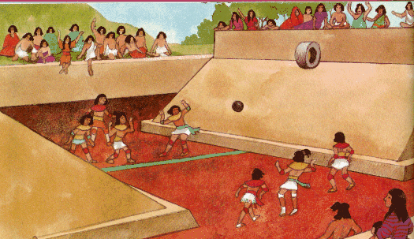
Subheadings
• Equipment
• Object of the game
• How to play
• How to win
• Equipment
To play Pok-A-Tok you will need the following: a rubber ball; two goal hoops; protective padding; and a playing large court.

Slide 12
How to play pok-a-tok
Equipment
To play Pok-A-Tok you will need the following: a rubber ball; two goal hoops; protective padding; and a playing large court.
Object of the game
How to play
How to win

Slide 13
L.O:To research and write a set of instructions
S.C:I can use subheadings to organise information
I can use a colon to introduce a list
I can use a semi-colon to separate items within a list

