Slide 1


Slide 2


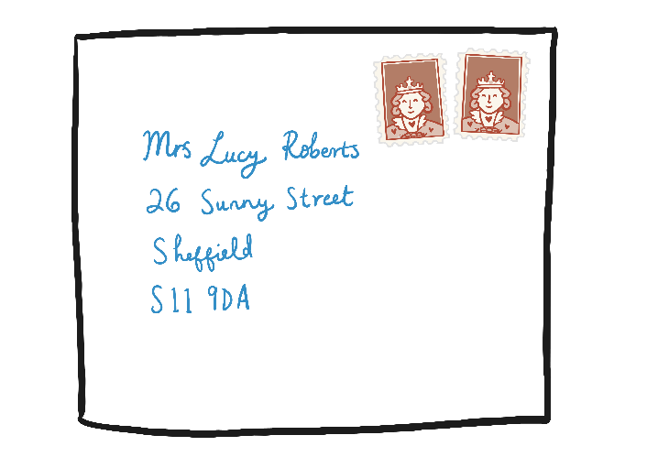

Here are some words that end with ‘er’:
Can you write the words?

Slide 3
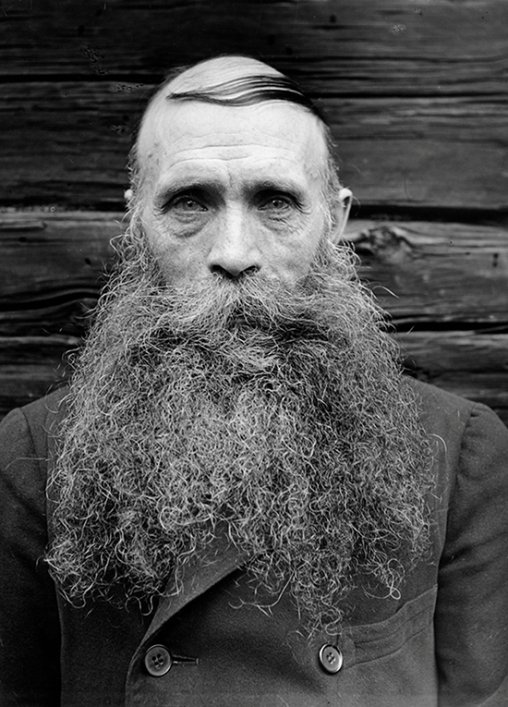
Write about the picture:
No copyright for this photo as it is a Public Domain image

Slide 4







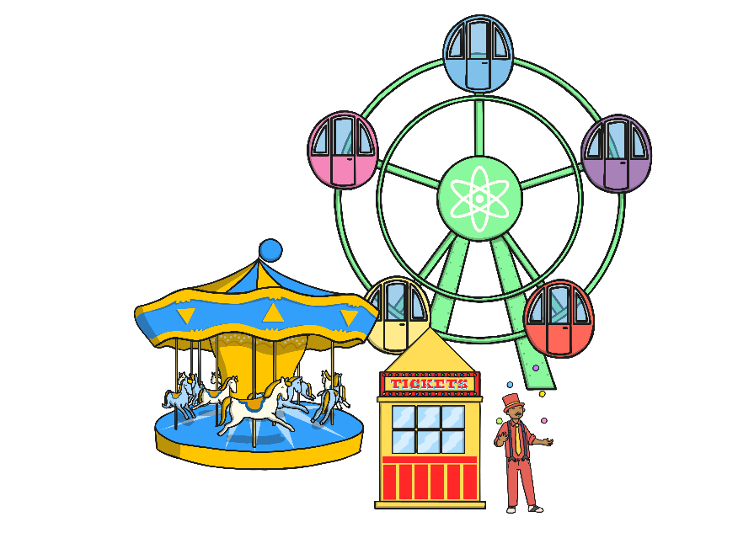
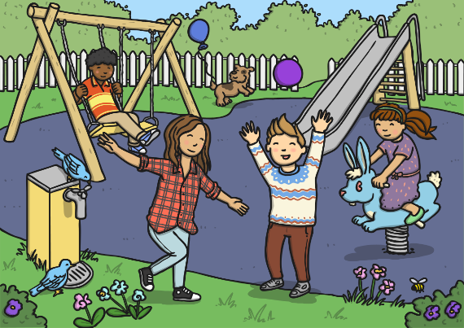
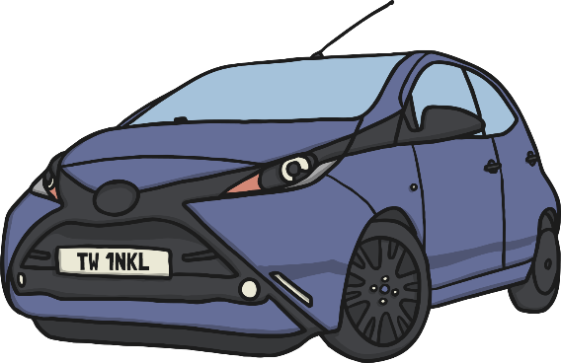
Find the words that rhyme and write them down in pairs:

Slide 5
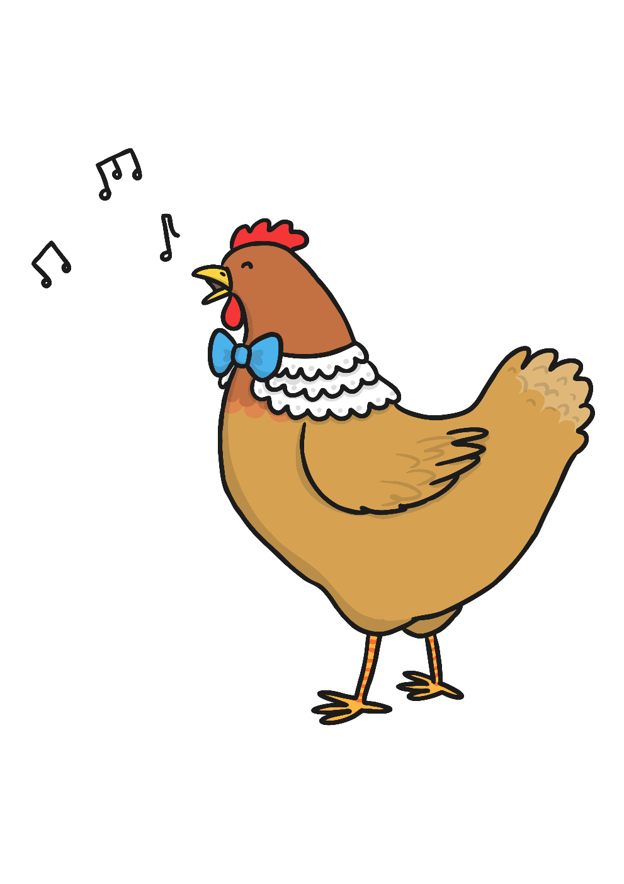
Yes or no?
Find a friend and read the questions.
Do you think the answer is yes or no?
Can a church zoom to the moon?
Can a chicken sing a song?
Can a bee buzz?
Is it dark at night?
Will six cows fit in a matchbox?
Can an owl sit in a tree?

