Slide 1
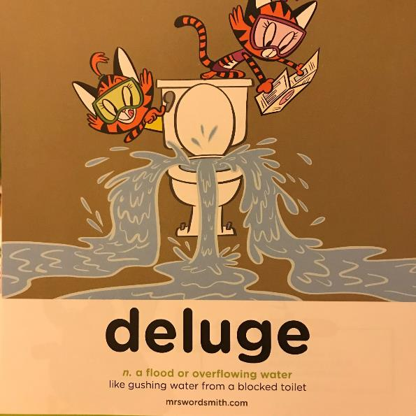

Day 1
Week 1

Slide 2
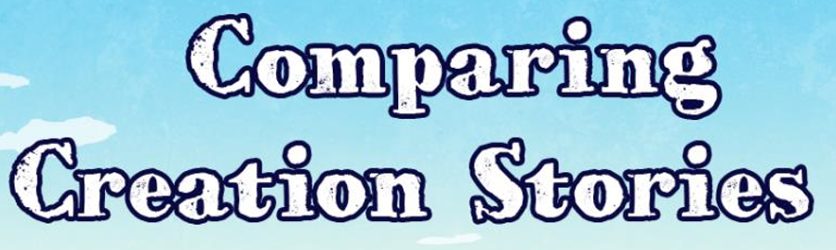


Slide 3
Aim
L.O:I can compare the Maya creation story with the Christian creation story.
Success Criteria
Order both creation stories.
Identify similarities and differences.

Slide 4
Speed Words
hardier determined crumbled
deafening worship paste
meaningless vision

Slide 5
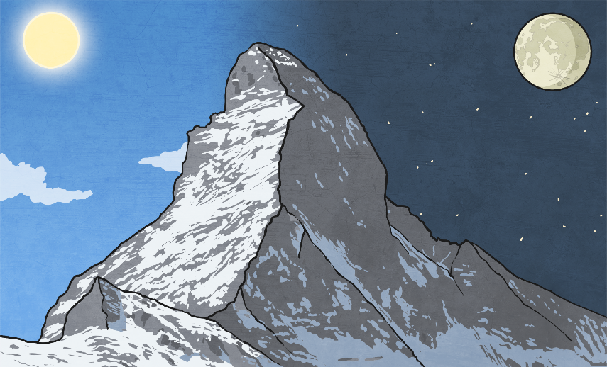
Christian
Creation Story

Slide 6
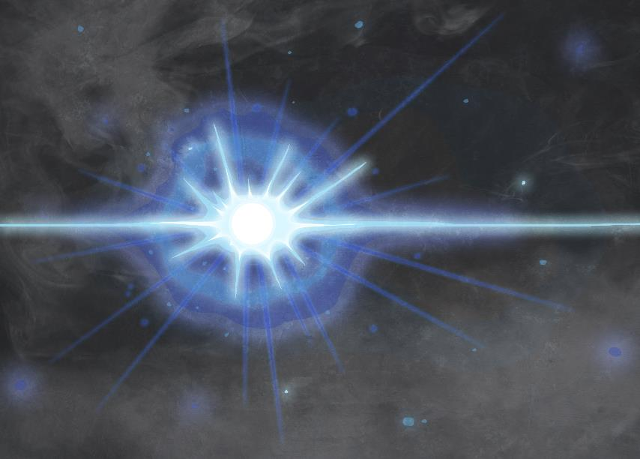
On the first day, God created light and separated it from darkness.

Slide 7

On the second day, God created the sky.

Slide 8
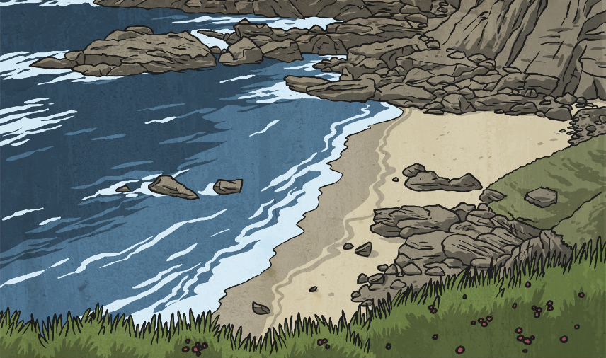
On the third day, God created the land and sea. He also created trees and plants.

Slide 9
On the fourth day, God created the sun, the moon and the stars.

Slide 10
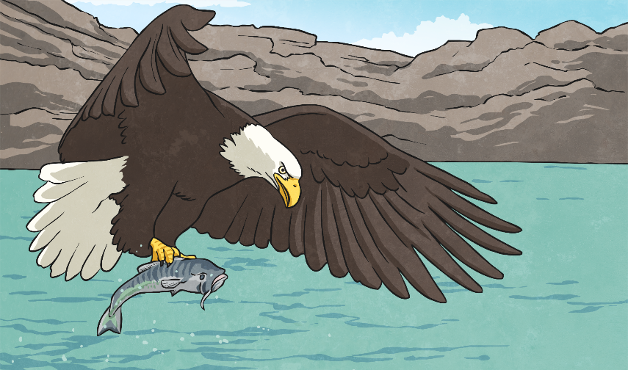
On the fifth day, God created birds and sea creatures.

Slide 11
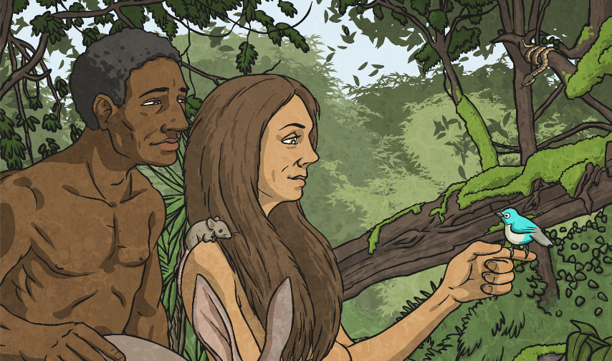
On the sixth day, God created all the other animals. He also created man and gave him great mental ability. God also gave man the power of speech and the responsibility to look after the animals on Earth.

Slide 12
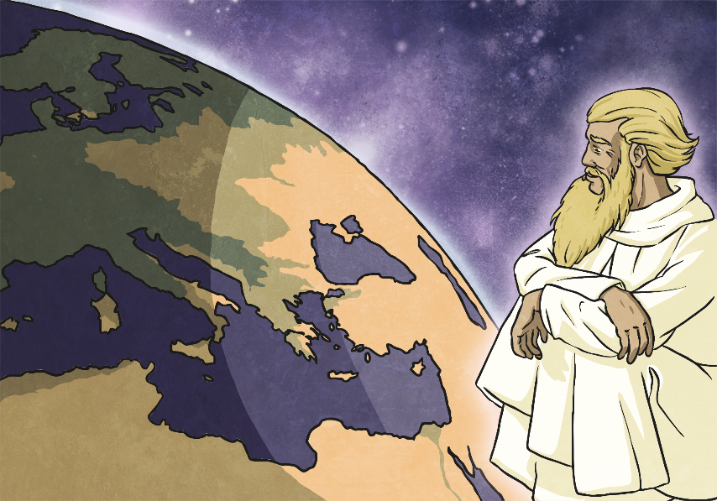
On the seventh day, everything was created and God rested. Christians believe that they should work for six days and rest on the seventh day. By doing this, Christians show that they believe in God as the creator of the world.

Slide 13

Please continue to the next PPT

