Slide 1


Slide 2
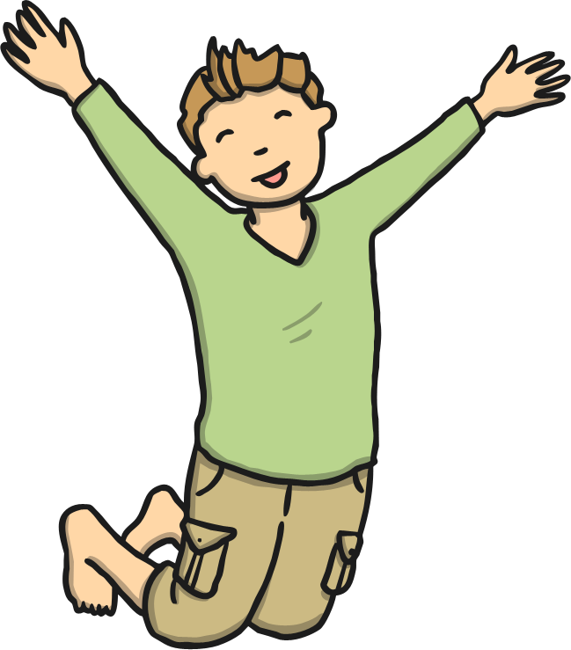
How many words can you write that rhyme with jump?
Menu

Slide 3
Read the words:
so
little
one
children
Now write some sentences using the words.
Menu

Slide 4
Read the words and draw the pictures:
sandpit
lunchbox
chimpanzee
windmill
handstand
printer
Menu

Slide 5
Read the words:
when
just
do
out
Now write some sentences using the words.
Menu

