Slide 1
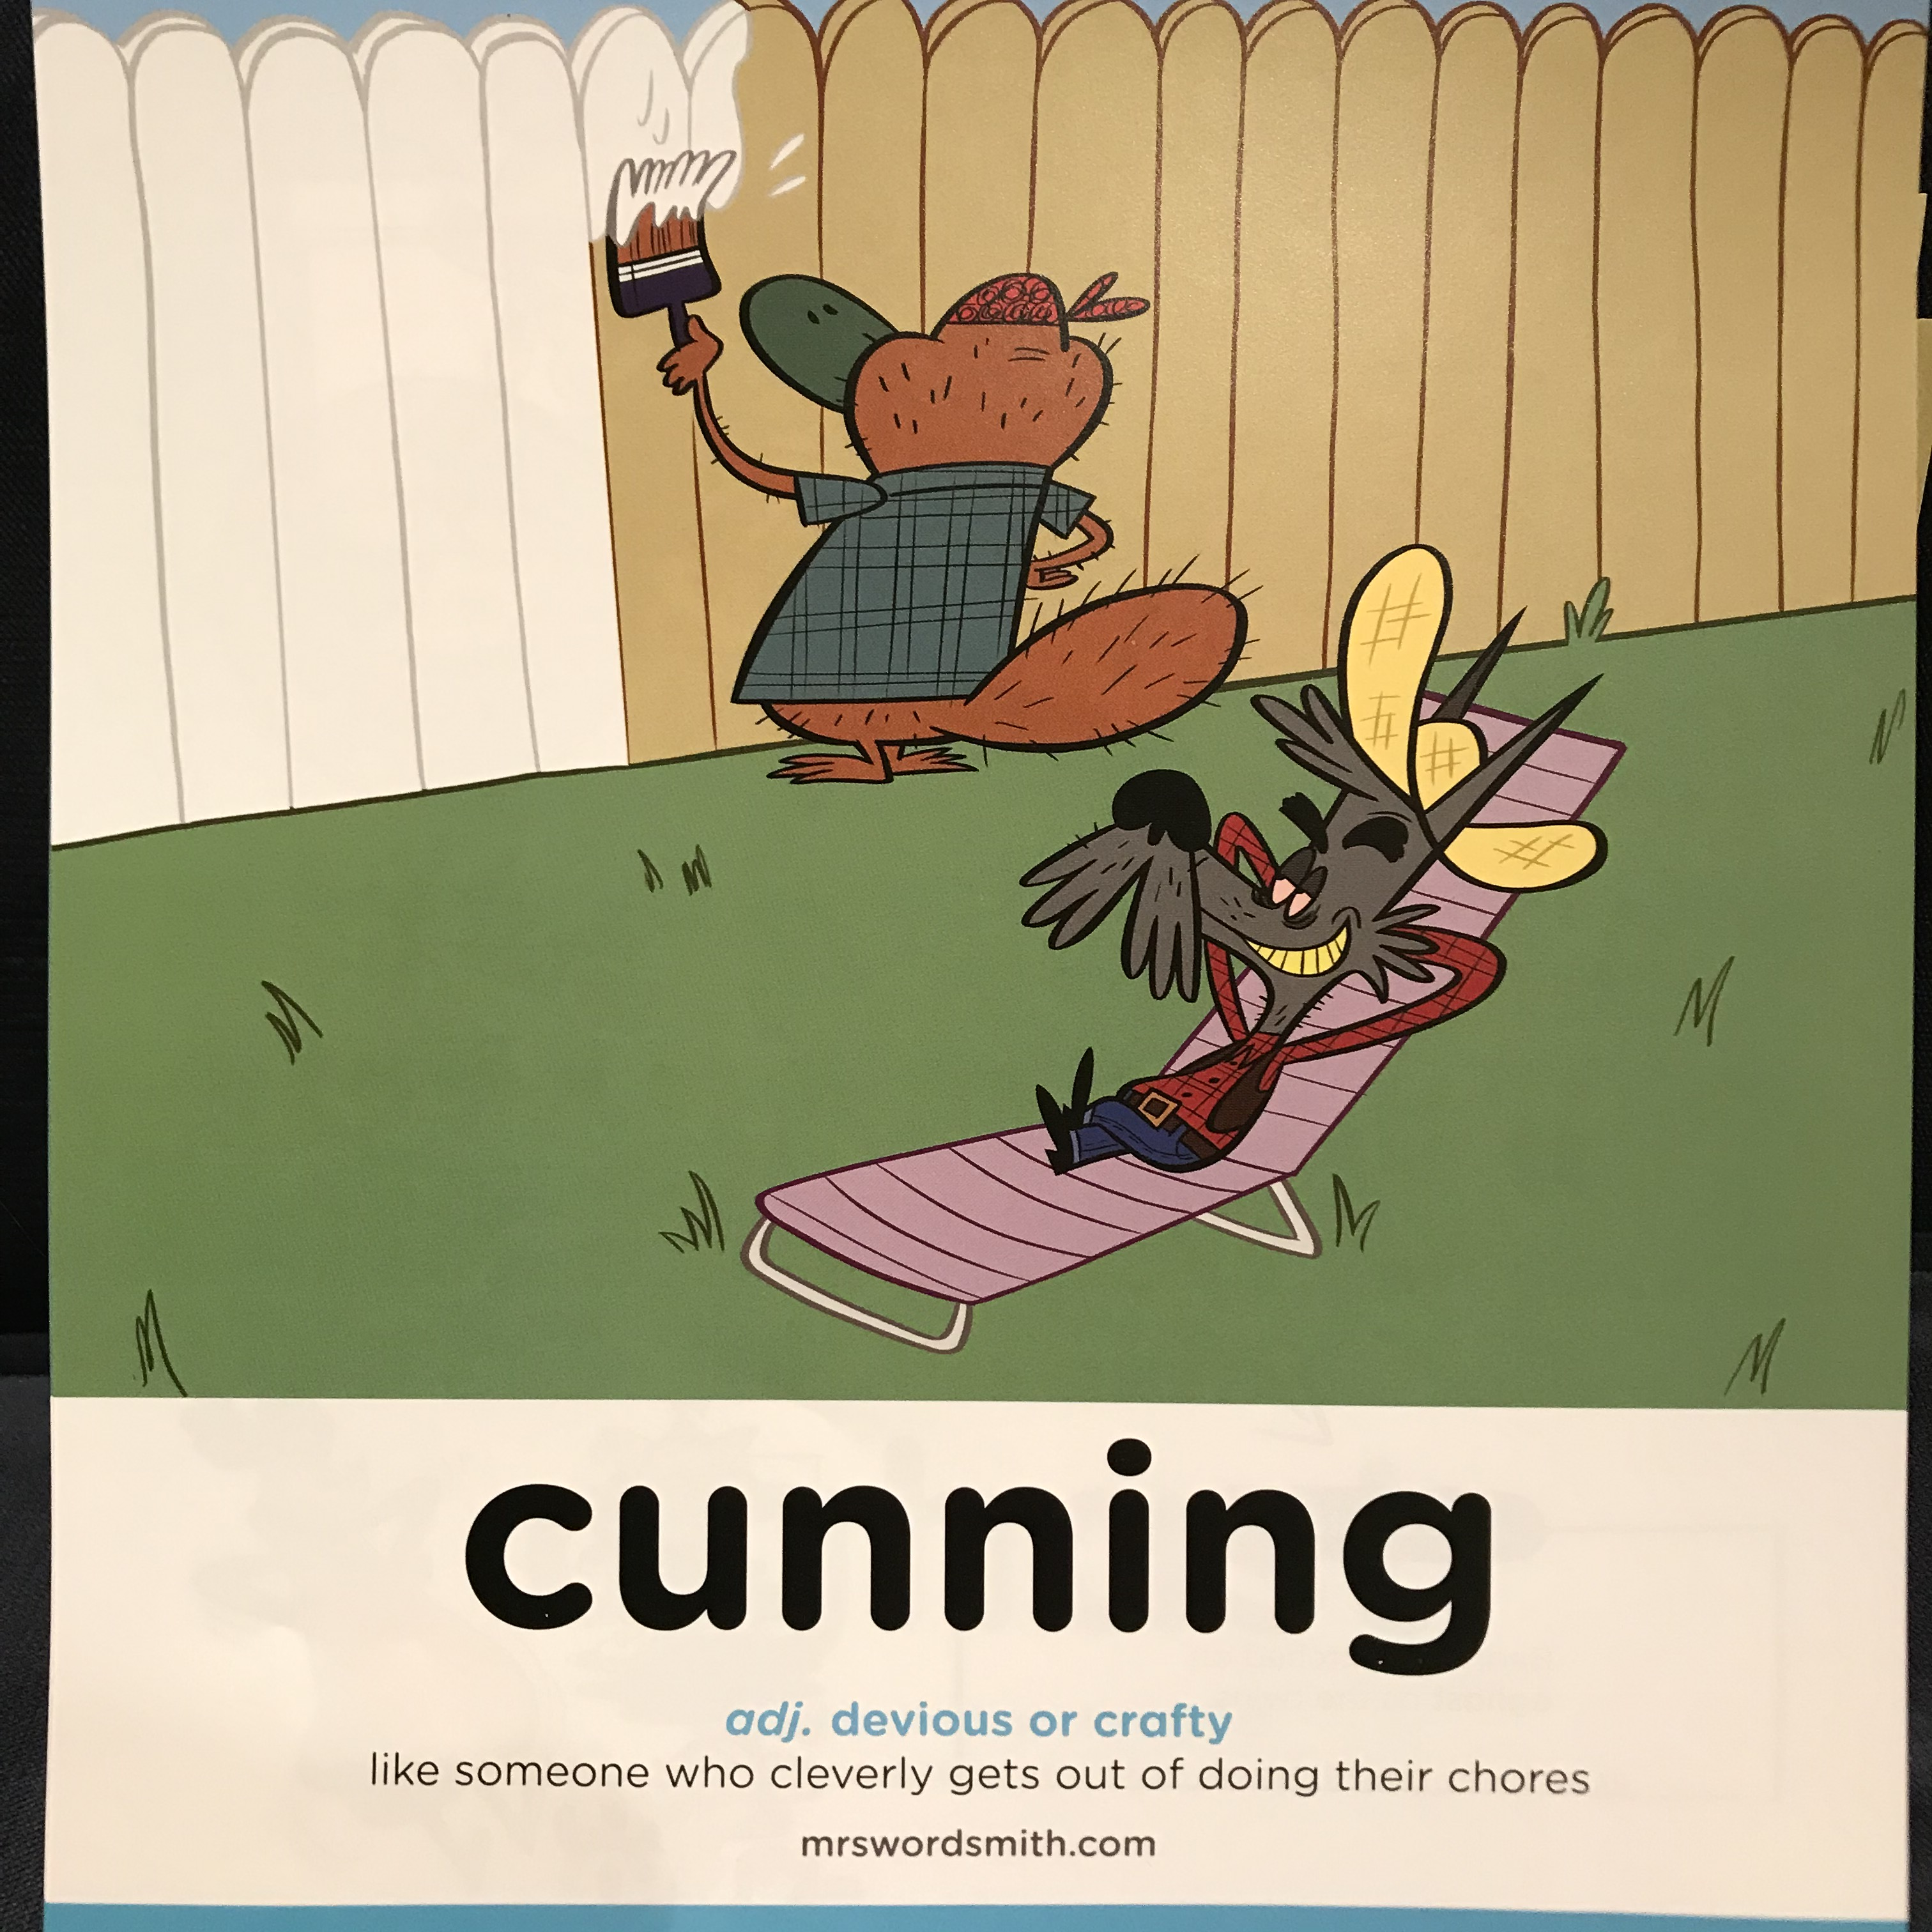

Day 4

Slide 2
English comprehension

Slide 3
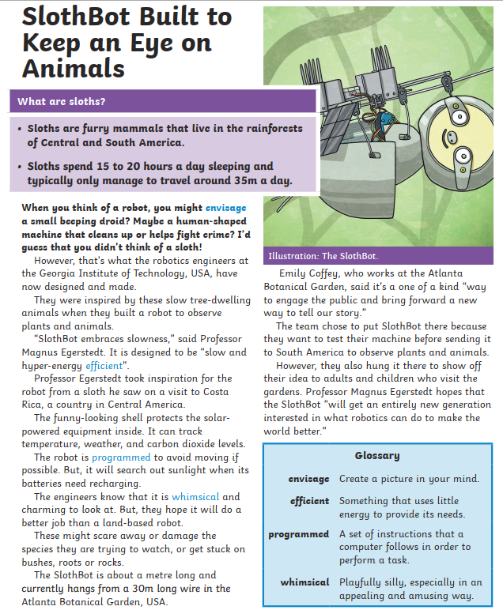

Slide 4
What are the top tips for comprehension
1. Don’t panic.
Read the text carefully, underline the key parts.
2. Carefully read the newspaper article again and do what it asks you to do.
3. Look in the text for the answer and reference or quote the text to support your answer.
4. DON'T PANIC
Look back in the text.
5. If you cannot find the answer go on to the next question.

Slide 5
Your work
L.O: To answer comprehension questions carefully.
Your turn
Read the newspaper article again.
Answer the questions.
***Challenge questions:
A. What features make it better than land based robots?
B. Using the features you mentioned in question A above, design your own animal robot. It doesn’t have to be a mammal ☺

