Slide 1

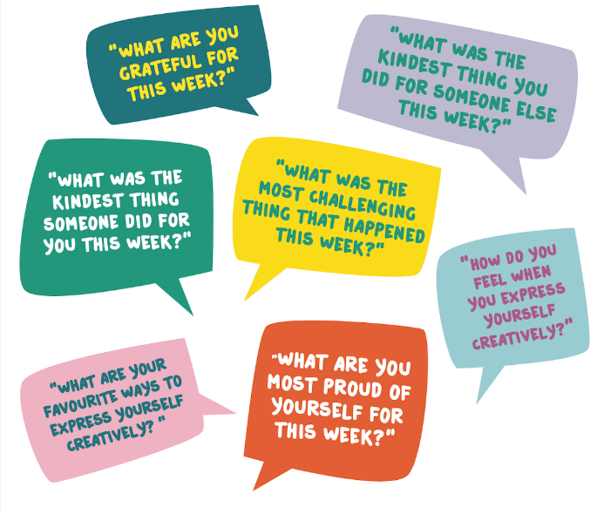


Children’s Mental Health Week 2021
LO: To identify and thank myself and those around me for the positive things we have done for ourselves and for each other this week.
Success criteria:
I can identify key feelings/actions I am proud of.
I can record these feelings/actions in my ten minute journal.
I can identify kindness in others and thank them for their actions
I can try learning new skills to take care of myself and my feelings.

Slide 2
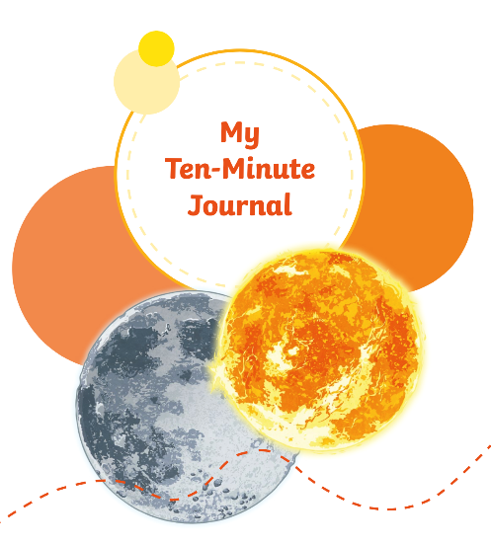

Slide 3
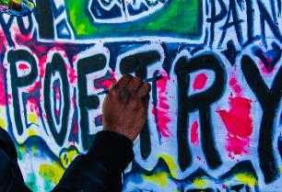
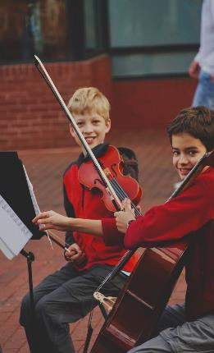
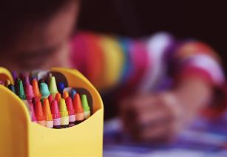
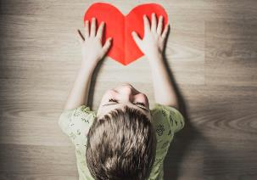
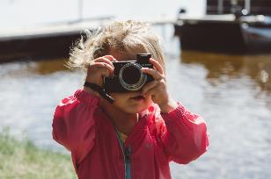
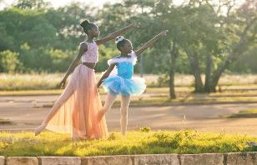
Slide 2
Watch the video message from Royal Patron Catherine, Duchess of Cambridge, then spend two minutes thinking through the question above…https://youtu.be/PEBURwEL9HM

Slide 4

Slide 3

Slide 5




Slide 4

Slide 6

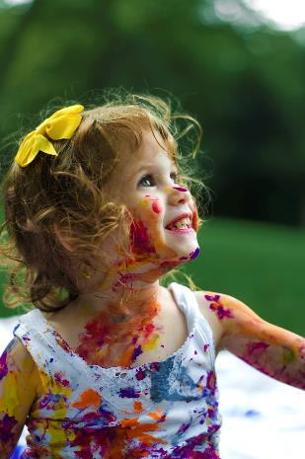
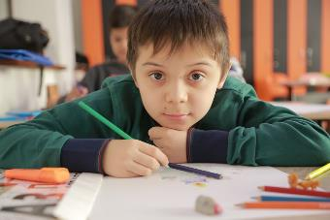
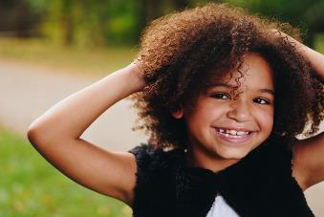

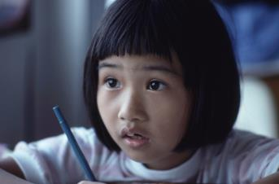
Slide 5

Slide 7

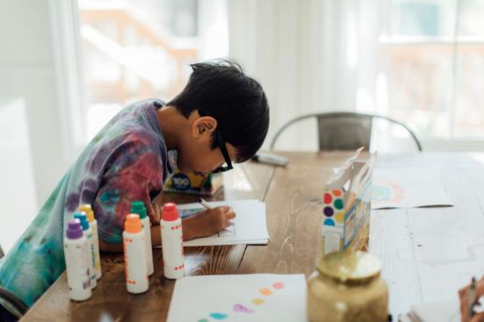
Slide 6
Hopefully, you’ve already read the story “Beautiful Oops”
https://www.youtube.com/watch?v=Hs9MTv3XBmY
Remember, when we express ourselves we don’t have to be a great artist or a wonderful dancer.
It’s not about being the very best at something or putting on a performance.
Let’s encourage each other to find lots of different ways to get creative and express ourselves.

Slide 8


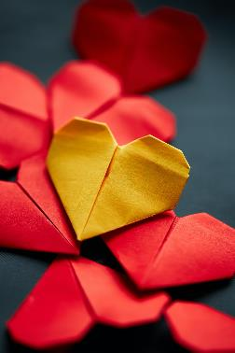
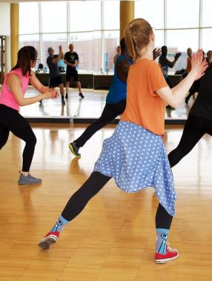
Slide 7

Slide 9

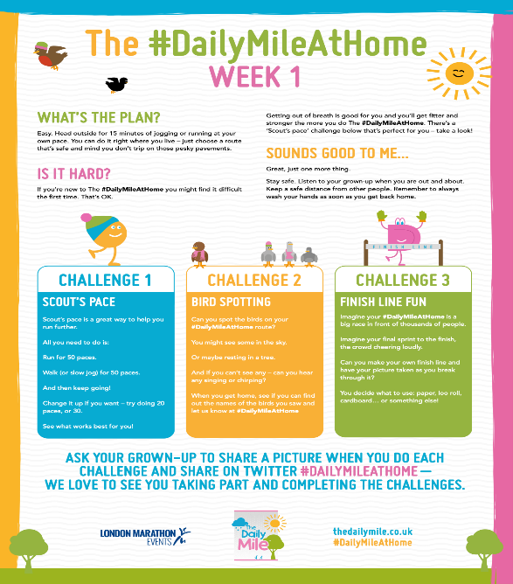
Other ways you can stay fit and well together at home…
Ask a grown up to share a picture when you do each challenge and share with us back at school…

