Slide 1


Slide 2







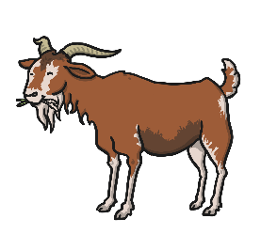
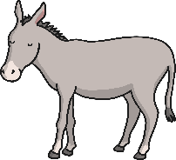
Can you hear the initial sound?
Say the names of the pictures out loud. What sound do they start with?
Now can you sort them into 3 lists? Draw the pictures under the correct sound.
m d g

Slide 3
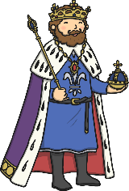





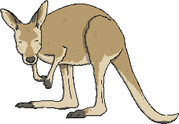
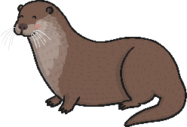

Can you hear the initial sound?
Say the names of the pictures out loud. What sound do they start with?
Now can you sort them into 3 lists? Draw the pictures under the correct sound.
o c k

Slide 4


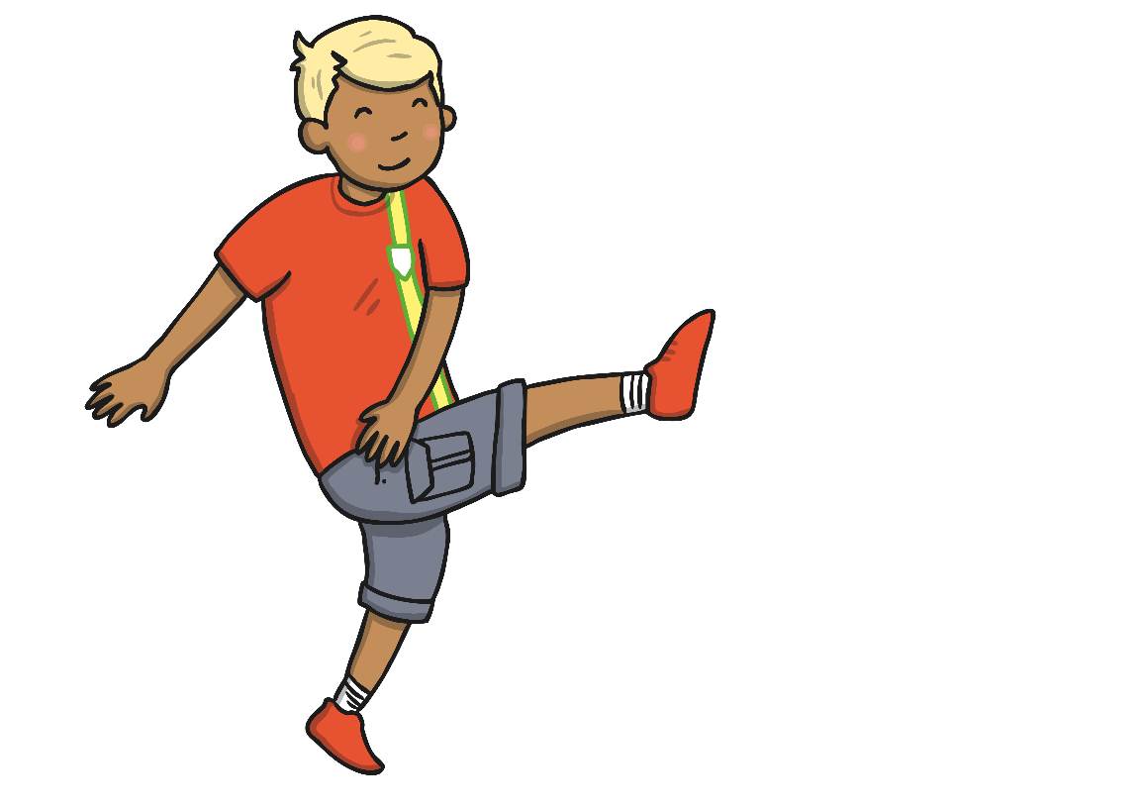
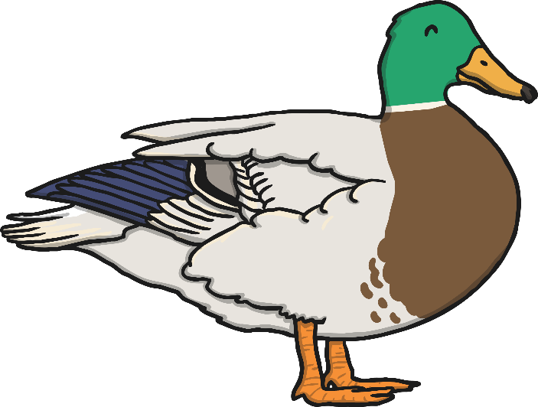
These words end with ck:
Can you write these words?

Slide 5
Read the words:
Now write a sentence using one of the words.
go
in
can
if

Slide 6
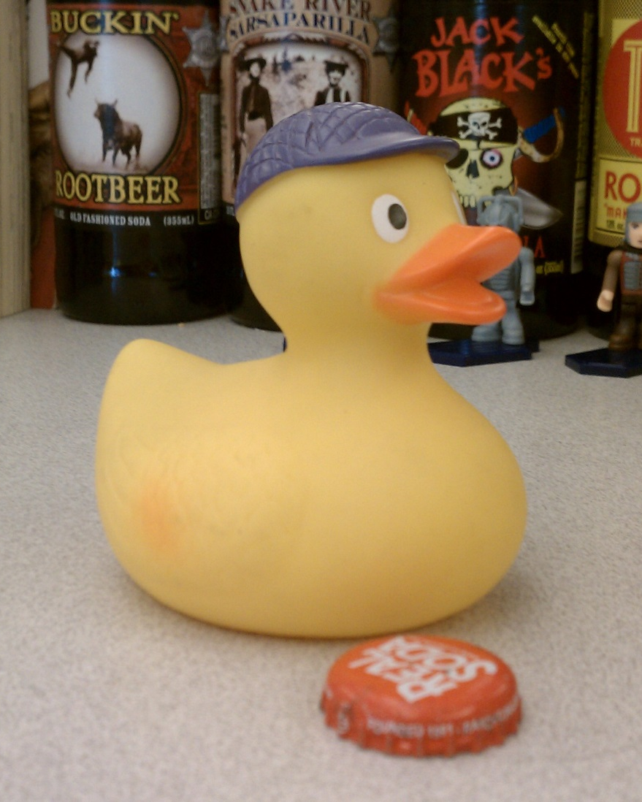
Write a sentence about this picture:
Photo courtesy of jdsmith1021 (@flickr.com) - granted under creative commons licence – attribution

Slide 7

Read the sentence and draw the picture:
The kid put his socks on a pig.

