Slide 1
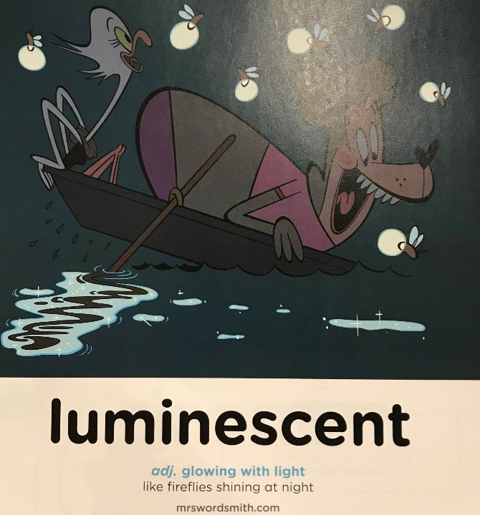

Day 3

Slide 2
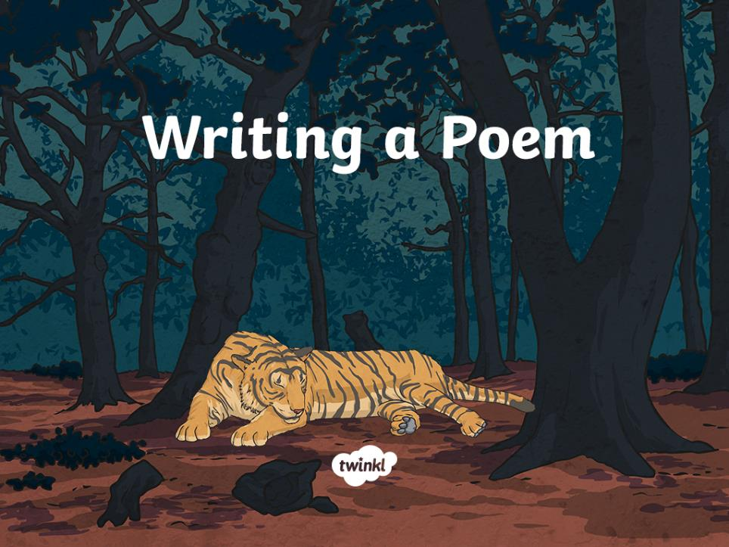

Slide 3
Aim
L.O:To draft and write a descriptive poem about an Amazonian animal.
Success Criteria
I can use structure suitable for a poem.
I can select appropriate vocabulary for the subject.
I can create a rhyme.
I can read and perform my poem aloud, with suitable intonation and expression.

Slide 4

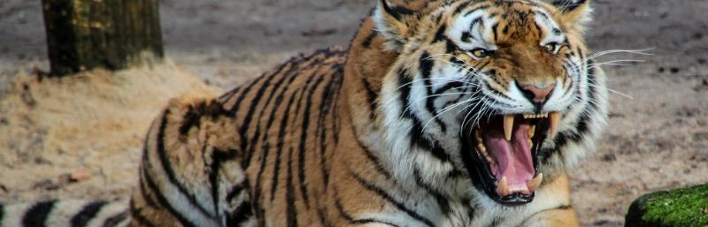
Today…
There are two main tasks for today:
1. You are going to come up with some rhymes for your poem
2. You will use your planning notes (along with rhyming ideas) to create your own Amazonian animal poem.

Slide 5
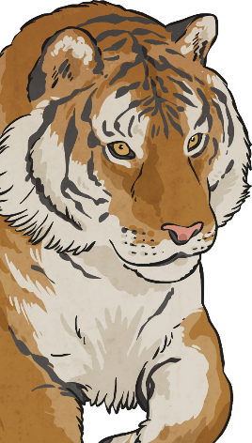
Rhyme
Tyger Tyger, burning bright,
In the forests of the night,
What immortal hand or eye,
Could frame thy fearful symmetry?
In what distant deeps or skies.
Burnt the fire of thine eyes?
On what wings dare he aspire?
What the hand, dare seize the fire?
The Tyger
And what shoulder, & what art,
Could twist the sinews of thy heart?
And when thy heart began to beat,
What dread hand? & what dread feet?
What the hammer? what the chain,
In what furnace was thy brain?
What the anvil? what dread grasp,
Dare its deadly terrors clasp!
When the stars threw down their spears
And water’d heaven with their tears:
Did he smile his work to see?
Did he who made the Lamb make thee?
Tyger Tyger burning bright,
In the forests of the night:
What immortal hand or eye,
Dare frame thy fearful symmetry?
by William Blake

Slide 6
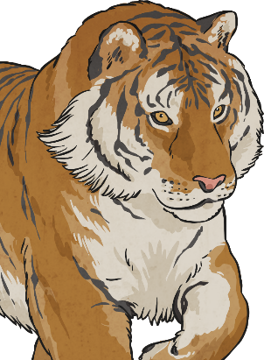
Words to Describe and Rhyme
Either using the sheet provided or on you own piece of paper, write down 5-10 words that describe your animal.
Thinking about these words, can you think of 3 words that rhyme with it?
Finally, for each list of three, highlight the best or most suitable to fit with a phrase or sentence about your animal.
Describing Word | Rhyming words
eyes | prize | demise | skies
Hold onto the work as you’ll need it shortly…

Slide 7
If you haven’t done this yesterday…
Use your notes from yesterday, to convert your notes into powerful phrases.
Your descriptive words about your animal can firstly be converted into some powerful phrases:
Majestic predator
searching for prey.
Can you think of ideas for the next two phrases, beginning with these words?
Burnt orange
stripes like fallen leaves.
Keep in mind the rhyming words you came up with earlier. Can you end a sentence with the complimentary rhyming word?
Muscular
legs poised and ready for its victim to stray.

Slide 8
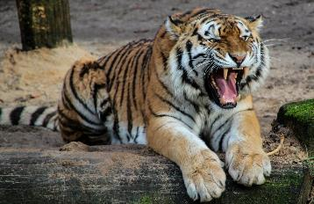
Joining Rhymes
Razor-sharp teeth and glaring eyes
Silently watches and follows its prize
Example:
The tiger follows the scent of its prey
Tracking and stalking from far away
Challenge: can anyone turn their rhyming words into a pair of lines as rhyming couplets?
If you are finding it hard to make your lines rhyme then just concentrate on your powerful phrases.

Slide 9
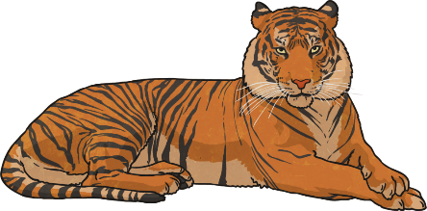
Joining Powerful Phrases and Rhymes together
With some ideas for powerful phrases, next we can combine them and turn the phrases into a poem!
Majestic predator searching for prey,
Creeping and stalking at the end of the day,
The stripes of this robber are not plain to see,
Piercing green eyes fixed on those that flee.

Slide 10
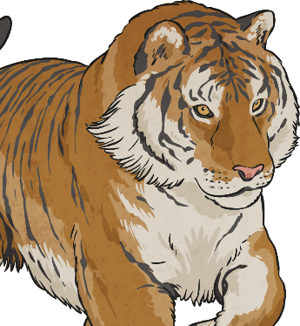
Poetry Writing
Try creating your own original, Amazonian animal poem!
Aim to make good use of well-chosen vocabulary, converted into powerful phrases.
* Include descriptive features about the tiger.
** Remember the tiger’s appearance and movement. Include rhymes if you can.
*** Include figurative language in your descriptive phrases. Add your own opinion about the tiger too.
Don’t forget to check your spellings!

Slide 11
Aim
L.O:To draft and write a descriptive poem about an Amazonian animal.
Success Criteria
I can use structure suitable for a poem.
I can select appropriate vocabulary for the subject.
I can create a rhythm and/or rhyme.
I can read and perform my poem aloud, with suitable intonation and expression.

Slide 12

Performing Poems
To complete your poetry experience, you are invited to perform your own compositions by reading them aloud.
Aim to use a loud, clear voice – or adjust the volume of your voice as you read, for effect.
Think about your intonation and expression to make the performance of your poem interesting and enjoyable to listen to.
You might even add movement to make your performance more visual for an audience.

