Slide 1
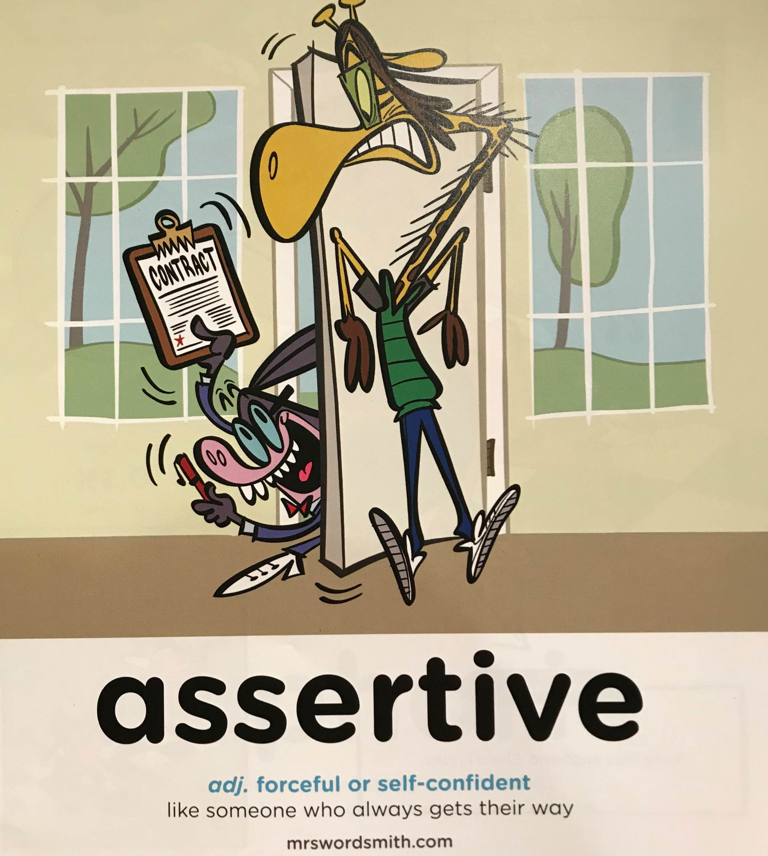

Day 2

Slide 2
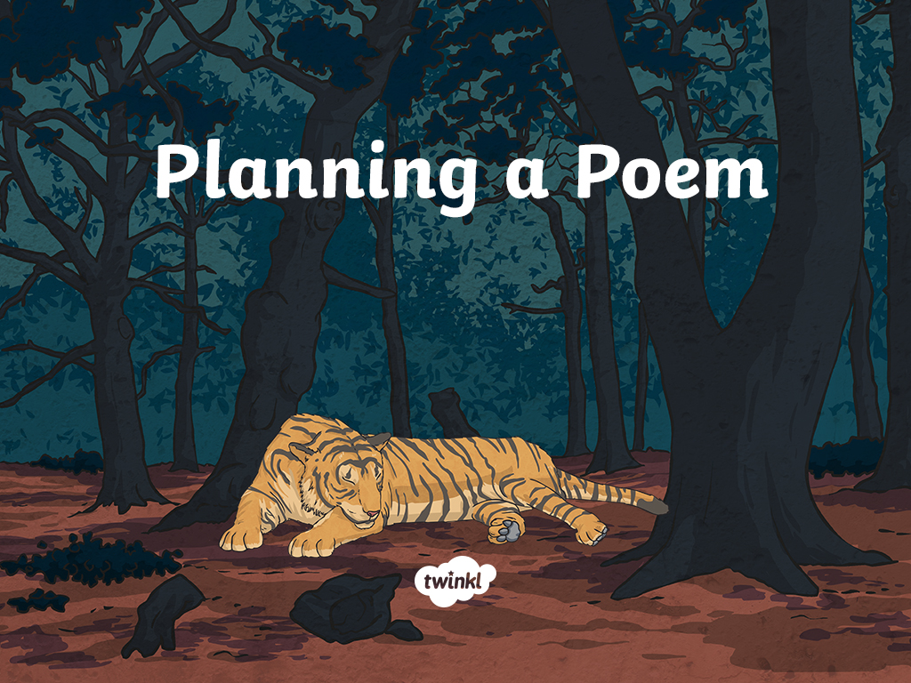

Slide 3
Aim
L.O:To develop initial ideas for a descriptive poem about an animal from the Amazon.
Success Criteria
I can make observation notes with relevant words and phrases.
I can include my personal opinion within descriptive phrases.
I can develop initial notes into powerful phrases.

Slide 4
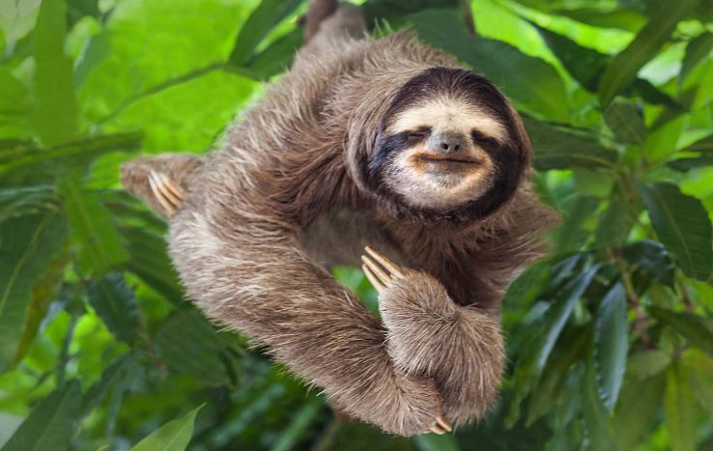
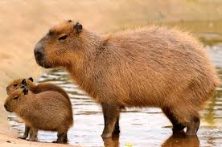
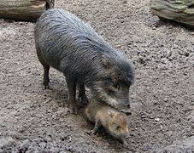
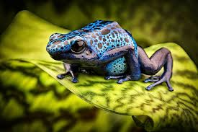
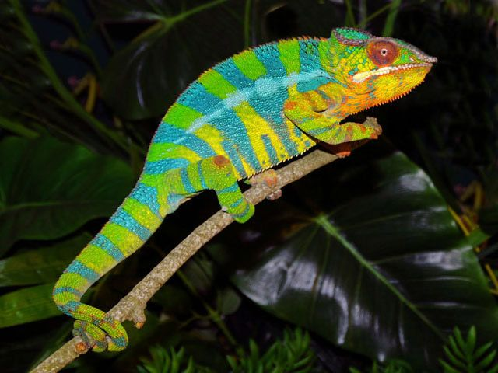
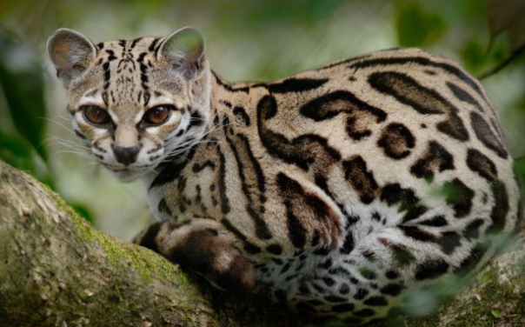
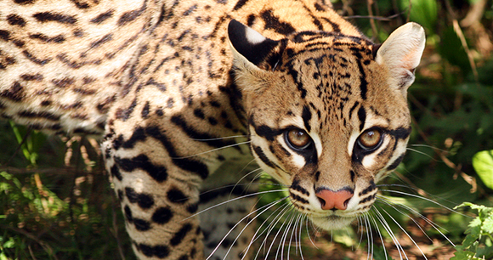
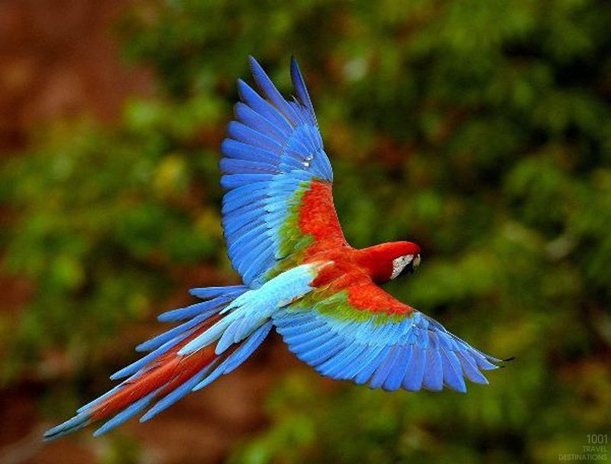
Research your own Amazonian animal
capybara
sloth
poison dart frog
chameleon
peccary
margay
parrot
ocelot

Slide 5
Research your own Amazonian animal
Search (nationalgeographic.com)
Species | Protecting Wildlife | World Wildlife Fund
Animalia - Online Animals Encyclopedia

Slide 6
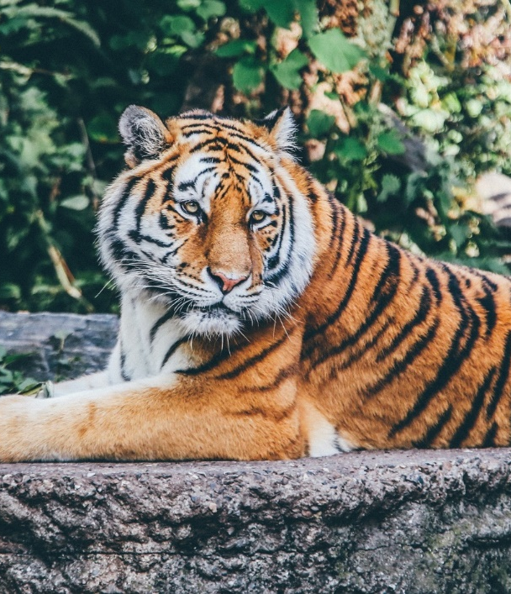
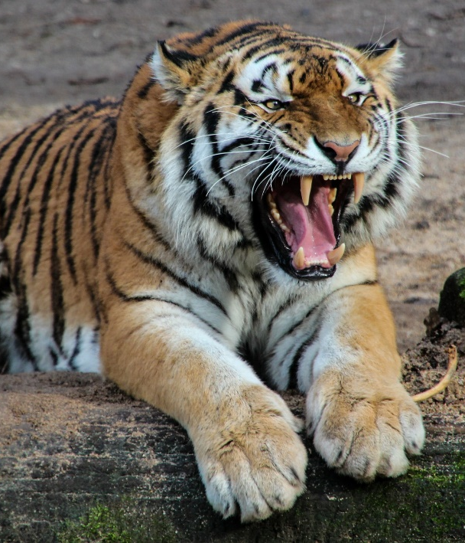
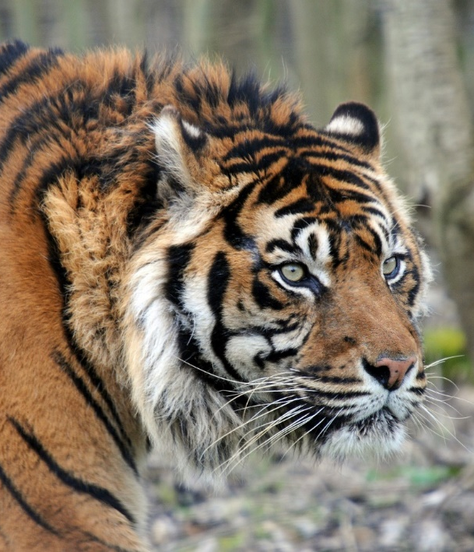
Appearance of the …
For example if you chose a tiger then look at some images of a tiger.
Jot down some ideas in the planning sheet or on a plain piece of paper.
Initial notes (words or phrases) to describe the appearance of a tiger. Be ambitious with your vocabulary!
Think about the colours, shapes and beauty of the creature.

Slide 7
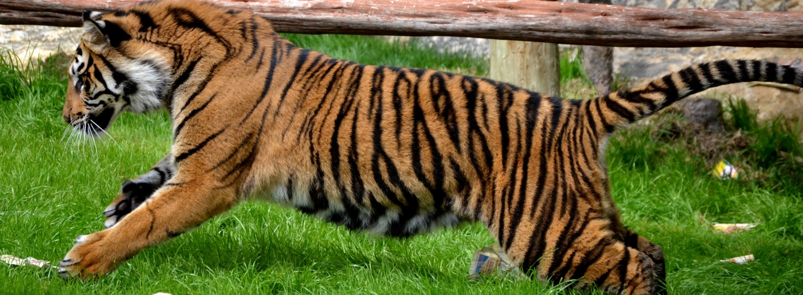
Movement of…
Next, we want to consider the movement of your animal.
Can anyone describe the way their animal moves at different times?
For example a tiger moves at differently at different times: slowly, silently stalking its prey, then sprinting and pouncing on a kill.
Think of its body, limbs, posture, speed and power.
Photo courtesy of MrGuilt(@flickr.com) - granted under creative commons licence - attribution

Slide 8

Danger of…
Think about the words and phrases to describe the danger of your creature if they are a predator or the danger it faces if it is prey.
Can you use any similes or metaphors as part of your descriptive phrases?

Slide 9
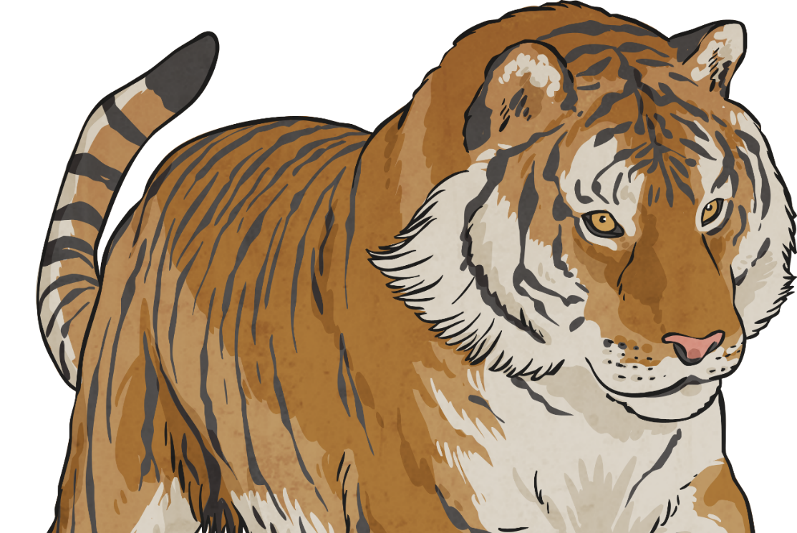
Opinions About the…
Based on all of your observations so far, along with your existing knowledge, what is you personal opinion about your animal?
Is it positive, negative or mixed?
What words or phrases incorporated into the poem add to a personal opinion?
To me…
I believe…
I think…

Slide 10
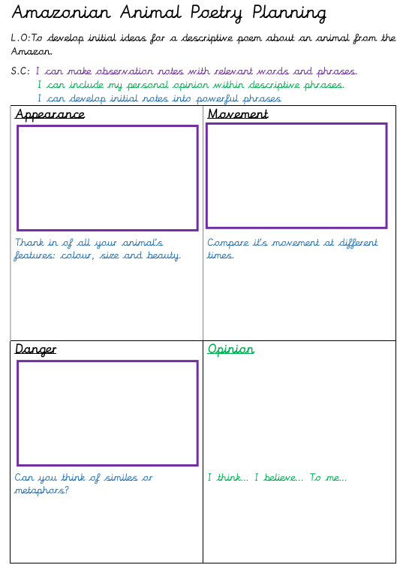
Use the links to look at pictures of your animal and then either use the plan provide or use its structure to make notes about these areas of your animal.
Search (nationalgeographic.com)
Species | Protecting Wildlife | World Wildlife Fund
Animalia - Online Animals Encyclopedia

Slide 11
Powerful Phrases
The final task in today’s lesson is to develop some of our initial notes and convert them into powerful phrases, that could be used as part of a poem.
stalks silently
pounces
majestic
muscular sprints
predator
orange stripes
huge legs
Majestic predator, silently stalking its prey
Huge, muscular legs sprinting or poised ready to pounce
Burnt orange stripes like flickering flames
DON’T write your poem yet! We have more to do before we start writing it!
Now try it with some of your initial notes.
What powerful phrases can you create?

Slide 12
Aim
L.O:To develop initial ideas for a descriptive poem about an animal from the Amazon.
Success Criteria
I can make observation notes with relevant words and phrases.
I can include my personal opinion within descriptive phrases.
I can develop initial notes into powerful phrases.

