Slide 1


Slide 2

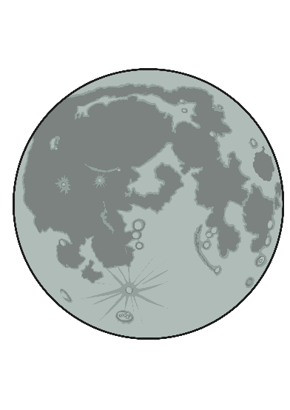
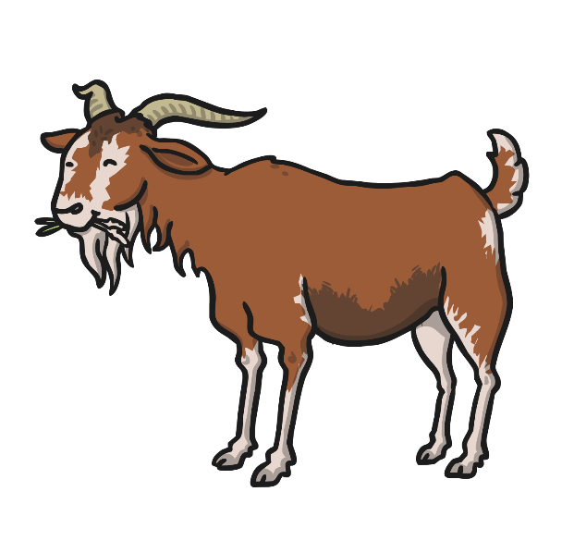

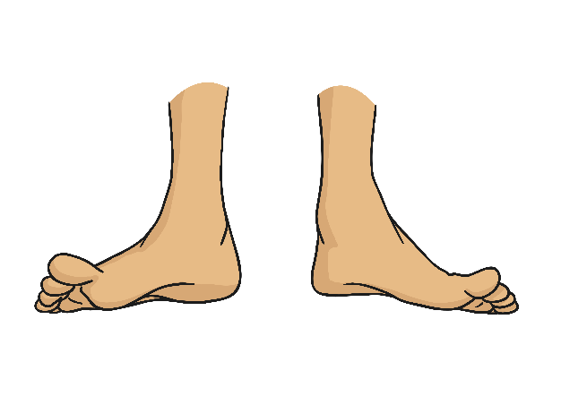

Can you write these words?
Now write a sentence using one of the words.

Slide 3

Read the sentence and draw the picture:
The man put ten coins in his jar.

Slide 4
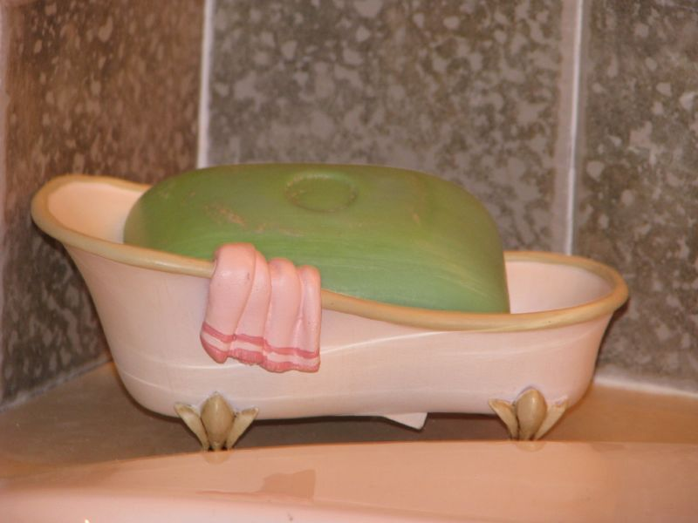
Write a sentence about the picture:
Photo courtesy of stacyrackley (@flickr.com) - granted under creative commons licence – attribution

Slide 5
Write a word using each phoneme:
ee
ai
igh
oa
oo

