Slide 1
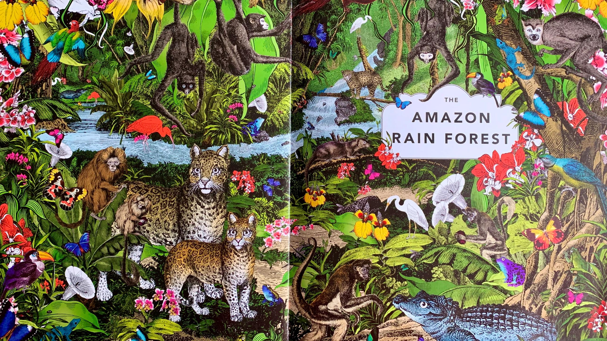

LO: I can use my growing bank of research skills to conduct an appropriate independent investigation of my own choosing into a specific geographical feature of Brazil.
Success criteria:
I can identify a suitable research focus for my independent research project.
I can identify the appropriate tools I need to carry out this research.
I can consider the needs of the listener/reader of the work I carry out and produce my work in a reader/listener friendly format;
I can use key geographical terms appropriately.

Slide 2
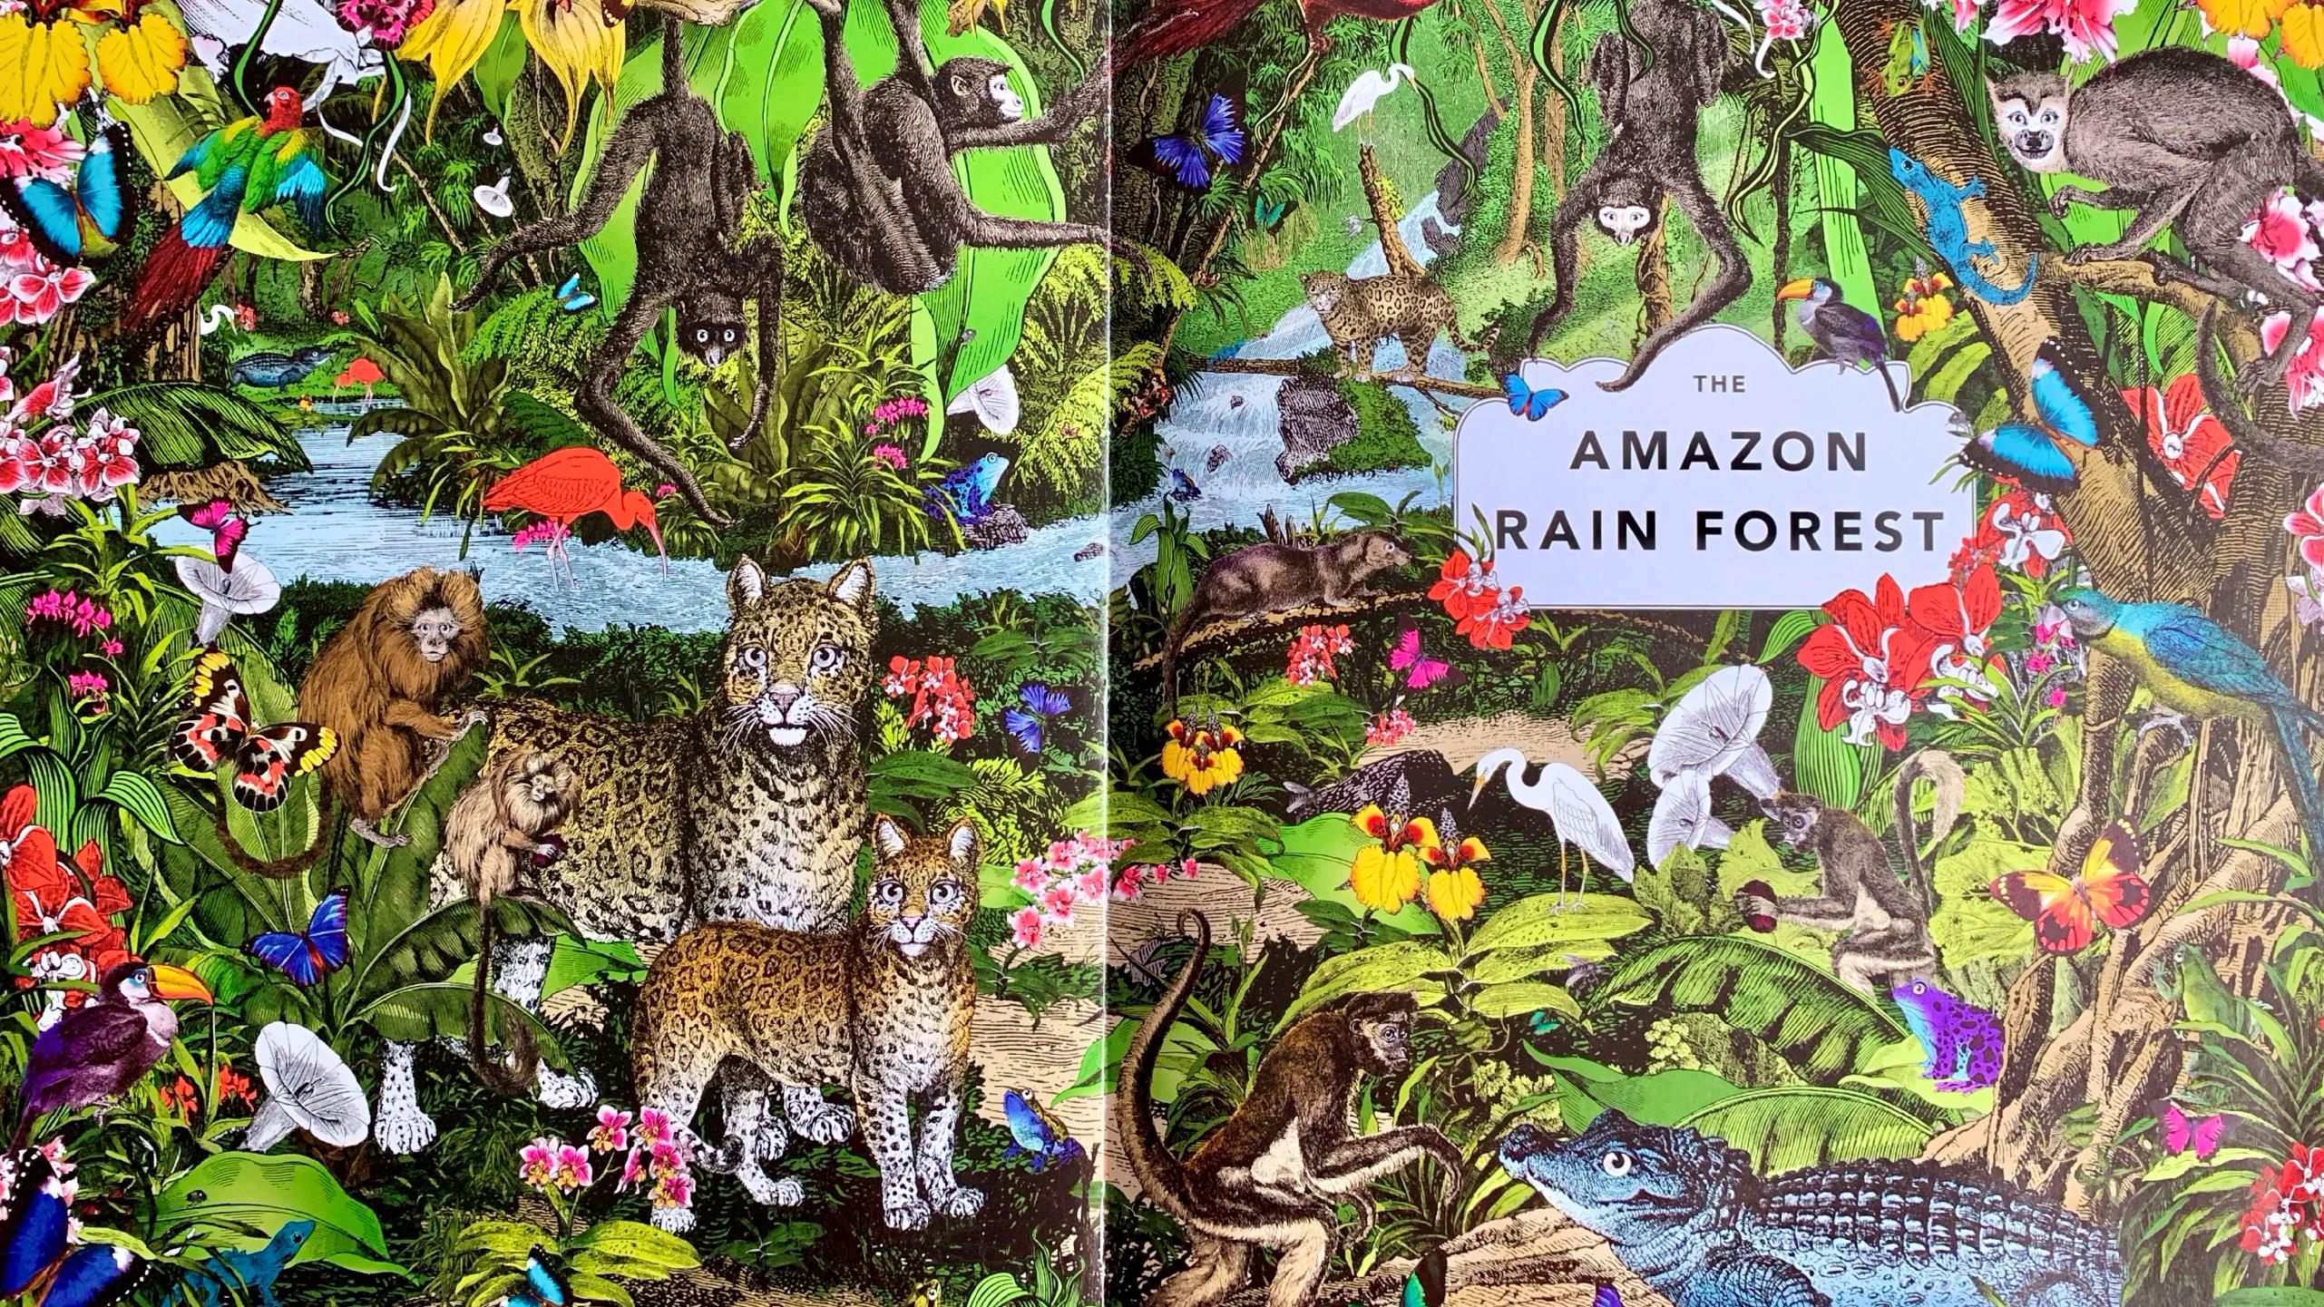
The Wonder Garden written by Jenny Broom and illustrated by Kristjana S Williams

Slide 3
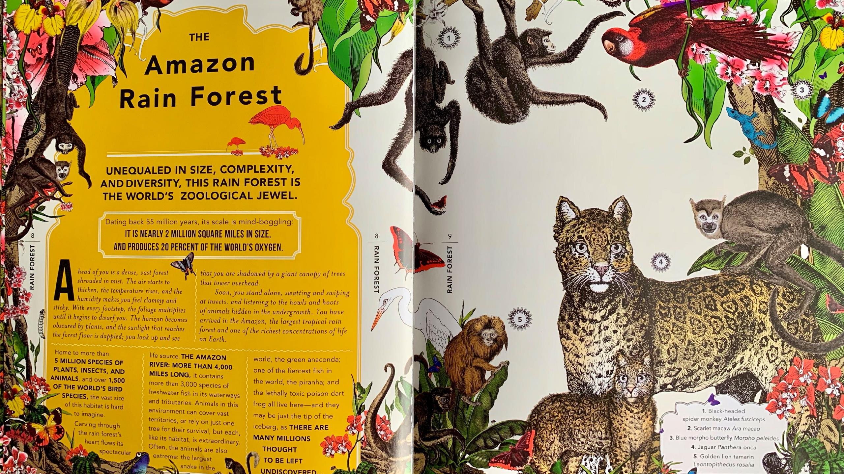

Slide 4
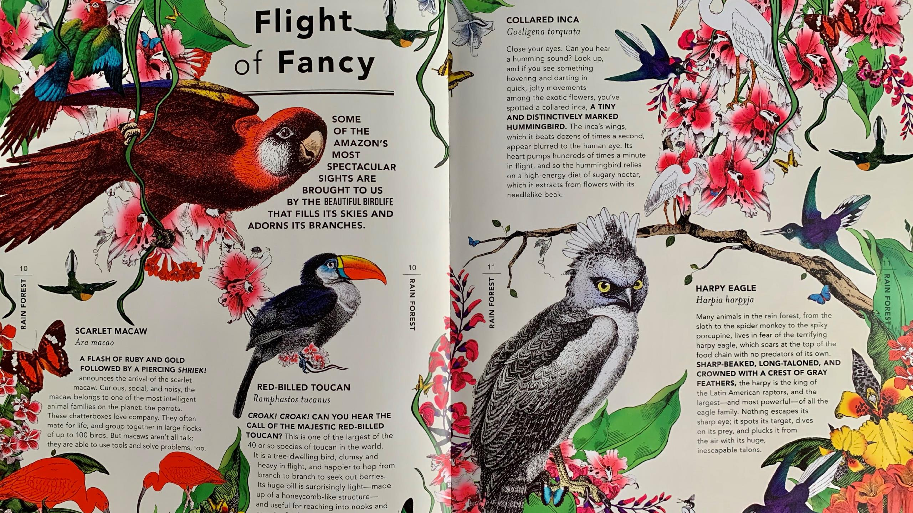

Slide 5
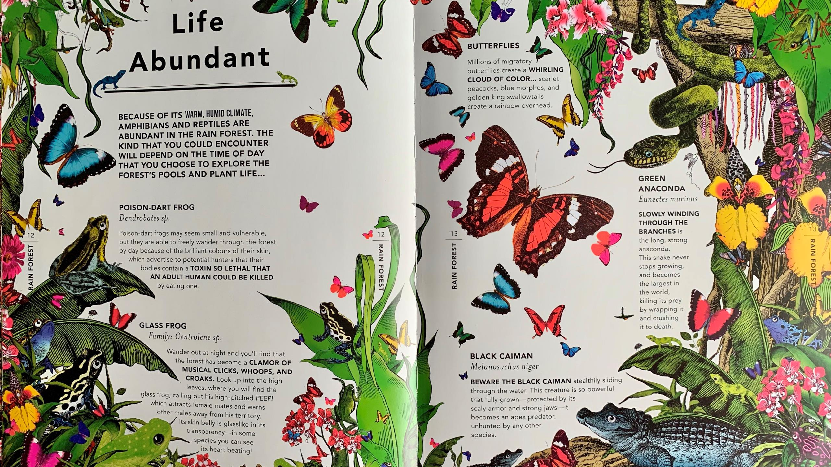

Slide 6
When we started our topic on Brazil, you said you would like to find out more…
About the poisonous animals and plants of Brazil
About the 1,500 types of birds living in the Amazon Rainforest …
About Brazilian festivals (dancing, music and the arts)…
About the animals in the Amazon Rainforest…
?
More about the tribes who live in the Amazon Rainforest…
About the people and the language…
About Brazilian food (ingredients and what to cook)…
About the weather and climate in different regions…
About the animals in the Amazon Rainforest

Slide 7

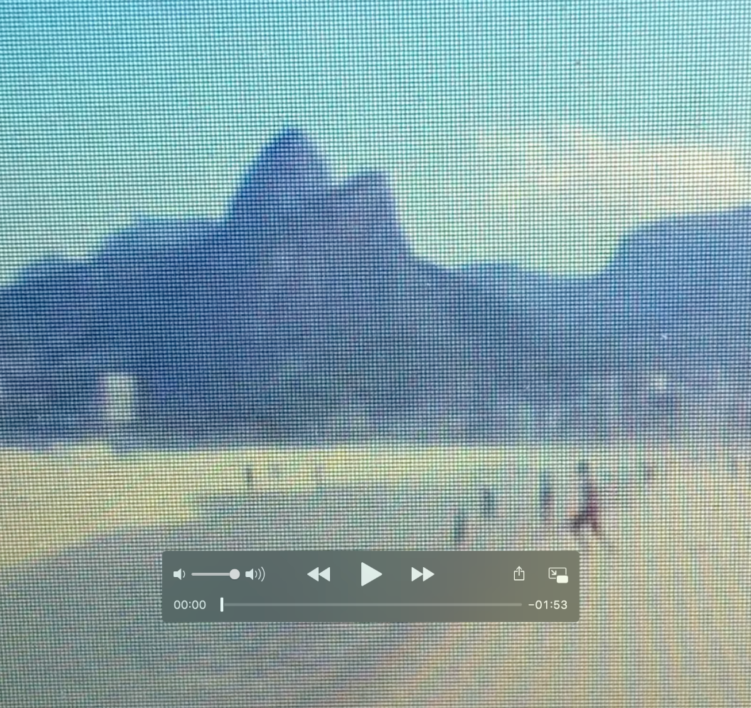

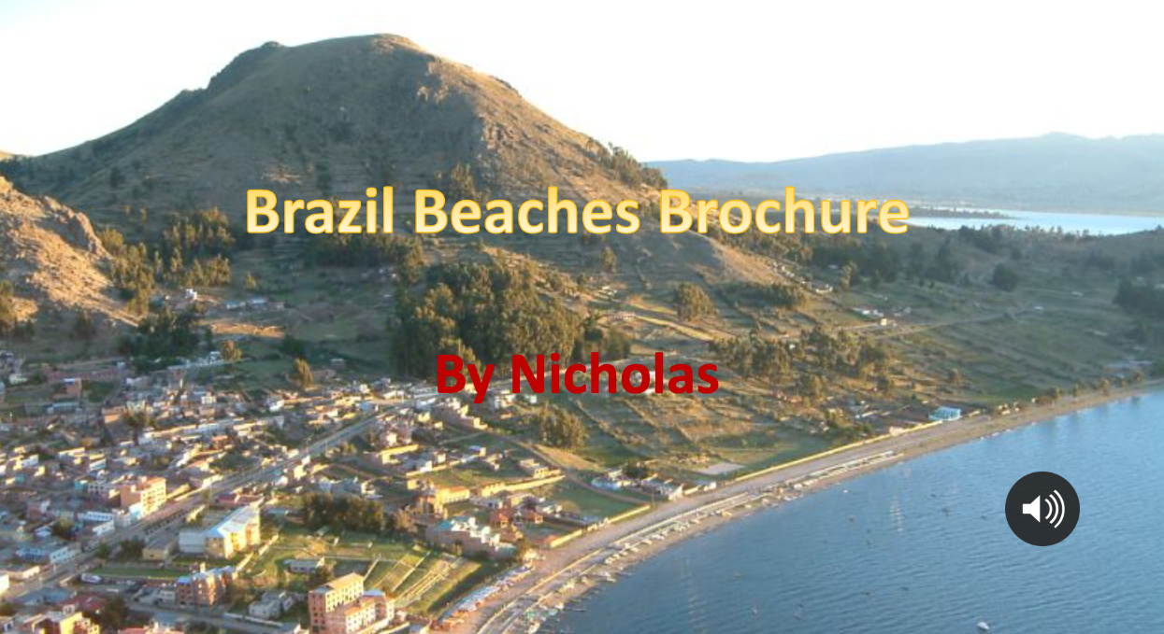
Main task: create a fact file to let people know more about a specific geographical feature of Brazil that you find interesting…

Slide 8
?
Day one: First, think back to all the things we’ve looked at in Geography this term and think about something about Brazil’s geography you would like to find out more about…
Day one: Next, think about all the resources you have to hand and what you can use to find out more about your chosen subject…
Day one: Then, create a spidergram of your chosen topic area to identify what you want to find out…
Day two: After that, decide how you are going to present your research - powerpoint, movie, PDF poster, information book…
Day two, conduct your research, work it up into your chosen presentation format, edit your work, then submit …

