Slide 1


Slide 2
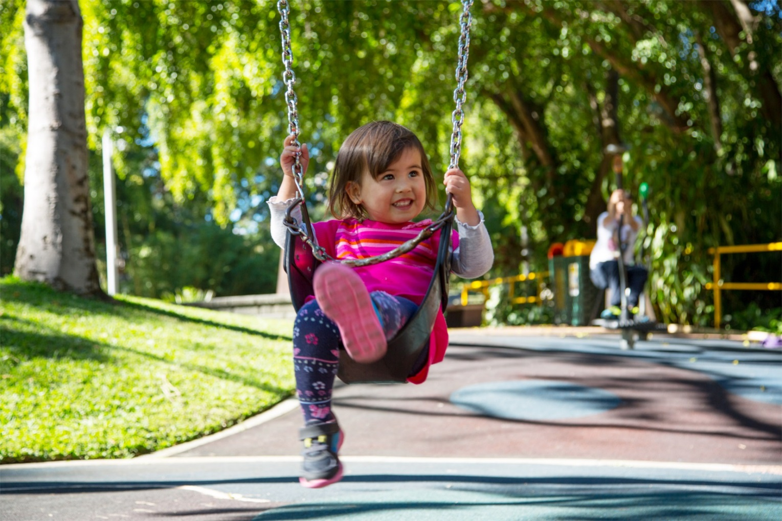
Write a sentence about this picture:
Menu
Photo courtesy of Brisbane City Council (@flickr.com) - granted under creative commons licence – attribution

Slide 3

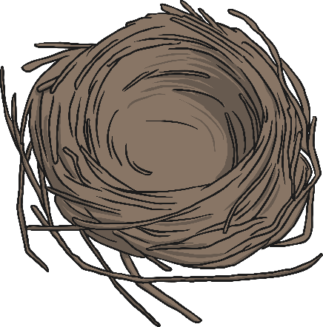
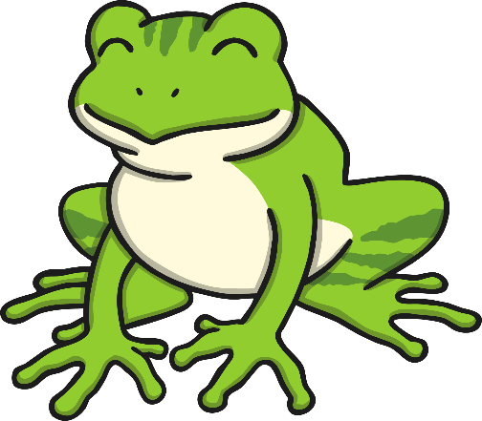
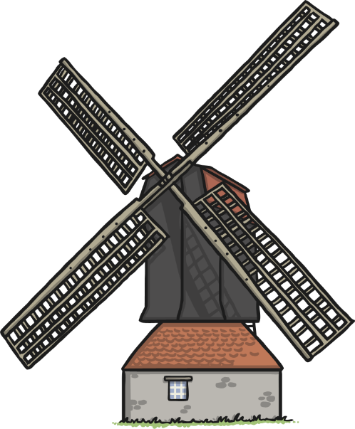
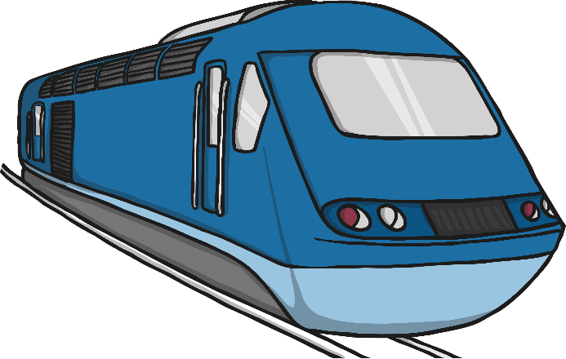
Write a sentence about one of these pictures:
Menu

Slide 4
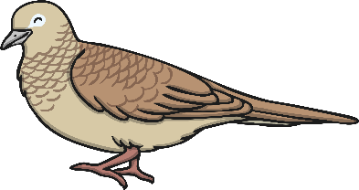
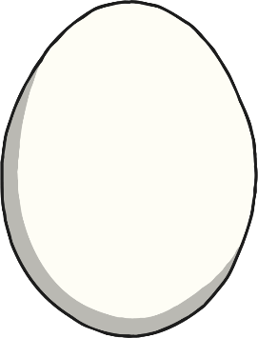
Help Thelma the Thrush!
The real eggs have real words on them.
The fake eggs have made up words on them.
Help Thelma to find the real eggs.
chest
treast
melting
spark
sost
pelf
scrunch
punch
chilp
fost
plump
spoift
See answers
Menu

Slide 5
Read the words:
Now write some sentences using the words.
have
from
there
like
Menu

