Slide 1
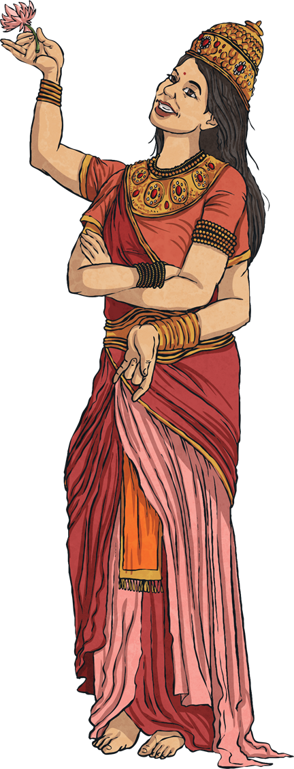

Symbolism
L.O: To demonstrate the Hindu belief that Brahman is in everything.
Symbolism is used in most religions. Here are a few Hindu symbols…
next

Slide 2
Success Criteria
I can understand that Hindus believe that Brahman is the supreme principle and is in everything.
I can understand specific Hindu symbolism.
I can understand the symbolism of the lotus flower and that Hindus believe that Brahma came from a lotus flower.
I understand that Aum is the most important symbol in Hinduism, that it represents Brahman and the universe and that it is pronounced ‘Ohm’.

Slide 3

Lotus Flower
This is a very important symbol as Hindus believe that Brahma the Creator came from a lotus flower.
Despite growing in muddy waters, the lotus turns into a beautiful flower.
It represents how people should always be kind and good.
next

Slide 4
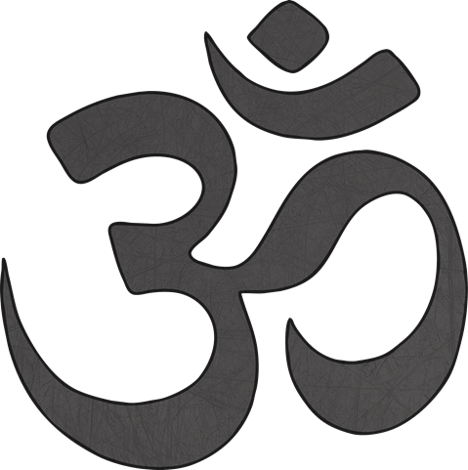
Aum
This is the most important symbol in Hinduism.
It represents Brahman and the universe.
It is pronounced ‘Ohm’.
next

Slide 5
Long, long ago, there lived a sage named Uddalaka. He had a son named Swetaketu. When Swetaketu was seven years old, Uddalaka sent him to continue his studies under a suitable guru.
Swetaketu was a bright and diligent student, and learnt all he could from his guru, pleasing everyone. Finally, his studies complete, he returned home, bursting with pride at his achievement.
Uddalaka saw his son approaching the ashram, and realized at once that his son had returned filled with pride and ego. He was saddened, for true learning and knowledge brings not pride, but humility. A true scholar is one who has subdued his ego and humbly bows before the Supreme.
Uddalaka decided that he would have to complete his son’s education himself, and called Swetaketu. The boy arrived with a smile, ready to tell his father about all that he had learnt and all the praises he had received.

Slide 6
His father asked him about God, but Svetaketu didn’t give the answer required.
His father sent for a glass of water and asked Svetaketu to put some salt in it.
The next day, he asked where the salt was. Svetaketu could not see the salt, but he could taste it in the water in the glass.
‘That’s a bit like God in the world,’ said his father. ‘God is invisible, but is there in everything.’

Slide 7
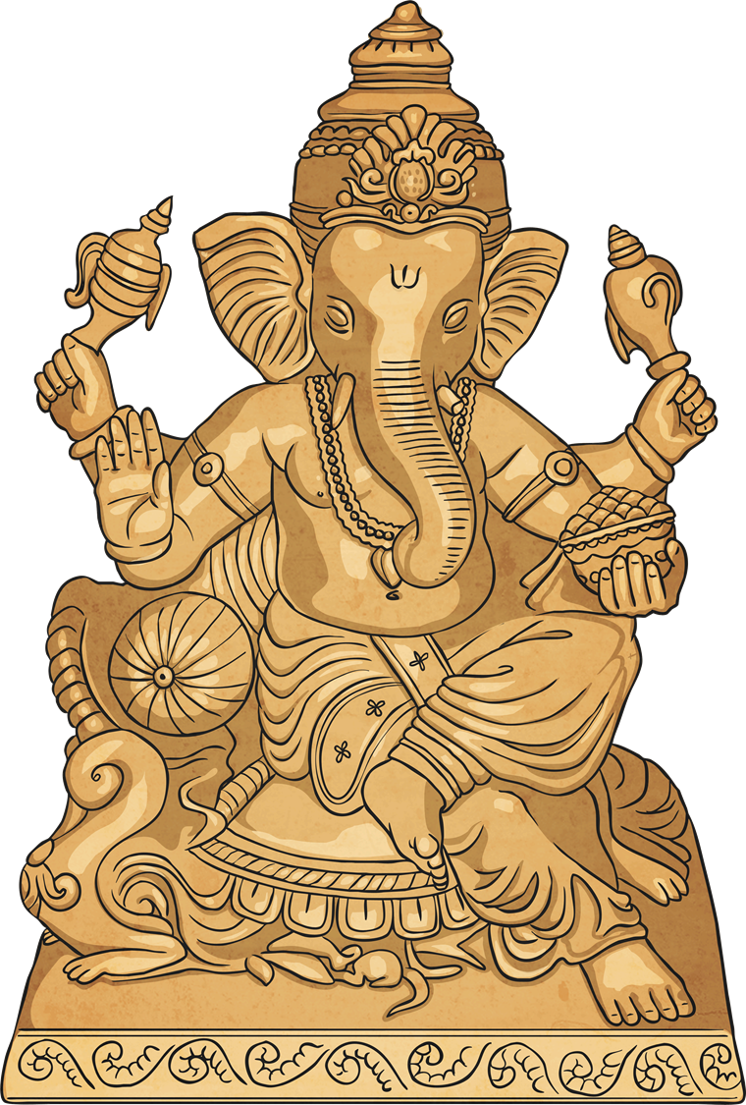
L.O: To demonstrate the Hindu belief that Brahman is in everything.
YOUR TASK: Now, take out your Windows to the World activity sheet and make a collage to show how believing that Brahman is in everything makes a difference to what people can do.

