Slide 1
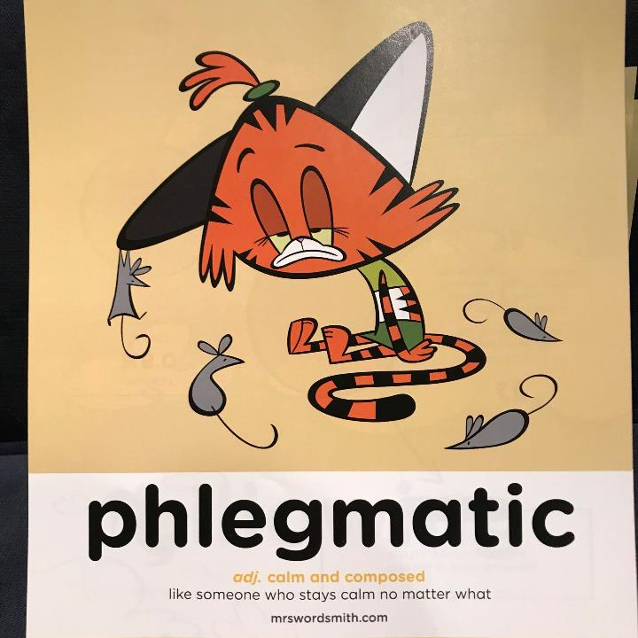

Day 1

Slide 2
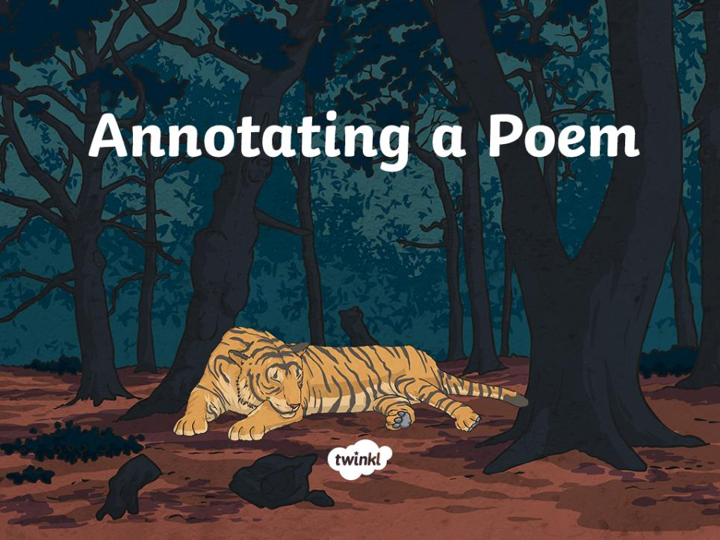

Slide 3
Aim
L.O:To annotate and evaluate a poem.
Success Criteria
I can identify an author’s use of figurative language, imagery, rhyming and repetition.
I can add relevant notes to a poem.
I can recall and read a section of poetry aloud.
I can discuss my personal opinions about a poem and comment on how effective a poem is.

Slide 4
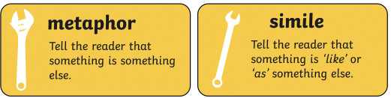
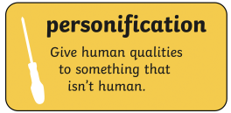
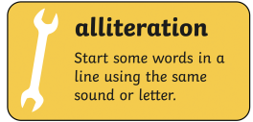
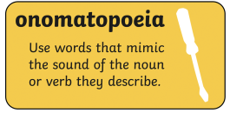
What is figurative language?

Slide 5
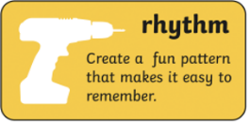
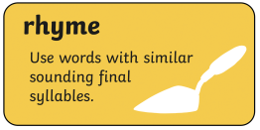
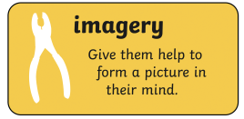
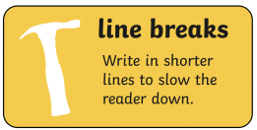
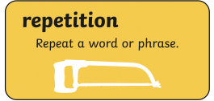

Slide 6
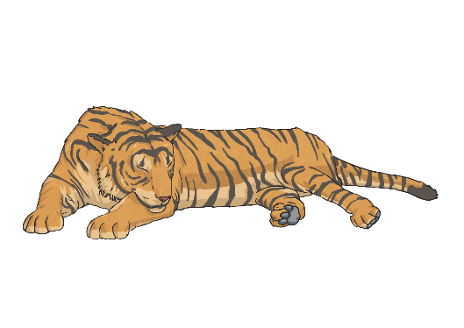
The Tyger
We are going to read ‘The Tyger’, a famous poem by William Blake, first published in 1794.
You will then consider the language chosen and how it helps to create images for the reader. You will then have a go by yourself at annotating the poem.
After you have had a go. Come back to the PPT and we will go through it together, one stanza (verse) at a time, you can then take another coloured pen to add to your annotations.
Your notes should be made to help you understand the poem.
On the next slide I will read the poem.
annotate
Verb
add notes to (a text or diagram) giving explanation or comment.

Slide 7
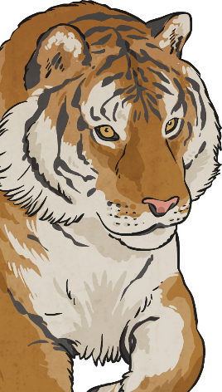
Tyger Tyger, burning bright,
In the forests of the night,
What immortal hand or eye,
Could frame thy fearful symmetry?
In what distant deeps or skies.
Burnt the fire of thine eyes?
On what wings dare he aspire?
What the hand, dare seize the fire?
The Tyger
And what shoulder, & what art,
Could twist the sinews of thy heart?
And when thy heart began to beat,
What dread hand? & what dread feet?
What the hammer? what the chain,
In what furnace was thy brain?
What the anvil? what dread grasp,
Dare its deadly terrors clasp!
When the stars threw down their spears
And water’d heaven with their tears:
Did he smile his work to see?
Did he who made the Lamb make thee?
Tyger Tyger burning bright,
In the forests of the night:
What immortal hand or eye,
Dare frame thy fearful symmetry?
by William Blake

Slide 8
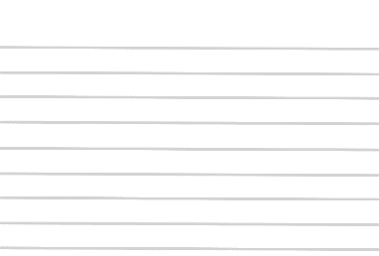

Annotating
Now its your turn. Read through the poem by yourself and see what you can identify. Choose one of the worksheets to help * or *** or make a list on a piece of paper.
What to do when annotating:
identify any figurative language (alliteration);
highlight any imagery;
identify rhyming words;
identify any repetition;
are there any parts you don’t understand?
When you are done come back and listen to the PPT. I will explain the poem. Make sure you have a go first!

Slide 9
The Tyger
repetition
What do you think this means?
He’s asking divine being could have created the incredible creature.
Tyger Tyger, burning bright,
In the forests of the night,
What immortal hand or eye,
Could frame thy fearful symmetry?
In what distant deeps or skies.
Burnt the fire of thine eyes?
On what wings dare he aspire?
What the hand, dare seize the fire?
alliteration
Imagery
Rhyme
What are these?
Questions. At the end of each stanza he asks questions. Each one building on the last.

Slide 10
The Tyger
Rhyme
And what shoulder, & what art,
Could twist the sinews of thy heart?
And when thy heart began to beat,
What dread hand? & what dread feet?
What the hammer? what the chain,
In what furnace was thy brain?
What the anvil? what dread grasp,
Dare its deadly terrors clasp!
The writer is wondering out loud.
Imagery
This time the vocabulary is encouraging as to feel fearful.
Asking what tools were used to create such a creature.
What person uses there tools to make things?
Blacksmith

Slide 11
The Tyger
Rhyme
When the stars threw down their spears
And water’d heaven with their tears:
Did he smile his work to see?
Did he who made the Lamb make thee?
Tyger Tyger burning bright,
In the forests of the night:
What immortal hand or eye,
Dare frame thy fearful symmetry?
He goes back to the maker. He asks is the maker happy with his work?
He also askes whether the same hands who made this ferocious tiger could have made a lamb.
Imagery
This stanza is a repeat of the first stanza but with greater importance or warning.

Slide 12
Reading Aloud
Challenge 1:
Practise reading the poem (or a section of it) aloud. Use your best expression and a loud, clear voice to perform the piece.
Challenge 2:
Try memorising a section of the poem and learning it by heart.
Can you perform it from memory, without reading?
Challenge 3:
Now that you have spent some time studying and learning the poem, consider your own personal opinion of it. Can you comment on what you think of the poem, with justification to support your thoughts?

Slide 13
Aim
To annotate and evaluate a poem.
Success Criteria
I can identify an author’s use of figurative language, imagery, rhyming and repetition.
I can add relevant notes to a poem.
I can recall and read a section of poetry aloud.
I can discuss my personal opinions about a poem and comment on how effective a poem is.

