Slide 1


Day 4

Slide 2



Slide 3

L.O: I can edit a Travel Journal entry for Brazil
Top Tips
Give the edit your best polish!
Edit for success
1. Read for does it make sense___
2. Read for punctuation ___
3. Read for spelling ___
4. Read to improve___
Read it out loud.
Read it backwards.
Please check that your journal has:
A clear purpose explained in your first paragraph.
A sentence at the end of the entry summarising how you feel about your trip.

Slide 4

Travel Journaling
This was our checklist from yesterday…
We had one thing missed out
L.O: I can plan and draft a Travel Journal entry for visiting the Amazon rainforest
S.C: Writing checklist
A clear story line.□
A clear purpose. □
1st paragraph that hooks the reader. □
Speech. □
5. Show and tell things I did. □
6. I entertained my reader □
7. Described the:
surroundings □
characters □
food □
weather □
8. Pictures/drawings/diagrams

Slide 5
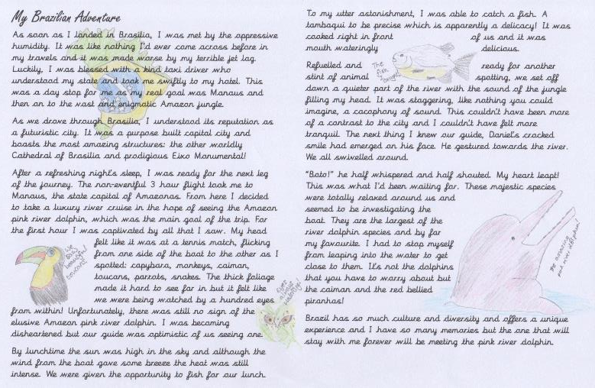
Travel Journaling
L.O: I can edit a Travel Journal entry for Brazil and write it up to present it as a journal entry.
S.C: I included pictures/drawings/diagrams

