Slide 1

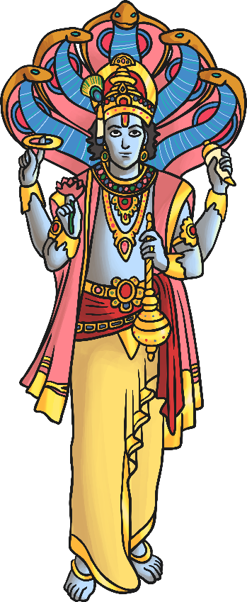
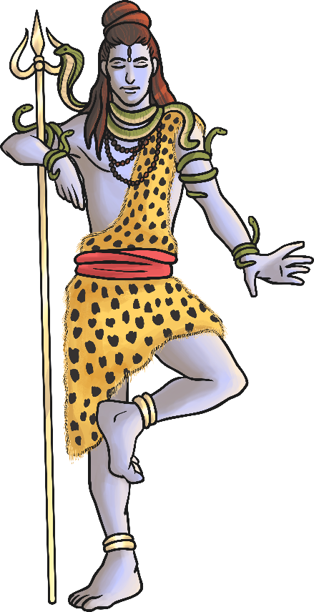
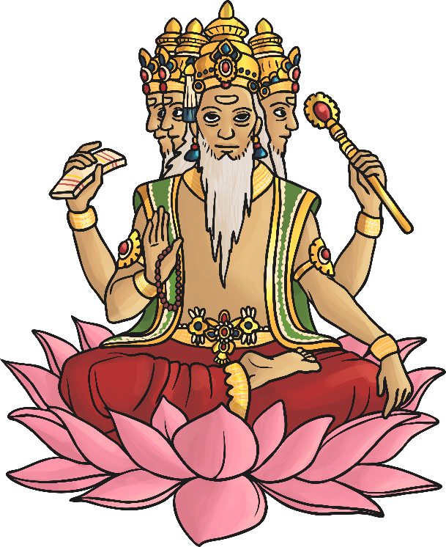

Hindu Gods and Goddesses
LO: I can understand who and what Brahman is to Hindus and demonstrate my understanding by creating a poster detailing what I’ve learnt.

Slide 2
Hindu Gods and Goddesses
Success criteria:
I can understand that Brahman is the supreme spirit which is fundamental to Hindus.
I can understand that Brahman can take certain forms such as avatars which are worshipped as gods within Hinduism.
I can understand that each avatar performs a specific function within Hinduism
I can understand the major gods within Hinduism and what their jobs are by creating a poster demonstrating my knowledge.

Slide 3
Great Gods
Watch the video lesson below. Pause when asked to and ensure you complete the quiz at the end of the video lesson
https://classroom.thenational.academy/lessons/who-is-brahman-to-hindus-65k30d?step=2&activity=video
Vishnu
Brahma
Shiva

Slide 4
Great Gods
Hindus believe that there are three great gods (Māhadevas).
These are considered the Trimurti – the three aspects of the universal supreme God.
Vishnu
Brahma
Shiva

Slide 5
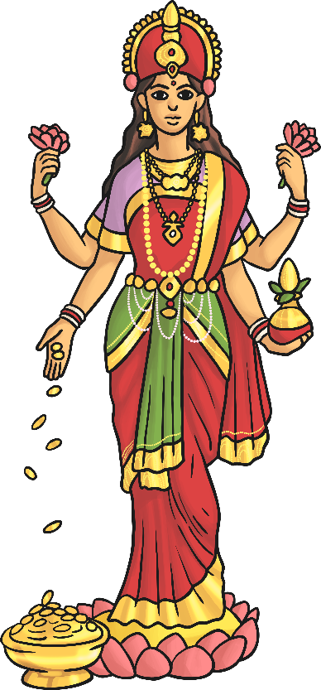
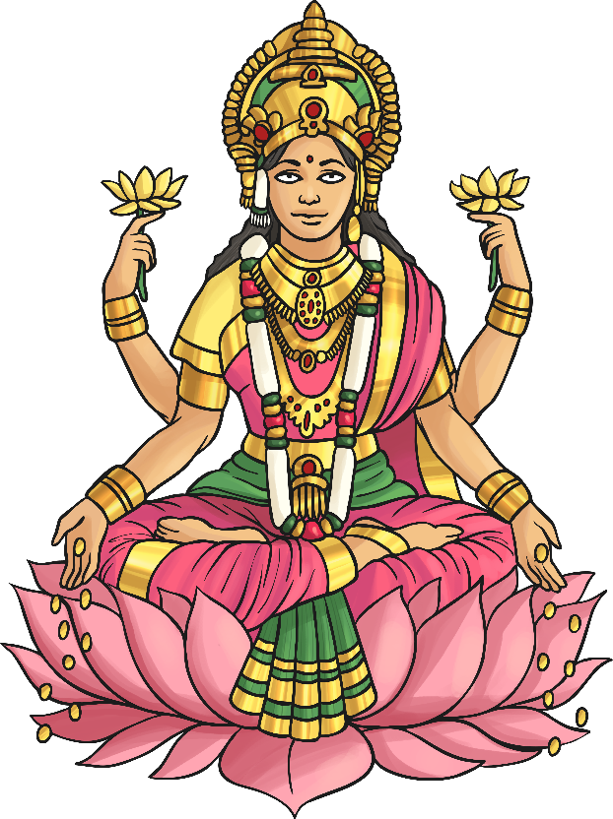
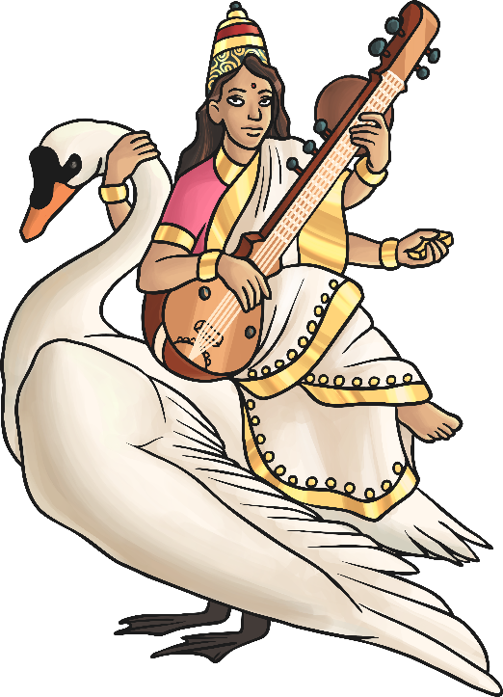
Great Gods
The Tridevi are Goddesses who are equally important.
Saraswati
Lakshmi
Shakti

Slide 6
Brahma
Brahma is the god (deva) of creation.
He has four arms and four faces, looking in the four directions.
Each of his four heads is believed to be responsible for one of the four Vedas (sacred Hindu texts).
Brahma is not worshipped as much as the other gods, as it is believed his role as creator is over.
His wife is Saraswati – the goddess of Knowledge.

Slide 7
Saraswati
Saraswati is the goddess (devi) of knowledge and the arts.
Her swan personifies pure knowledge. She is sometimes depicted with a peacock which is said to represent the arts.
She taught Brahma (her husband) the ability to sense, think, comprehend and communicate.
Saraswati rejected material things in favour of pure wisdom.

Slide 8
Vishnu
Vishnu is the god responsible for preserving and protecting the universe.
His role is to return to Earth during troubled times to restore the balance between good and evil.
His incarnations (human forms of Vishnu) include Rama and Krishna.
His last incarnation is said to be Siddartha Gautama – otherwise known as ‘Buddha’ (the founder of Buddhism).
His wife is Lakshmi.

Slide 9
Lakshmi
Lakshmi is the goddess of wealth and purity.
She is depicted with four arms and standing on a lotus flower.
Hindus believe that if she is worshipped sincerely, and not in greed, she will bless them with fortune and success.
Like her husband, Lakshmi has also had incarnations on Earth as Sita, Radha and Rukmini.

Slide 10
Shiva
Shiva is the god of destruction. His role is to destroy the universe in order to re-create it.
He is seen as the source of both good and evil.
His wife, Shakti, is said to enable him to gain balance.
He is often depicted with:
a third eye (represents wisdom and insight)
a cobra necklace (representing destruction and recreation – snakes represent this in the way they shed their old skin for new skin)
vibhuti (three lines drawn across the face to represent his power)
a trident (which represents the three functions of the Trimurti)

Slide 11

Shakti
Shakti is the mother goddess - the source of all energy, power and creativity in the universe.
She represents nature and therefore can be nurturing as well as dangerous.
She can appear as:
Parvati
(kind)
Kali
(Cruel and frightening)
Durga
(protector)

Slide 12
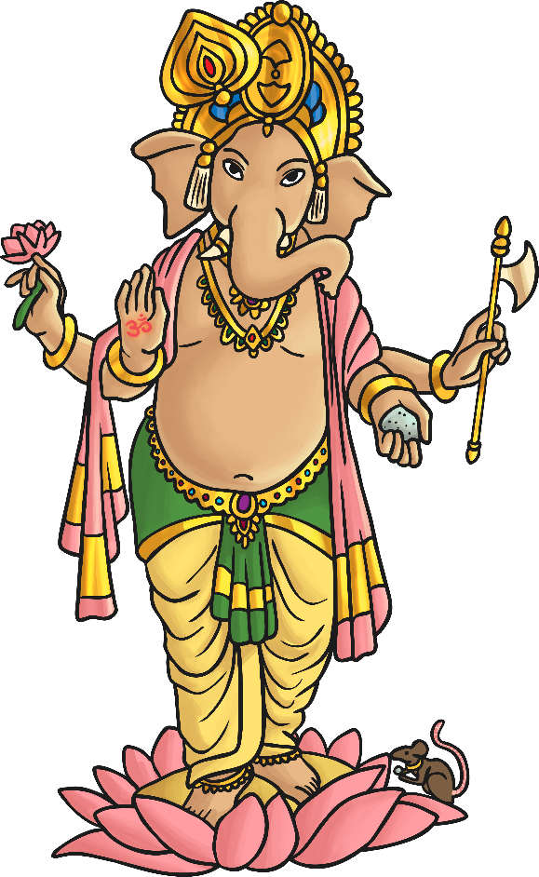
Ganesha
Son of Parvati and Shiva – he has an elephant’s head and a human body.
His tusks – one broken and the other unbroken – represent imperfection and perfection in the world.
Ganesha is worshipped by Hindus who believe he bestows good fortune and wisdom.
He is often prayed to when his followers are starting something new in their lives e.g. getting married, starting a new job.

Slide 13
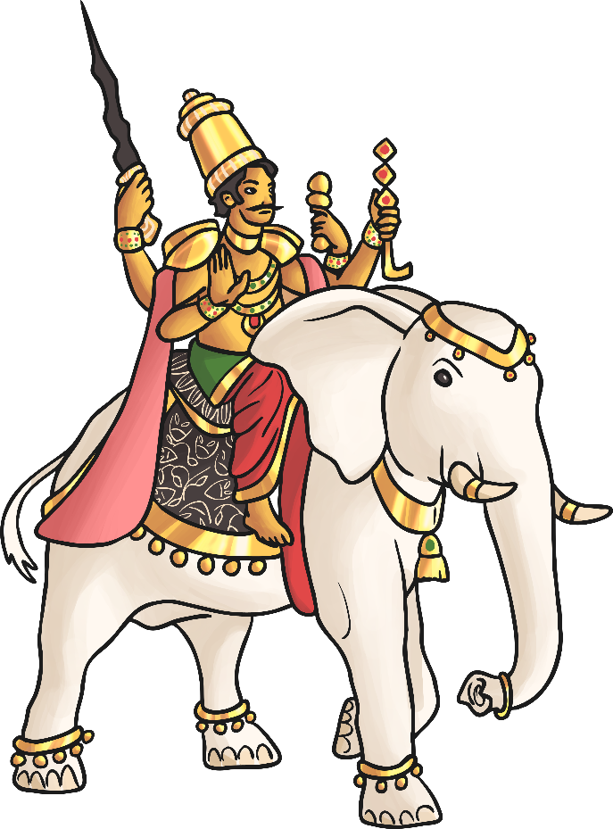
Indra
Indra is the king of heaven and lord of the gods who maintain the heavens.
He wields a thunderbolt, creates thunderstorms and provides rain.
He wages war against the opponents of the gods and thus is considered the god of war.
The rainbow is referred to as Indra’s Bow.

Slide 14
Agni
Agni is the god of fire.
Fire holds a special place in many Hindu ceremonies including weddings.
The sacrifices and offerings made to him go to the other gods as he is a messenger from and to them.
He lives on Earth among humans rather than with the gods.

Slide 15
Surya
Surya is the Sun god.
He is depicted as a warrior on a chariot pulled by seven white horses.
He is thought to be capable of healing the sick and dispelling darkness by illuminating the world.
Hindus believe that placing the sign of the Sun over main doors will bring them good luck.

Slide 16
Vayu
Vayu is the god of air/wind.
He is also considered the god of life as air is vital to
being alive.
Vayu is also known by the names of Pavana, Vata
and Prana.
He is the father of Hanuman who is known as Pavanaputra (son of Pavana)
Like other gods, he is considered a fighter, destroyer,
powerful and heroic.

Slide 17
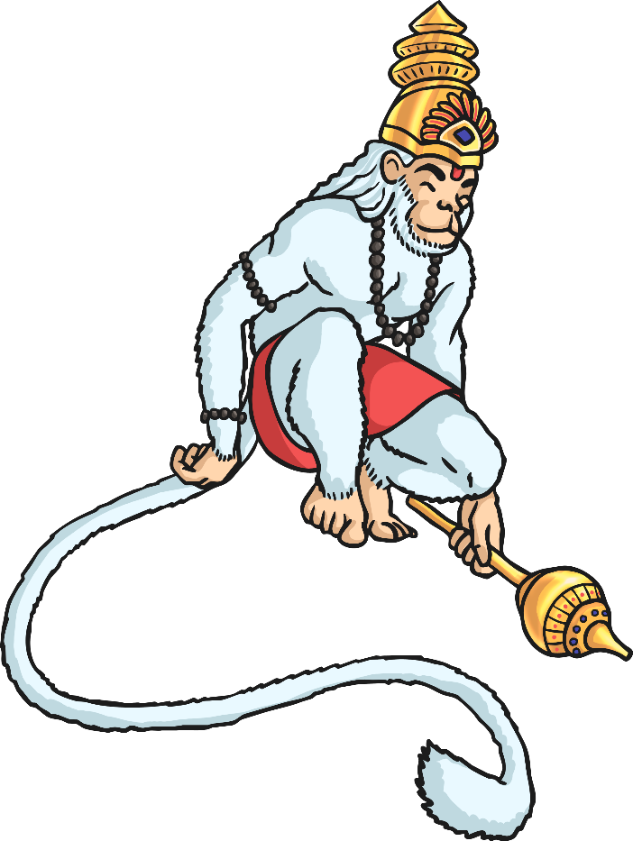
Hanuman
Hanuman is the Hindu monkey god.
They believe that as a child, Hanuman was mischievous and liked to play tricks!
However, it is his role in the story of the festival of Diwali for which he is known.
He commanded an army to aid Rama’s fight against the demon Ravana in order to rescue Sita.

Slide 18
LO: I can understand who and what Brahman is to Hindus and demonstrate my understanding by creating a poster detailing what I’ve learnt.
ACTIVITY: ON A SHEET OF A4 PAPER DRAW A POSTER DETAILING WHAT YOU KNOW ABOUT BRAHMAN AND THE HINDU GODS AND GODDESSES

