Slide 1
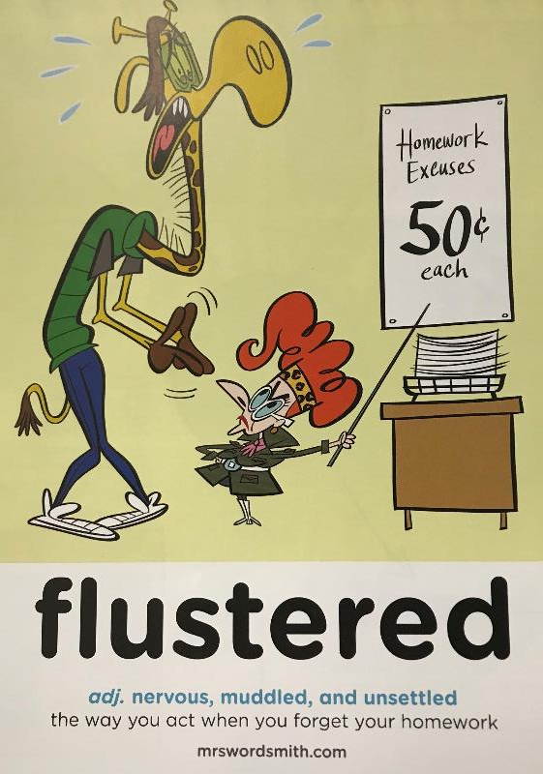

Day 3

Slide 2

Travel Journaling
Day 1-Identifyt he features
Day 2-Plan and write the first part of your journal
Day 3-Plan and write the second part of your journal
Day 4-Edit and present your work as a journal.
© Original plan copyright Hamilton Trust, who give permission for it to be adapted as wished by individual users.

Slide 3
As I stepped off the plane, arriving in marvellous Manaus, I was met with the stunning views and warm, sunny, blue skies. I could not wait to visit the place that has the most beautiful architecture and is surrounded by incredible jungle landscapes. The latter was the main reason for my visit.
When I reached the city, I was overwhelmed by the many buildings that had such classic charm and history. As I entered the municipal market, it was full of the most unique items and a delicious tasting herb called jambú. Ambling around this breath-taking city, I couldn’t help but notice the elegantly designed opera house and the museums full of information on the rich culture of the city.
As it was getting late, I had to choose one of the many restaurants to eat at. One caught my eye, so I sat down and ordered. I was brought the most exquisite tasting fish: tambaqui. It’s flavour was like nothing I had ever tasted before. After I had finished, the locals began to dance and asked me to join in. They made me feel so welcome in this vibrant and friendly city.

Slide 4
Travel Journaling
Today we are going to plan and draft the next stage of our Travel Journal.
This is our journey to the Amazon Jungle and your exploration of it.
Where will you visit? | Go from Manaus to the Amazon rainforest
What do you hope to experience in the jungle?
What form of transport will you use? | Car to the jungle
What challenges might you face?
What is there to see and do in jungle? How would you describe it? (adjectives and emotions)
What food is there to try?
What is the weather like?
What are the locals like (i.e. the animals and guides)?
Please watch the video and jot down some notes. Think about the following…(you’ll find this on the todays worksheet).
Now go and watch the video
(Year 5 January 2021 Home School Learning Video Support | Datchet St Mary's CofE Primary Academy (primarysite.media) and make notes and come back to hear the rest of the PPT.

Slide 5
Travel Journaling
Lets see if we can add to our plan now...
Guided Imagery
Close your eyes and to be aware of the sounds around you. Concentrate on your own thoughts, breathing and feelings.
Imagine you are in Brazil, in the rainforest.
What sounds do you notice? What do you see near you? What do you notice further away?
What does the weather feel like? How do your face and fingers feel? Is the air around you hot or cold? Humid or dry? Take a deep breathe it in of this air.
With your eyes still shut, what do you see? Who is with you? What are you doing? What colours do you notice? What is happening?
Stay in this scene for a while. You will need to remember all that you’ve noticed (and more).
Gradually bring your mind back to being in the classroom or room at home and then to open your eyes.

Slide 6
Travel Journaling
Use your plan to draft your Travel Journal for your journey to the Amazon rainforest and your exploration of it.
L.O: I can plan and draft a Travel Journal entry for exploring the Amazon rainforest.
S.C: Writing checklist
A clear story line.□
A clear purpose. □
Speech. □
4. Show and tell things I did. □
5. I entertained my reader □
6. Described the:
surroundings □
characters □
food □
weather □
** By the end of today you will have finished your travel journal for visiting Manaus and the Amazon.(We will edit tomorrow) **

Slide 7
Magpied Vocabulary
Magpied Vocabulary Specific to country
staggering
magnificent
dramatic
otherworldly
treacherous
beauty abundant
authentic
unique
cultural
diverse
sacred
endures
serenity
vast
sultry
unfathomable
kaleidoscope
earthquakes
volcanic
glacier
Geothermal
National Reserve
migration
Safari
grassland

Slide 8
Travel Journaling
Some vocabulary ideas for travel writing
breath-taking
jaw-dropping
leaving the modern world behind
chilled out
pampering
nothing but the sound of waves
bygone era
stunning
dream
clear blue skies
cobbed streets
mouth-watering delicacies
smiling staff
romantic
vibrant
azure
hearty
rustic
there’s something for everyone
friendly locals
colourful/bustling markets
rich in history
quirky
lively nightlife
panoramic views
off the beaten track
priceless treasures
tranquillity
paradise
lapping waves
powder-white sand

