Slide 1

L.O: I understand the many roles I have and what makes me me.
grandmother grandfather
grandmother grandfather
aunt uncle
mother father
aunt uncle
sibling
you
sibling
Make your family tree. What roles do you have in your family?

Slide 2
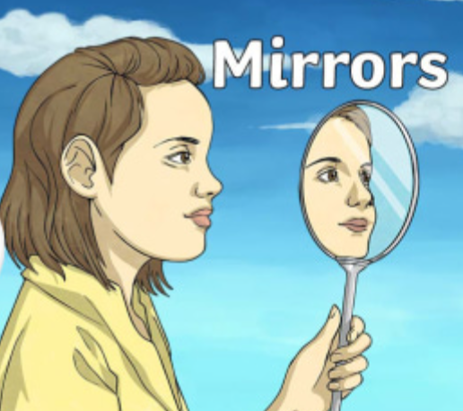
Who are you and what do you mean to different people?
Do you behave differently/ have different roles in different situations?
What stays the same?

Slide 3
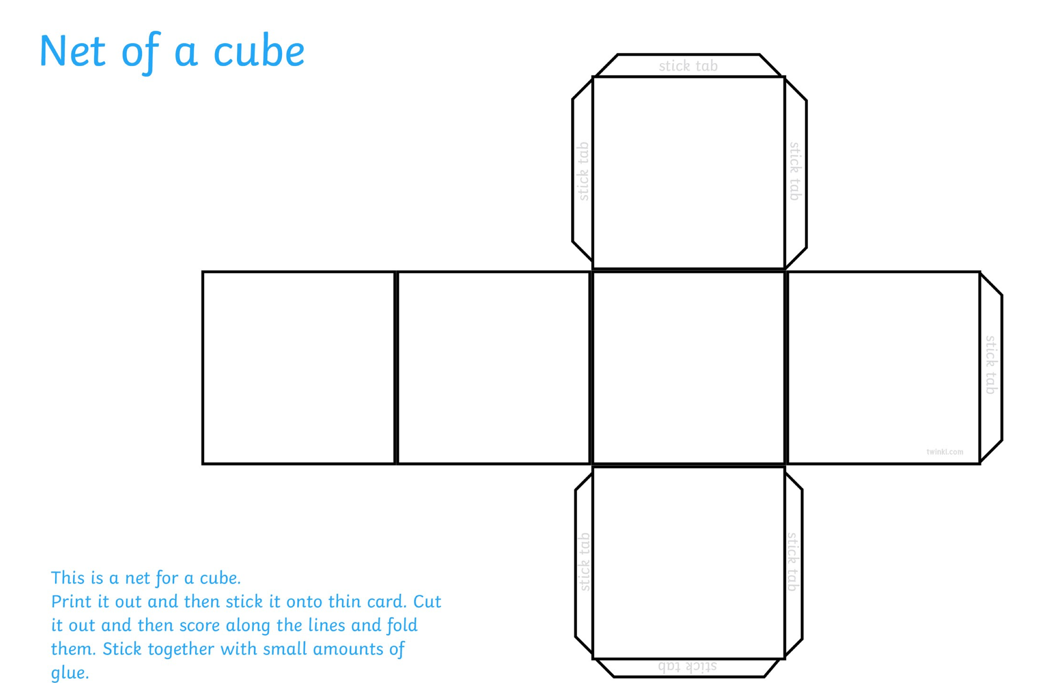
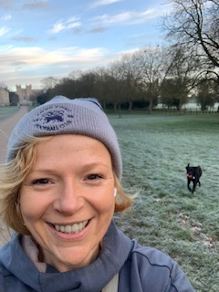
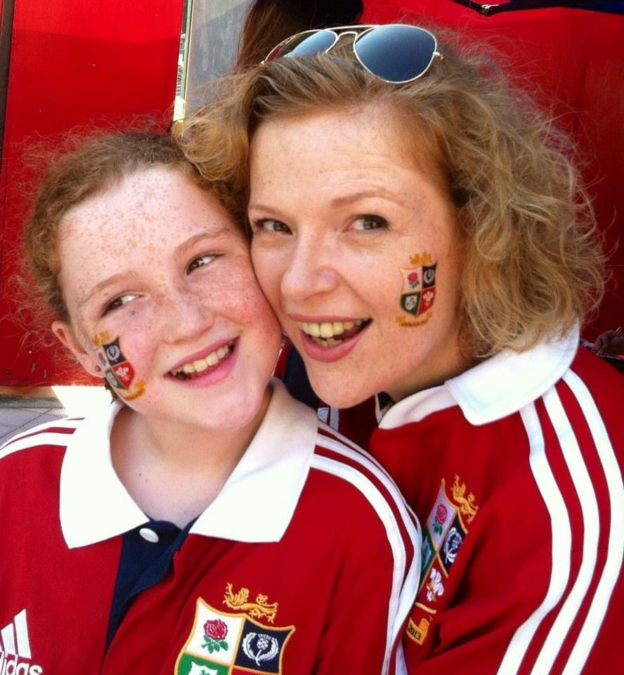
We are going to make a cube about you.
Each face will have a different picture of you on it. For example: brother, friend, football player, grandson, cub scout, fisherman.

Slide 4
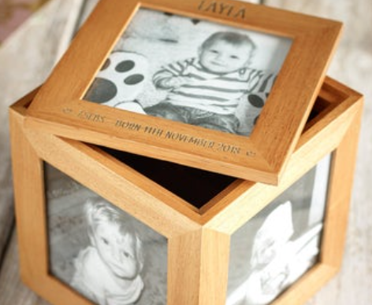
L.O: I understand the many roles I have and what makes me me.
What is it about you that is inside the box that makes you?

Slide 5
Hindus believe that there is one God with many different aspects.
If this is true of you, can it be true of a God? Can he have many different roles, but still be the same inside?

