Slide 1


Slide 2


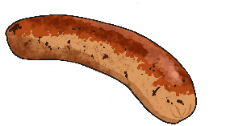

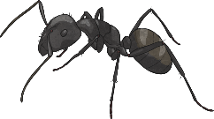

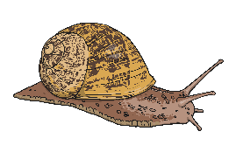


Can you hear the initial sound?
Say the names of the pictures out loud. What sound do they start with?
Now can you sort them into 3 lists? Draw the pictures under the correct sound.
s a t

Slide 3

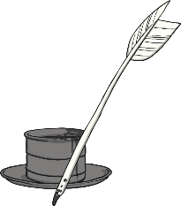

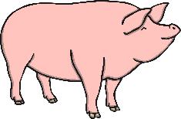


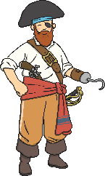
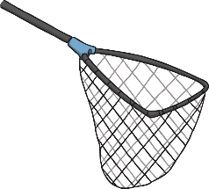

Can you hear the initial sound?
Say the names of the pictures out loud. What sound do they start with?
Now can you sort them into 3 lists? Draw the pictures under the correct sound.
p i n

Slide 4

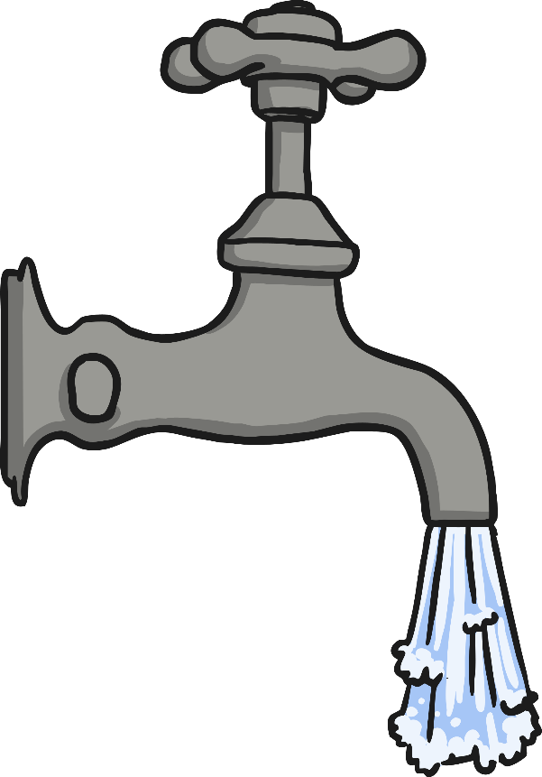

Can you write these words?

Slide 5
Read the words:
Now write a sentence using one of the words.
is
big
I
the

Slide 6
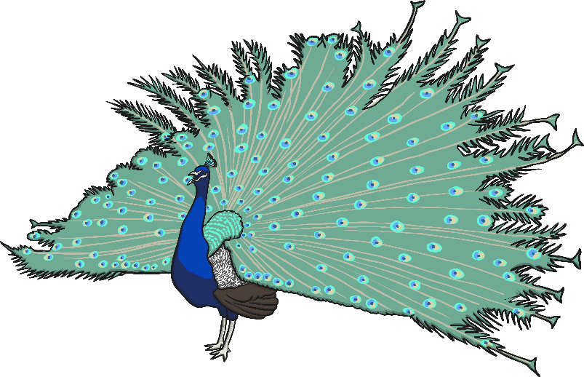
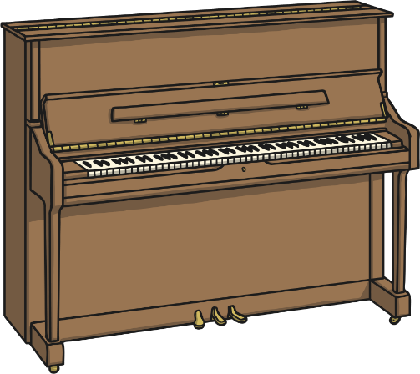

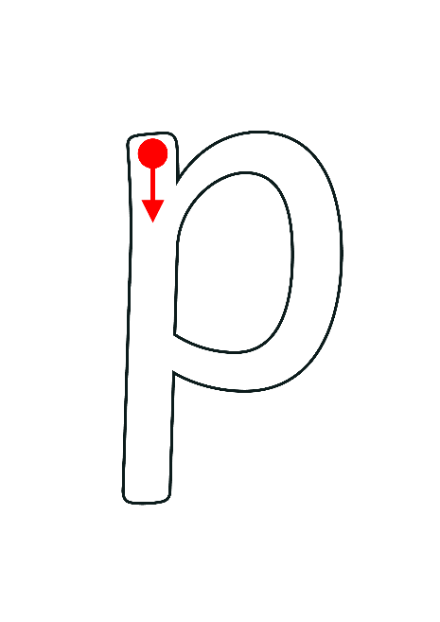
Initial Sound ‘p’
Draw some pictures of words beginning with p.
Here are some ideas to get you started.
Now practise writing the letter p.
Can you make them all look exactly the same?

Slide 7

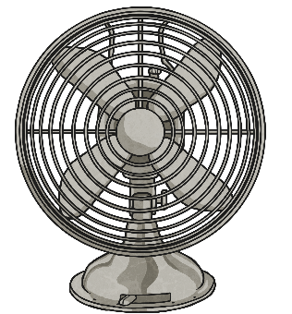


Can you hear the missing sound?
Say the word.
Can you hear the missing phoneme in each?
Write the words.
h_ll
f_n
b_g
p_n
s_n
s_ck

