Slide 1

Lesson six:
What is life like in Brazil?
LO: I can demonstrate my understanding of the geography of Brazil by creating a tourist brochure through independent research.
Success criteria:
I can use geographical vocabulary to describe the human and physical features
I can use maps, diagrams, and images to describe the environment
I can use titles and headings to describe the different features
I can use persuasive language to describe my location
I can use interesting sentence starters and connectives
I can use a variety of punctuation including rhetorical questions

Slide 2

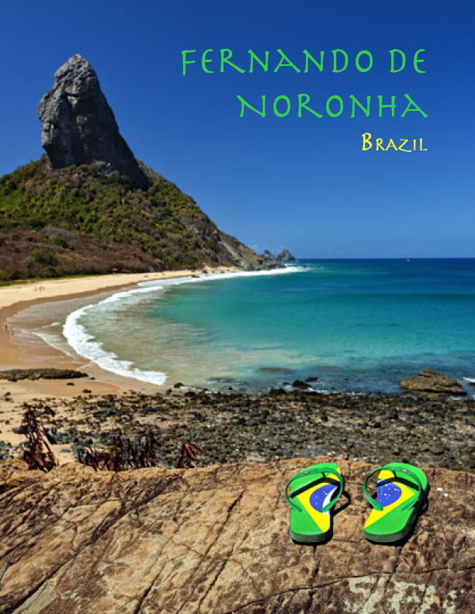
Tourist Guides
Source: http://www.solar-science-web.com/
http://explorcruises.com/travel-brochures/

Slide 3
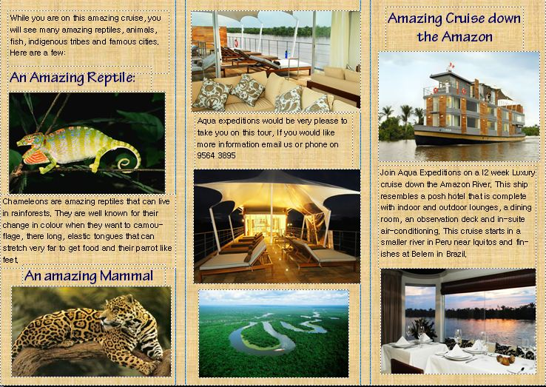
Tourist guides
http://www.aquaexpeditions.com/

Slide 4
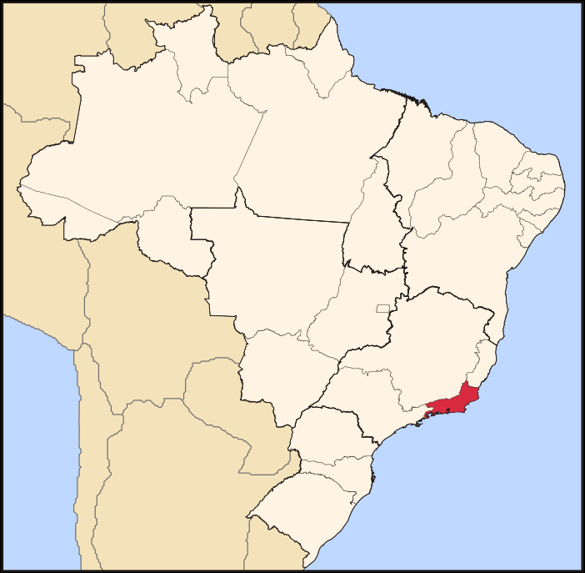
Map to show the location of Rio de Janeiro
Include a map in your tourist guide to show the location of your destination.
Rio de Janeiro
RiodeJaneiro by Raphael Lorenzeto de Abreu - Own work.
Licensed under CC BY 2.5 via Wikimedia Commons
Notes:
http://commons.wikimedia.org/wiki/File:Brazil_State_RiodeJaneiro.svg#/media/File:Brazil_State_RiodeJaneiro.svg

Slide 5
Success Criteria
I can use geographical vocabulary to describe the human and physical features
I can use accurately annotated maps to show location
I can include diagrams and images to show the environment
I can use titles and headings to describe the different features
I can use persuasive language to promote my destination

Slide 6
Task card 1:
A city escape brochure
As a member of the Rio de Janeiro tourist information board your task is to attract tourists to visit your city.
Your guide should include the following information:
- The location of the city
- The major human and physical landmarks
- The best places to visit and explore in the city
- The food and drinks you should try
- The best cultural events you should attend

Slide 7
Task card 2:
A beach resort brochure
As a member of the Brazilian tourist information board your job is to encourage people to visit the beaches of Brazil.
Your task is to create a beach resort brochure.
Your brochure should include the following:
Images and descriptions of the best beaches
Maps and directions to the beaches
The best human and physical landmarks found close to the beaches of Brazil
The best places to stay, visit, and eat whilst visiting Brazil’s beaches

Slide 8
Task card 3:
The natural wonders of Brazil information guide
Many people have heard about the natural wonders of the world, however very few have the opportunity to visit them. As a member of the eco-tourism board in Brazil your task is to create an information guide to share with tourists who want to visit these places.
Your guide should include information about the following:
- The Amazon Rainforest
- The Pantanal
- The Cerrado
- The Caatinga
- The Mata- Atlantica
- The Pampas

Slide 9
Task card 4:
A guide to the Amazon rainforest
As one of Brazil’s most well-known natural environments, many tourists want to visit. As a member of the Amazon Rainforest tourism board your task is to create a tourist information guide to help visitors find out all they need to know about the Amazon.
Your guidebook should include the following:
-The location and size of the Amazon Rainforest
-The plants and animals of the rainforest
-The indigenous people of the rainforest
-The cities of the rainforest: Manaus

Slide 10
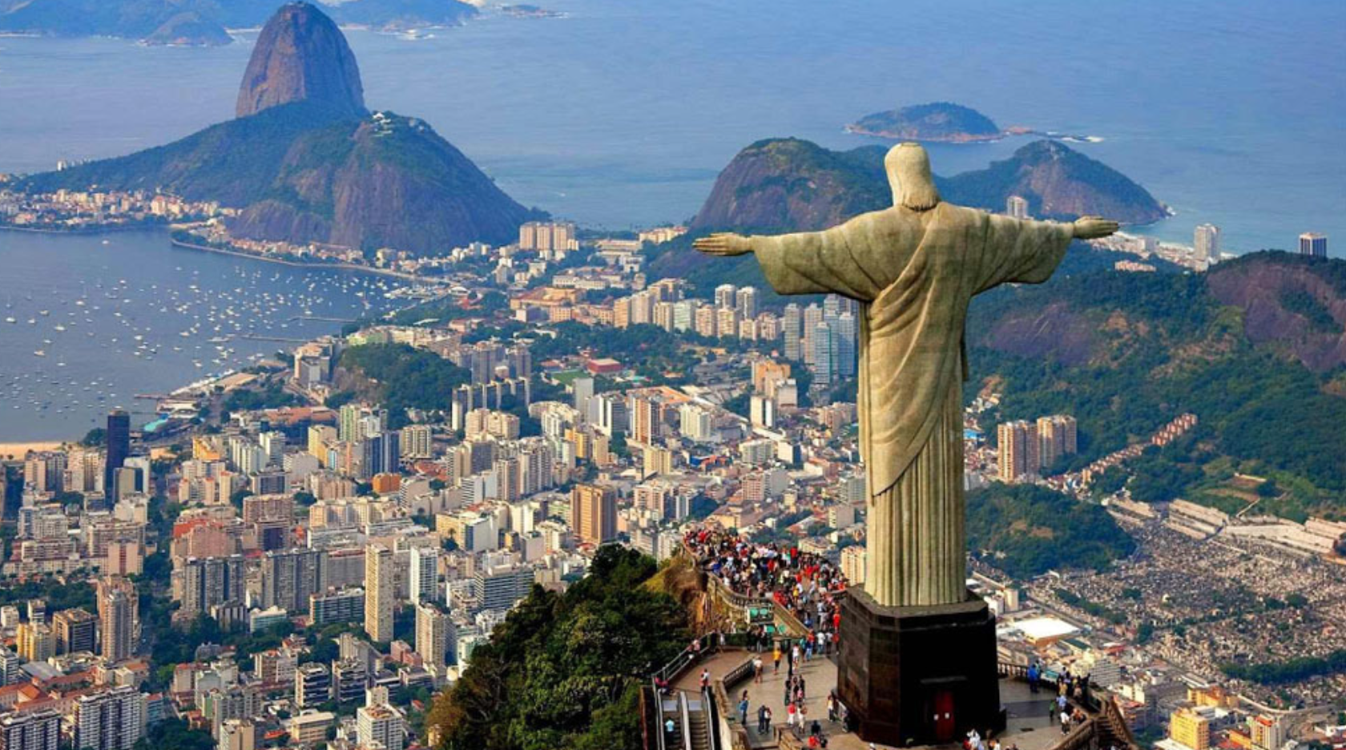
Working Wall
Brazil
      Year 5/olive Datchet st Mary’s acadeMY January 2021

Slide 11
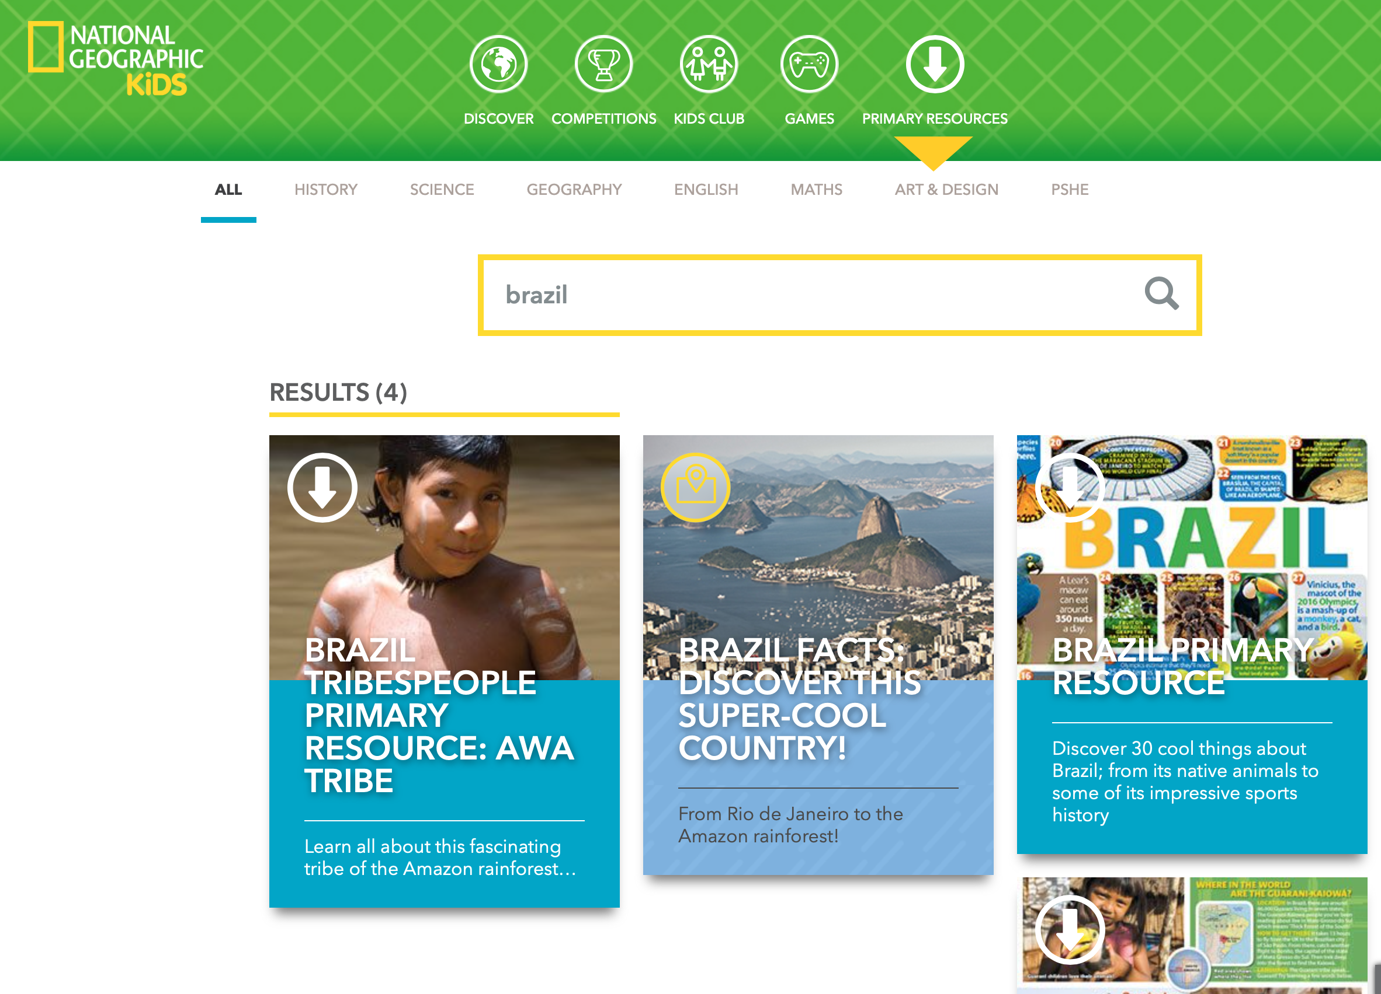
http://travel.nationalgeographic.com/travel/countries/brazil-guide/
http://ngkids.co.uk/places/country-fact-file-brazil
http://brazil-ecotravel.com/

