Slide 1
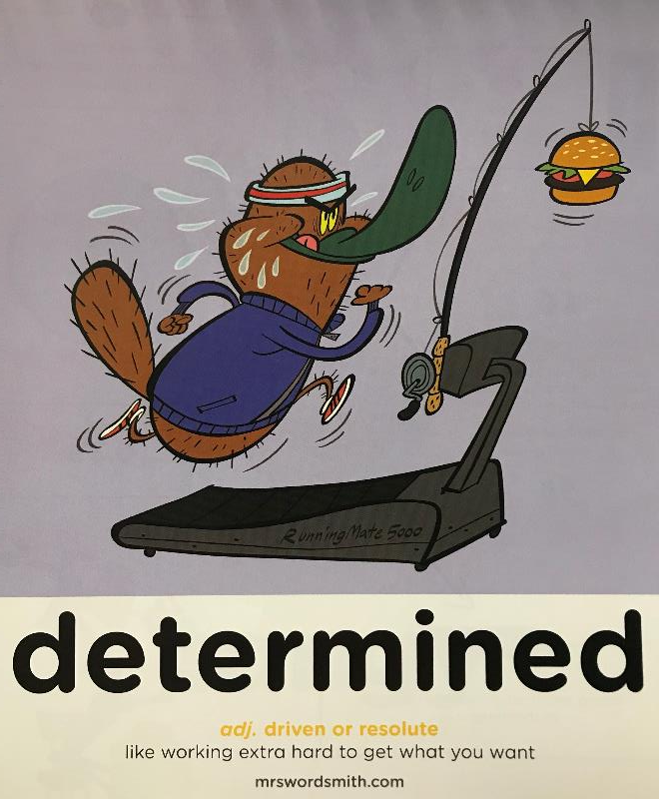

Day 1

Slide 2
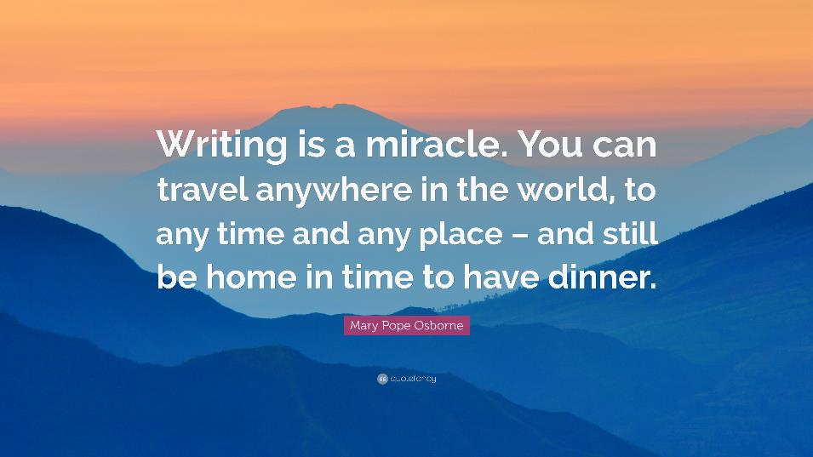

Slide 3
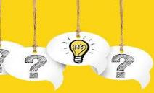
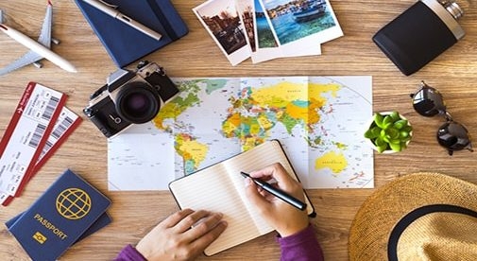
Travel Journaling
How do you think this might differ from last weeks Travel writing?

Slide 4

Travel Writing
Speed words
oppressive | humidity | vast | enigmatic
reputation | futuristic | monumental | prodigious
captivated | foliage | elusive | disheartened
optimistic | delicacy | stint | cacophony
tranquil
futuristic
Adjective
having or involving very modern technology or design
elusive
Adjective
difficult to find, catch, or achieve.
stint
Noun
a person's fixed or allotted period of work
oppressive
Adjective
(of weather) close and sultry
foliage
Noun
plant leaves collectively
humidity
Noun
atmospheric moisture
monumental
Adjective
great in importance, extent, or size.
cacophony
Noun
a harsh discordant mixture of sounds.
enigmatic
Adjective
difficult to interpret or understand; mysterious
disheartened
Adjective
having lost determination or confidence; dispirited.
prodigious
Adjective
remarkably or impressively great in extent, size, or degree.
tranquil
Adjective
free from disturbance; calm.
optimistic
Adjective
hopeful and confident about the future.
reputation
Noun
the beliefs or opinions that are generally held about someone or something.
captivated
Verb
attract and hold the interest and attention of; charm.
delicacy
Noun
a choice or expensive food

Slide 5
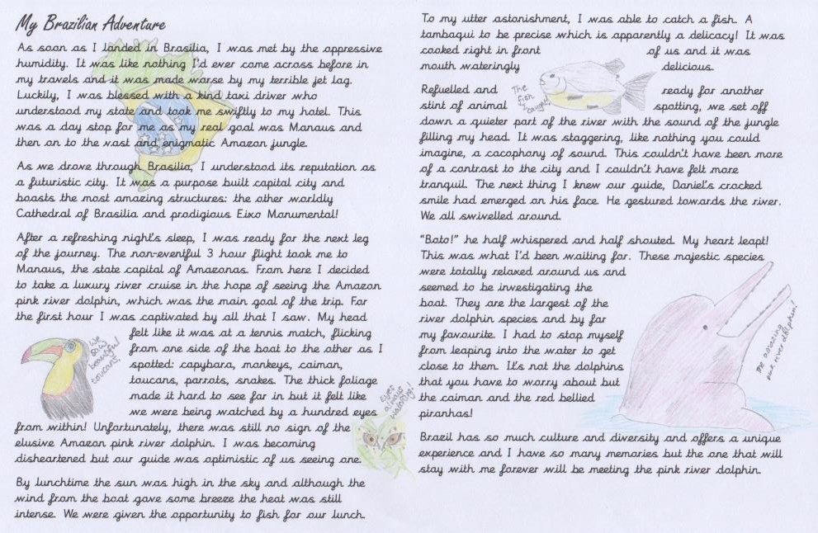

Travel Journaling Example

Slide 6
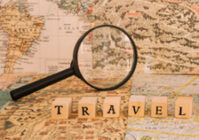
Travel Journaling
L.O:To identify some features of a Travel Journal
What is the same as Travel writing?
How is a Travel Journal different?
Digging deeper now, what do you notice about the content of the Travel Journal example?
© Original plan copyright Hamilton Trust, who give permission for it to be adapted as wished by individual users.

Slide 7
Travel Journaling
Now have a go yourself and come back to the next PPT after you have finished.
© Original plan copyright Hamilton Trust, who give permission for it to be adapted as wished by individual users.

