Slide 1

Travel Journaling
Now have a go yourself and come back to the rest of the PPT after you have finished.
© Original plan copyright Hamilton Trust, who give permission for it to be adapted as wished by individual users.

Slide 2


What could we add and/or take away? What is the purpose, is it the same or different?
pb
Features or Ingredients
physical features of the country e.g. mountains etc
facts
descriptions- adjectives
strong verbs
Purpose
food
Travel Writing
Make the reader want to finish reading the piece of writing.
Makes the reader want to go to the country
lists
third person
language
Travel Journaling
positive writing
best time to visit
pictures
present tense

Slide 3

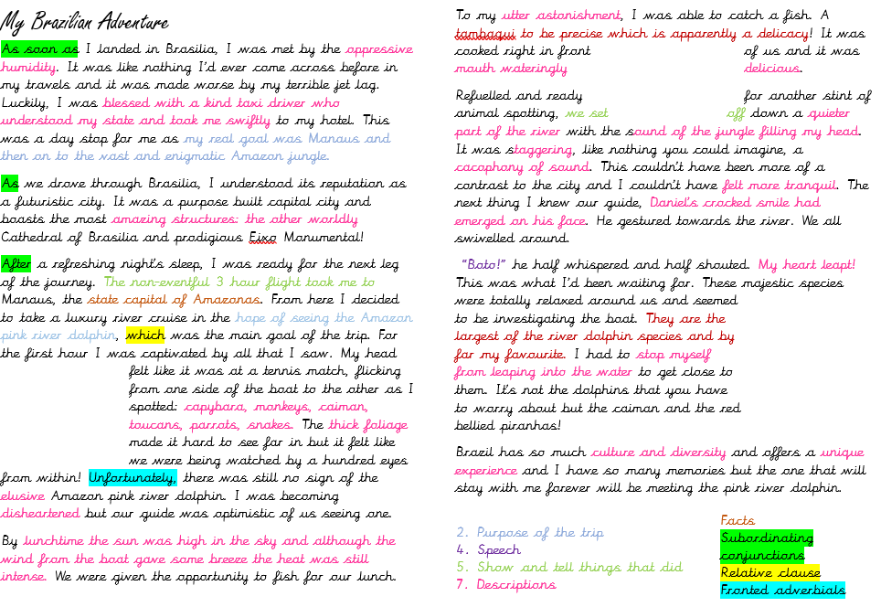
Travel Journaling Example

Slide 4

Travel Journaling
L.O:To identify some features of a Travel Journal
What is the same as Travel writing?
It tells you about a country
Has lots of descriptions (adjectives /verbs)
Includes emotions
Talks about the language/food/human and physical features
Includes facts about the country
Generally positive about the country
Pictures
How is a Travel Journal different?
It’s written in the first person
Written in the past tense
Might have hand drawn pictures or drawings
Provides a personal opinion
There is a purpose/reason to the trip
Entertaining?
© Original plan copyright Hamilton Trust, who give permission for it to be adapted as wished by individual users.

Slide 5
What could we add and/or take away? What is the purpose, is it the same or different?
pb
Features or Ingredients
provides a personal opinion
physical features of the country e.g. mountains etc
facts
descriptions- adjectives
strong verbs
Purpose
food
Travel Writing
Entertaining?
Make the reader want to finish reading the piece of writing.
Makes the reader want to go to the country
lists
third person
language
first person
Entertaining, so that the reader wants to find out if the person met their goal.
Travel Journaling
positive writing
a purpose/reason to the trip
best time to visit
pictures
past tense
present tense
hand drawn pictures or drawings

Slide 6
Travel Journaling
Digging deeper now, what do you notice about the content of the Travel Journal example?
It has a clear story line.
Has a clear purpose.
1st paragraph hooks the reader
Include speech
5. There is show and tell
6. Entertains the reader
7. Describes the surroundings/characters/food/weather
(Describing the characters- kind/quirky/their personality/way talk or walk)
8. Pictures/drawings/diagrams
This will be our success criteria for our writing.
© Original plan copyright Hamilton Trust, who give permission for it to be adapted as wished by individual users.

Slide 7
Travel Journaling
What do you notice about the Travel Journal example?
It has a clear story line.
Has a clear purpose.
1st paragraph hooks the reader
Include speech
There is show and tell
Entertains the reader
Describes the surroundings/characters/food/weather
(Describing the characters- kind/quirky/their personality/way talk or walk)
8. Pictures/drawings/diagrams
So, as a writer, your first job is to decide on the particular story you want to tell, and the events which make up that story, and ensuring all of those events are interesting or useful to the reader.
© Original plan copyright Hamilton Trust, who give permission for it to be adapted as wished by individual users.

Slide 8
Travel Journaling
What do you notice about the Travel Journal example?
It has a clear story line.
Has a clear purpose.
1st paragraph hooks the reader
Include speech
There is show and tell
Entertains the reader
Describes the surroundings/characters/food/weather
(Describing the characters- kind/quirky/their personality/way talk or walk)
8. Pictures/drawings/diagrams
Give your article direction:
Some trips have a physical objective (like reaching the top of a mountain or seeing a tiger).
Many trips don’t have an obvious goal. They are more about discovering a place, unpicking its history or meeting its people.
You want the reader to carry on reading to know if you met your goal.
Sentences like “I wanted to discover…” or “I was keen to understand…” give readers an idea of what’s to come, instead of you simply plunging them into the unknown.
© Original plan copyright Hamilton Trust, who give permission for it to be adapted as wished by individual users.

Slide 9
Travel Journaling
What do you notice about the Travel Journal example?
It has a clear story line.
Has a clear purpose.
1st paragraph hooks the reader
Include speech
There is show and tell
Entertains the reader
Describes the surroundings/characters/food/weather
(Describing the characters- kind/quirky/their personality/way talk or walk)
8. Pictures/drawings/diagrams
You can start a travel article any way you like, as long as it grabs the reader’s attention. You can use drama, humour, dialogue, (or all three) – but those first sentences must grip like glue.
© Original plan copyright Hamilton Trust, who give permission for it to be adapted as wished by individual users.

Slide 10
Travel Journaling
What do you notice about the Travel Journal example?
It has a clear story line.
Has a clear purpose.
1st paragraph hooks the reader
Include speech
There is show and tell
Entertains the reader
Describes the surroundings/characters/food/weather
(Describing the characters- kind/quirky/their personality/way talk or walk)
8. Pictures/drawings/diagrams
“Look! There! The tiger is on the prowl,” whispered Joseph. Or: "we could see the tigers heading off hunting." Which sentence is more interesting to read?
© Original plan copyright Hamilton Trust, who give permission for it to be adapted as wished by individual users.

Slide 11
Travel Journaling
What do you notice about the Travel Journal example?
It has a clear story line.
Has a clear purpose.
1st paragraph is the most exciting
Include speech
There is show and tell
Entertains the reader
Describes the surroundings/characters/food/weather
(Describing the characters- kind/quirky/their personality/way talk or walk)
8. Pictures/drawings/diagrams
‘Showing’ and ‘telling’ are two everyday storytelling techniques you probably use without realising.
Showing is when you slow down your writing and describe a scene in detail – what you saw, tasted, heard, felt – you are showing the reader the world through your eyes. Telling is simply moving the story along: "We returned to the tents for a well-earned rest."
Articles typically switch repeatedly between the drama of ‘showing’ and the practical economy of ‘telling’ – you need both, so include a good mix in your feature.
© Original plan copyright Hamilton Trust, who give permission for it to be adapted as wished by individual users.

Slide 12
Travel Journaling
What do you notice about the Travel Journal example?
It has a clear story line.
Has a clear purpose.
1st paragraph hooks the reader
Include speech
There is show and tell
Entertains the reader
Describes the surroundings/characters/food/weather
(Describing the characters- kind/quirky/their personality/way talk or walk)
8. Pictures/drawings/diagrams
We will look at this on day 4-Thursday!
© Original plan copyright Hamilton Trust, who give permission for it to be adapted as wished by individual users.

Slide 13
Travel Journaling
Day 1-Identify the features of Travel Journals
Day 2-Plan and write the first part of your Travel Journal
Day 3-Plan and write the second part of your Travel Journal
Day 4-Edit and present your work as a Travel Journal.
© Original plan copyright Hamilton Trust, who give permission for it to be adapted as wished by individual users.

