Slide 1

Lesson five:
The indigenous people of the rainforest
LO: I can create a fact file about the lives of the Awa tribe.
Success criteria:
I can understand the term ‘indigenous people’;
I can use my growing knowledge of physical and human geography to locate the Awa tribe in the Amazon Rainforest and understand how they live their lives;
I can understand the similarities and differences between the lives of the indigenous people and other people living in Brazil;
I can understand the threats facing the indigenous people of Brazil, especially the Awa tribe.

Slide 2
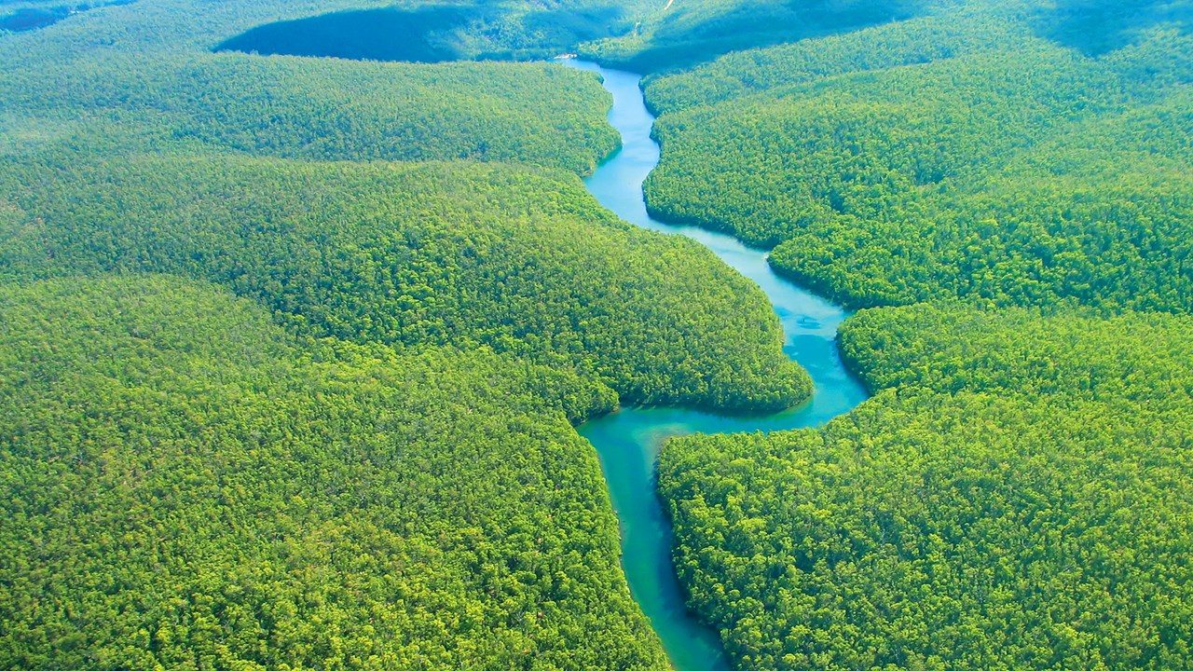
Starter
Does everyone want to migrate to urbanised areas?
Who lives in the Amazon Rainforest?
Source: Animal Blawg, Encyclopedia Britannica

Slide 3
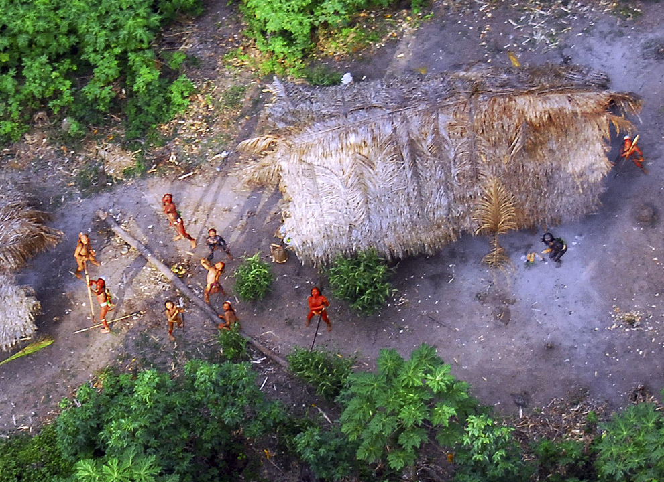
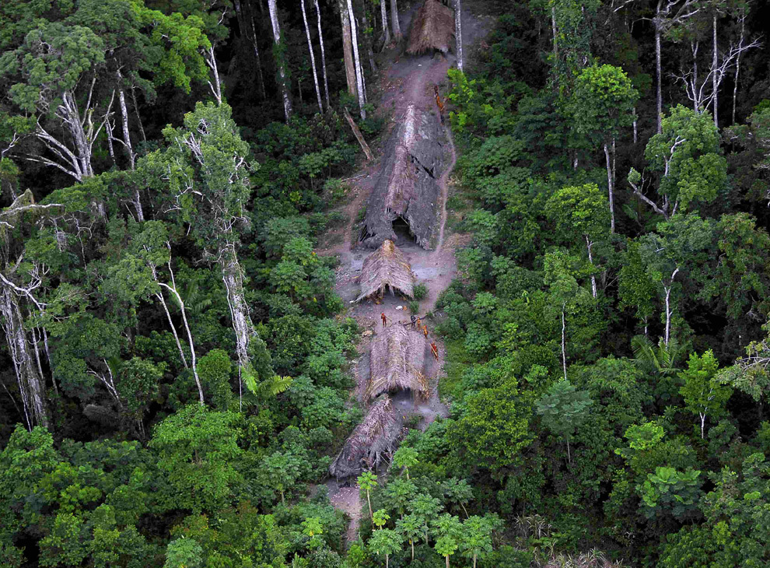
The Indigenous Tribes of the Amazon Rainforest
Video: First aerial footage of ‘uncontacted’ tribes
Source: http://www.neogaf.com/forum/showthread.php?t=970235
There are approximately 400 tribes living in the Amazon Rainforest, some of whom are ‘uncontacted’ and have very little contact with others outside their community.
Video: Further information about the Awa tribe by Survival International

Slide 4
What do we know about the indigenous tribes of the Amazon rainforest?
What can we learn about the lives of the indigenous people of the Amazon?
Source: Animal Blawg, Encyclopedia Britannica
What does the term ‘indigenous’ mean?

Slide 5
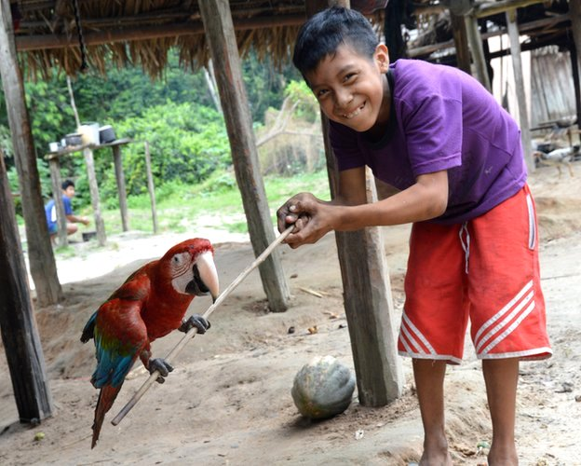
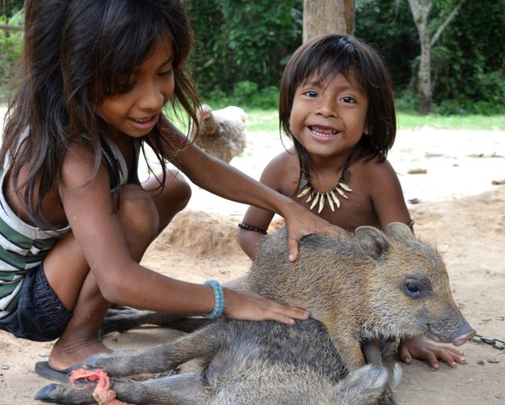
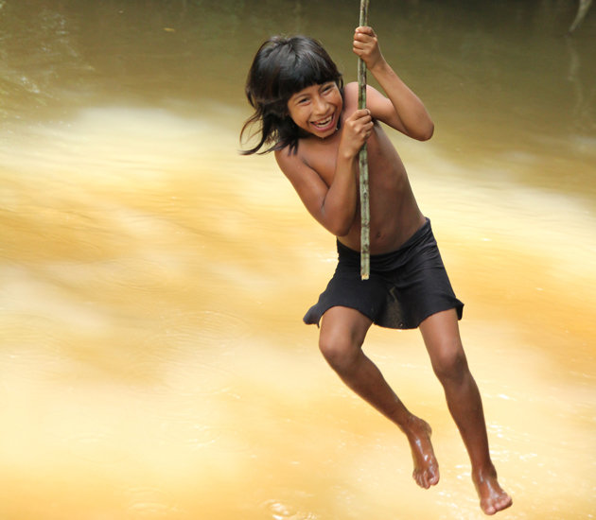
The Awa Tribe
Source (all photos): BBC

Slide 6
Fact File:
The Awa Tribe
Hi, my home is the Amazon rainforest. I am part of the Awa
tribe. In the Amazon we have cleared an area of trees to build our homes and
plant our crops.
My life is very different to yours. Each day I get up at 5.00 am as the sun rises, and go
to bed as the sun sets. In my village we grow crops including beans corn and bananas.
For breakfast I collect the crops for my family to eat.
I do not go to school, I help my family. Each day we hunt for food. We hunt
for turtles and fish in the river catching them with arrows. We cook the food
over a fire while it is fresh. I usually have fish for my lunch.
The rainforest is valuable to tribes like ours as it has many resources we can use
to build our homes, light our fires and provide medicines when we are sick. We
live in harmony with the rainforest and only use the resources we need
We don’t have electricity to watch T.V or play computer games.

Slide 7
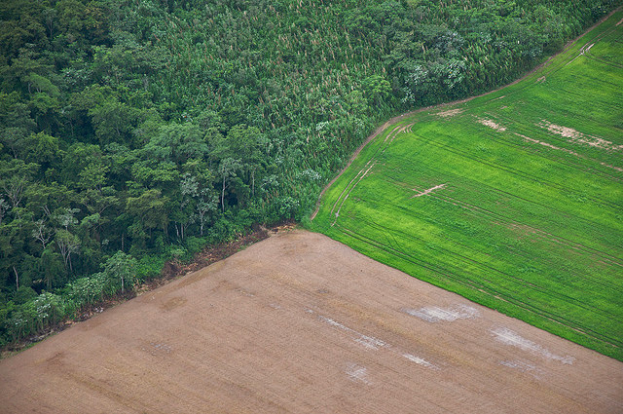
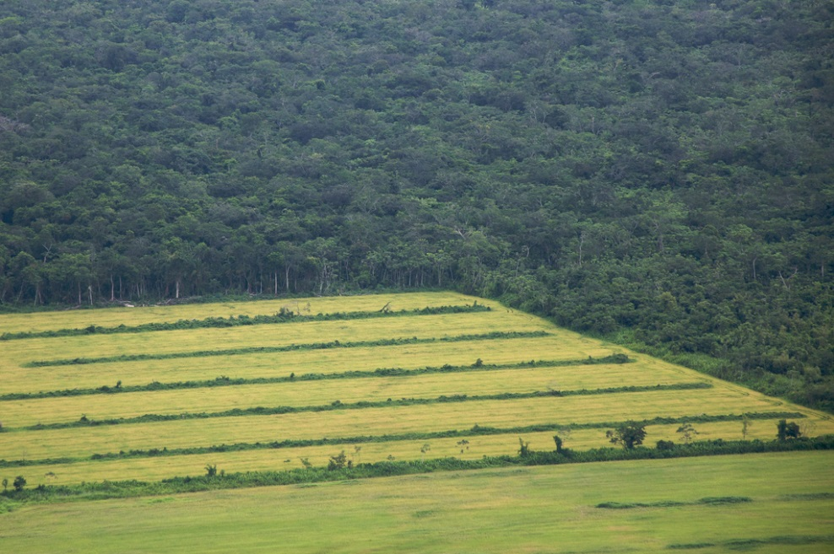
What do you think is happening to the rainforest?
Source: Rainforest © Flickr
Sam Beebe, Flickr
Source: Rainforest © Flickr
Sam Beebe, Flickr

Slide 8
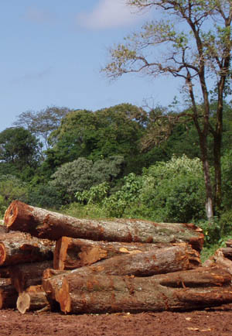
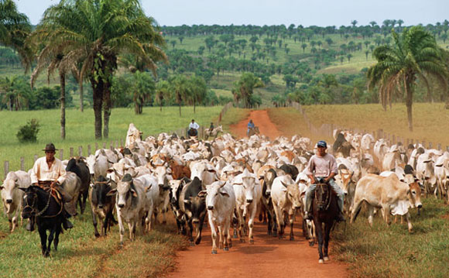
What do you think is happening?
Source: http://www.plant-talk.org/news/new-amazon-pledge-from-brazil.htm
Source: Bianca Bennett and Taylor Errichiello, Wikispaces

Slide 9
Threats to the tribal way of life
Cattle ranchers
Loggers
Farming
Road building
Disease

Slide 10
Main task: create a fact file to let people know about the plight of the Awa people
What can be done to further protect the tribes of the Amazon rainforest?…create a poster, write a news article, make a video, voice record a powerpoint…your choice!
Plight (Noun)
A situation, especially a bad or unfortunate one
Watch the video below to get inspired!
https://www.bbc.co.uk/news/magazine-27500689

Slide 11
Lesson five:
The indigenous people of the rainforest
Extension activity…

