Slide 1


Slide 2

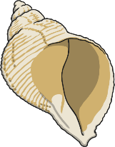


Can you write these words?

Slide 3
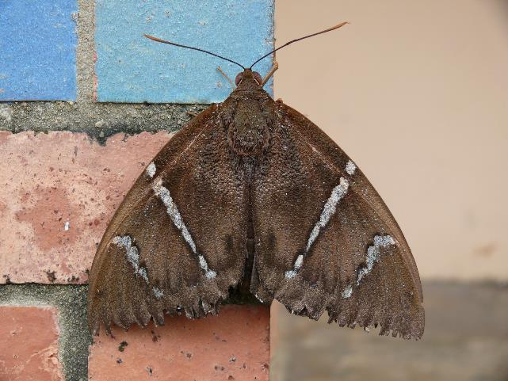
Write a sentence about this picture:
Photo courtesy of Arria Belli (@flickr.com) - granted under creative commons licence – attribution

Slide 4

Read the sentence and draw the picture:
The ship hit the rocks with a thud
and a bang.

Slide 5










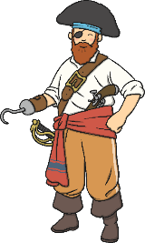




Help Pirate Pete find the treasure!
The real treasure has real words on it.
The fake treasure has got made up words on it.
Can you find the real treasure?

