Slide 1
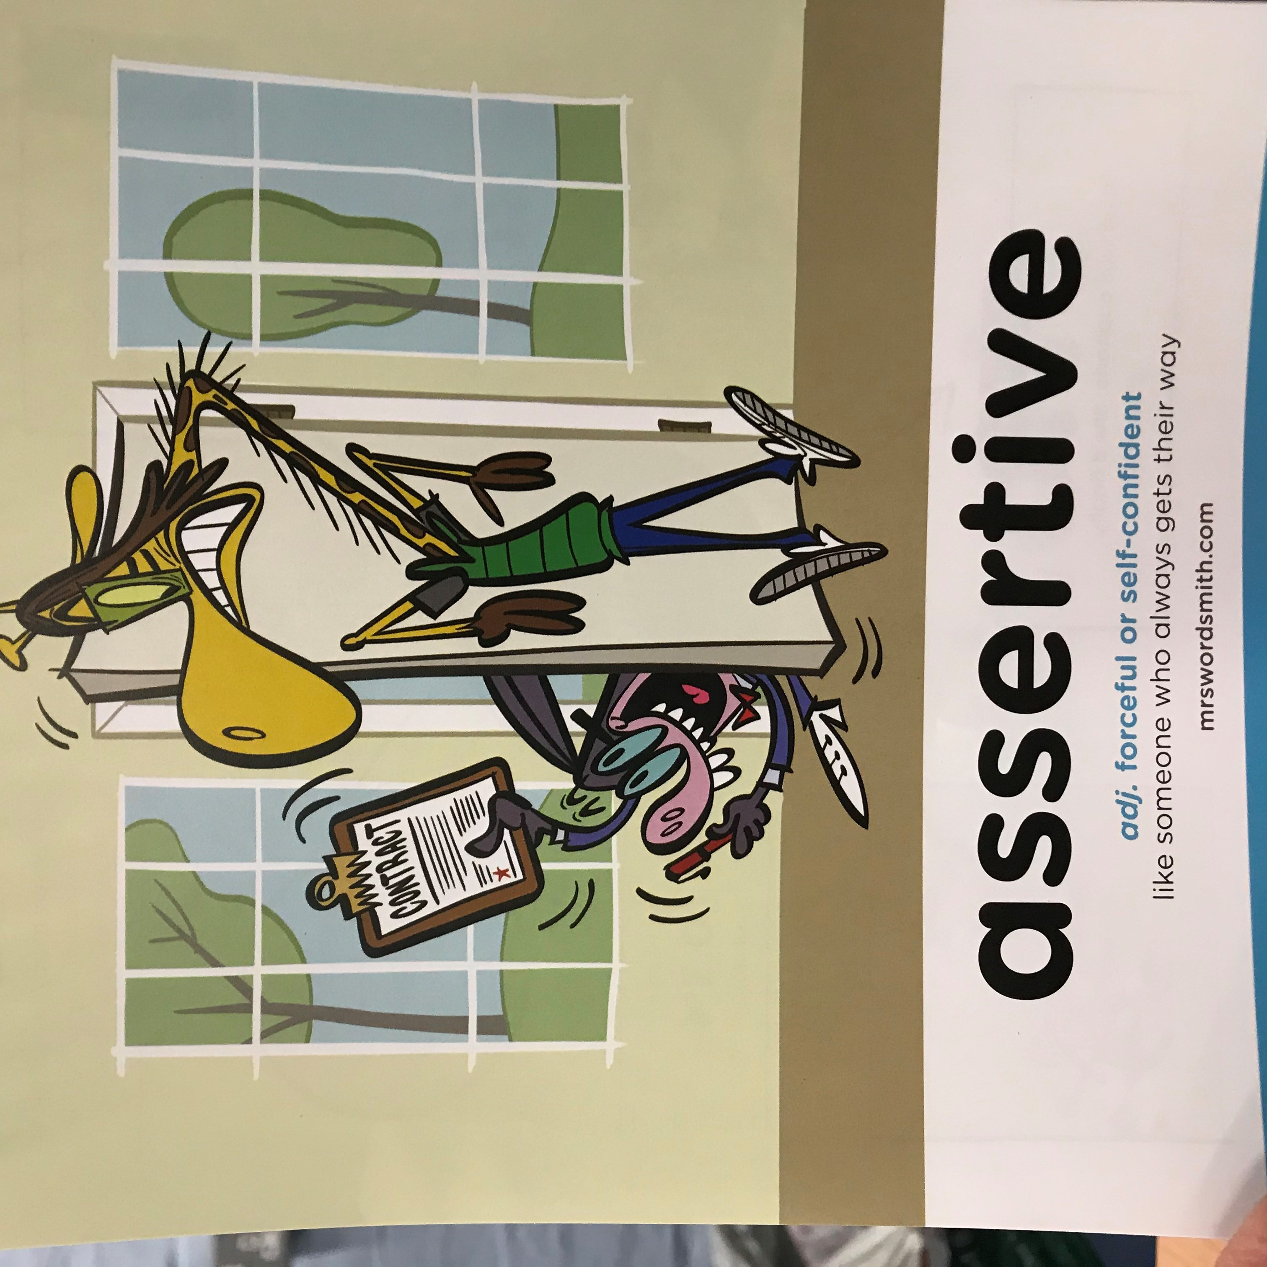

Day 4

Slide 2
English comprehension

Slide 3
Travel Writing Comprehension
We have two writers today
Steve Backshall
Bill Bryson
  Bill Bryson’s book is about his journey through Britain. It is comic travel writing. Like other travel writing, it does describe places and it does describe adventures, but mainly it is trying to be funny.

Slide 4
Hippo
I went to a suitable African river, me in a kayak, and Mark the cameraman in an inflatable boat, to get close to hippos in the wild. Our first hippo was floating languidly in a dark green pool with fast flowing water running through it. We spent most of the day watching. Whenever we got close he’d just duck his head underwater and disappear for half an hour. He was about as frightening as pocket fluff.
We were all feeling a bit deflated. I did my last piece to camera, turned the kayak around, and then stopped dead. There was another hippo right in front of us. He had come downstream, and found us blocking the way to his feeding grounds.
We weren't all that concerned, but then he dropped silently beneath the water. He was out of my view, but his vast bulk was still visible to the rest of the crew who'd taken up position on the bank. James started commentating: ‘OK Steve, he's just in front of you, maybe 30 metres or so… Er, OK, so he's starting to head your way now… Oooh, he’s moving quite fast, 20 metres… hang on, 10 metres… 5… GO GO GO he's right there!
Absolute total panic. The people on land were screaming, the camera boat guys were pulling their boat out of the water as the hippo came within metres of them, and I paddled off as fast as I could. It was terrifying, we couldn't see anything, but the guys on the side were yelling like we are about to get attacked (and having watched the footage back it looks like we nearly were).
I paddled full steam up to the bank. James grabbed the front of my boat, and I honestly believe he could have dragged me - still in the boat - all the way back to Cape Town and onto a plane home. Despite his 10 years in the natural history unit, producing gripping programs like Big Cat Diary, he said candidly that it was the scariest moment of his career.
From Steve Backshall’s Deadly 60 by Steve Backshall

Slide 5
Bill Bryson 1
MY FIRST SIGHT of England was on a foggy March night in 1973 when I arrived on the midnight ferry from Calais. For twenty minutes, the terminal area was aswarm with activity as cars and lorries poured forth, customs people did their duties, and everyone made for the London road. Then abruptly all was silence and I wandered through sleeping, low-lit streets threaded with fog. It was rather wonderful having an English town all to myself.
The only mildly dismaying thing was that all the hotels and guesthouses appeared to be shut up for the night. I walked as far as the rail station, thinking I’d catch a train to London, but the station, too, was dark and shuttered. I was standing wondering what to do when I noticed a grey light of television filling an upstairs window of a guesthouse across the road.
Hooray, I thought, someone awake, and hastened across, planning humble apologies to the kindly owner for the lateness of my arrival and imagining a cheery conversation which included the line, ‘Oh, but I couldn’t possibly ask you to feed me at this hour. No, honestly – well, if you’re quite sure it’s no trouble, then perhaps just a roast beef sandwich and a large dill pickle with perhaps some potato salad and a bottle of beer.’
Bill Bryson - Notes From A Small Island: Journey Through Britain
I meant 4 extracts from Bill Bryson ☺
Just listen to the first three extracts ☺

Slide 6
Bill Bryson 2
The front path was pitch dark and in my eagerness and unfamiliarity with British doorways, I tripped on a step, crashing face-first into the door and sending half a dozen empty milk bottles clattering. Almost immediately the upstairs window opened.
‘Who’s that?’ came a sharp voice.
I stepped back, rubbing my nose, and peered up at a silhouette with hair curlers.
‘Hello, I’m looking for a room,’ I said.
‘We’re shut.’
‘Oh.’ (But what about my supper?)
‘Try the Churchill. On the front.’
‘On the front of what?’ I asked, but the window was already banging closed.
The Churchill was sumptuous and well-lit and was clearly beyond my meagre budget. So I turned reluctantly from the Churchill’s beckoning warmth and trudged off into the darkness.
Further along Marine Parade stood a shelter, open to the elements but roofed, and I decided that this was as good as I was going to get. With my backpack for a pillow, I lay down and drew my jacket tight around me. The bench was slatted and hard and studded with big roundheaded bolts that made reclining in comfort an impossibility – doubtless their intention. I lay for a long time listening to the sea washing over the shingle below, and eventually dropped off to a long, cold night of mumbled dreams.
Bill Bryson - Notes From A Small Island: Journey Through Britain

Slide 7
Bill Bryson 3
I awoke with a gasp about three, stiff all over and quivering from cold. The fog had gone. The air was now still and clear, and the sky was bright with stars. A beacon from the lighthouse at the far end of the breakwater swept endlessly over the sea. It was all most fetching, but I was far too cold to appreciate it. I dug shiveringly through my backpack and extracted every potentially warming item I could find – a flannel shirt, two sweaters, an extra pair of jeans. I used some woollen socks as mittens and put a pair of flannel boxer shorts on my head as a kind of desperate headwarmer, then sank heavily back onto the bench and waited patiently for death’s sweet kiss. Instead, I fell asleep.
I was awakened again by an abrupt bellow of foghorn, which nearly knocked me from my narrow perch, and sat up feeling wretched but fractionally less cold. The world was bathed in that milky pre-dawn light that seems to come from nowhere. Gulls wheeled and cried over the water. Beyond them, past the stone breakwater, a ferry, vast and well lit, slid regally out to sea. I took off my sock mittens and looked at my watch. It was 5.55 a.m. I looked at the receding ferry and wondered where anybody would be going at that hour. Where would I go at that hour?

Slide 8
I picked up my backpack and shuffled off down the prom, to get some circulation going. Near the Churchill, now itself peacefully sleeping, I came across an old guy walking a little dog. The dog was frantically trying to pee on every vertical surface and in consequence wasn’t so much walking as being dragged along on three legs. The man nodded a good-morning as I drew level. ‘Might turn out nice,’ he announced, gazing hopefully at a sky that looked like a pile of wet towels. I asked him if there was a restaurant anywhere that might be open. He knew of a place not far away and directed me to it.
‘Best transport caff in Kent,’ he said. ‘Transport calf?’ I repeated uncertainly, and retreated a couple of paces as I’d noticed his dog was straining desperately to moisten my leg. ‘Very popular with the lorry drivers. They always know the best places, don’t they?’ He smiled amiably, then lowered his voice a fraction and leaned towards me as if about to share a confidence. ‘You might want to take them pants off your head before you go in.’ I clutched my head – ‘Oh!’ – and removed the forgotten boxer shorts with a blush. I tried to think of an explanation, but the man was scanning the sky again.
‘Definitely brightening up,’ he decided, and dragged his dog off in search of new uprights. I watched them go, then turned and walked off down the promenade as it began to spit with rain.
Bill Bryson - Notes From A Small Island: Journey Through Britain

Slide 9
Travel Writing Comprehension
As I said previously, this writing is by a writer called Bill Bryson and is a book about his journey through Britain. It is comic travel writing. Like other travel writing, it does describe places and it does describe adventures, but mainly it is trying to be funny.
This next piece is the one you will answer questions on.

Slide 10
Bournemouth
By the time I reached the East Cliff, a neighbourhood of medium-sized hotels perched high above a black sea, I was soaked through and muttering.
The one thing to be said for Bournemouth is that you are certainly spoiled for choice with hotels. Among the many gleaming palaces of comfort that lined every street for blocks around, I selected an establishment on a side-street for no reason other than that I rather liked its sign: neat capitals in pink neon glowing beckoningly through the slicing rain.
I stepped inside, shedding water, and could see at a glance it was a good choice – clean, nicely old-fashioned, attractively priced at £26 B & B according to a notice on the wall, and with the kind of smothering warmth that makes your glasses steam and brings on sneezing fits. I decanted several ounces of water from my sleeve and asked for a single room for two nights.
‘Is it raining out?’ the reception girl asked brightly as I filled in the registration card between sneezes and pauses to wipe water from my face with the back of my arm.
‘No, my ship sank and I had to swim the last seven miles.’
‘Oh, yes?’ she went on in a manner that made me suspect she was not attending my words closely.
‘And will you be dining with us tonight, Mr –’ she glanced at my water-smeared card ‘– Mr Brylcreem?’
I considered the alternative – a long slog through stair-rods of rain – and felt inclined to stay in. Besides, between her cheerily bean-sized brain and my smeared scrawl, there was every chance they would charge the meal to another room. I said I’d eat in, accepted a key and drippingly found my way to my room.
Bill Bryson - Notes From A Small Island: Journey Through Britain

Slide 11
What are the top tips for comprehension
1. Don’t panic.
Read the text carefully, underline the key parts.
2. Read the question carefully and do what it asks you to do, (go to the line of paragraph it tells you to).
3. Look in the text for the answer and reference or quote the text to support your answer.
4. DON'T PANIC
Look back in the text.
5. If you cannot find the answer go on to the next question.

Slide 12
Your work
L.O: To answer comprehension questions carefully.
Your turn
Choose the text and questions you would like to do, Steve Backshall * or Bill Bryson **(for more of a challenge). Answer them on a piece of paper.
On both questions you have the opportunity to draw the scene.
Then create your own questions.

