Slide 1

Lesson four :
A city of two halves
LO: I can use geographical knowledge to create a venn diagram showing the similarities and differences of rich and poor people living in Rio de Janeiro.
Success criteria:
I can understand the term ‘the poverty line’;
I can understand the similarities and differences between rich and poor;
I can compare the lives of the rich and the poor in Rio de Janeiro;
I can compare the lives of the people in Brazil to the lives of people in the UK.

Slide 2
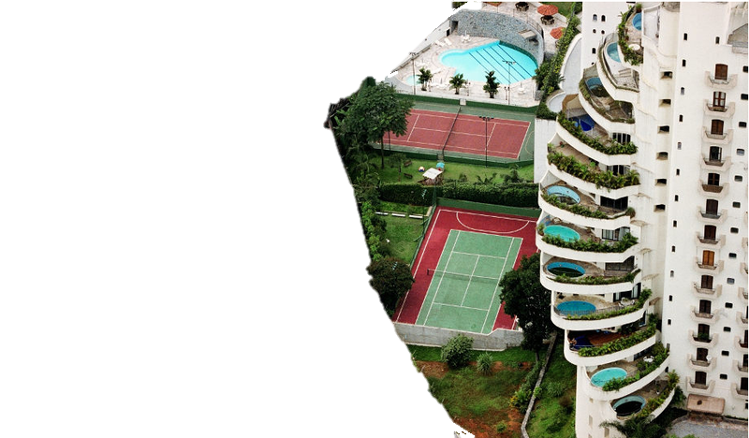
Starter
Half of this picture is missing- can you complete the picture by drawing what you think is on the other side?
© Luiz Arthur Leirão Vieira (Tuca Vieira)

Slide 3
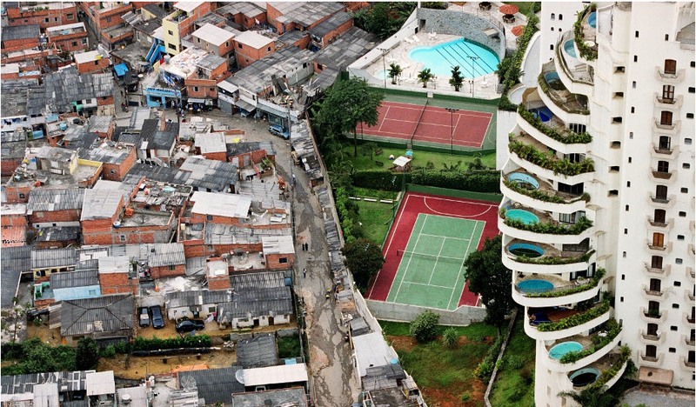
Starter
Is this what you expected to see?
Can you describe this picture and explain what you think has happened?
© Luiz Arthur Leirão Vieira (Tuca Vieira)

Slide 4
Why do over 16 million Brazilians live below the poverty line?
What is meant by the geographical term: poverty line?
People who do not have enough income (money) to afford essential resources such as food.
Usually seen as earning less than $1 (65p) a day.

Slide 5
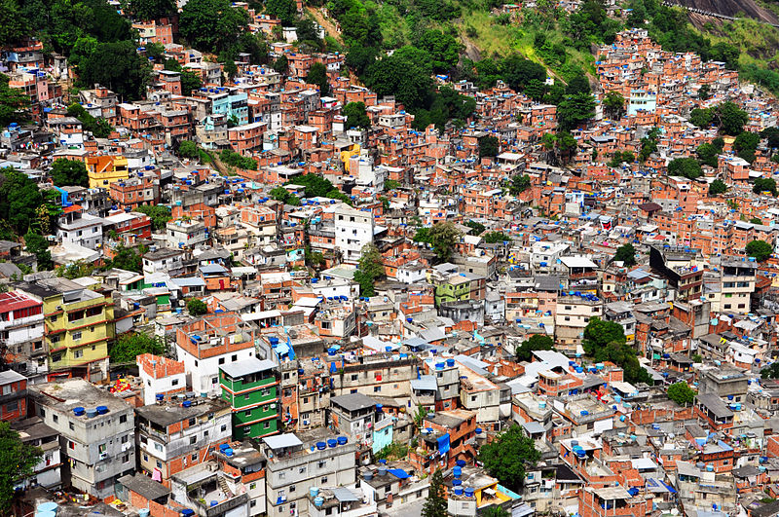
Comparison:
the rich and the poor
Watch the video clip about life in the Rochinha favela Rio De Janeiro.
Video:
Rochinha Life
Source: Wikipedia

Slide 6
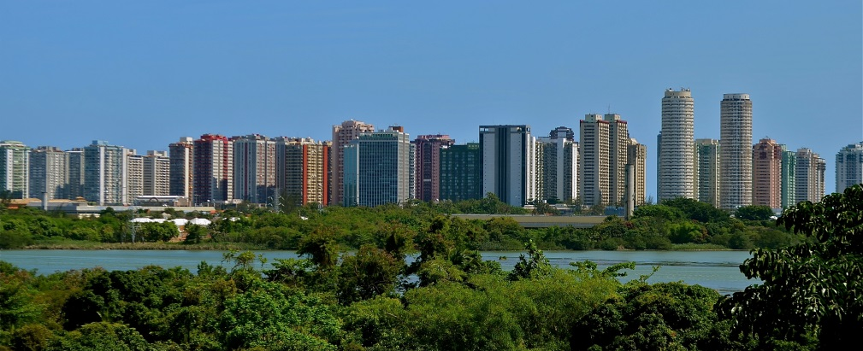
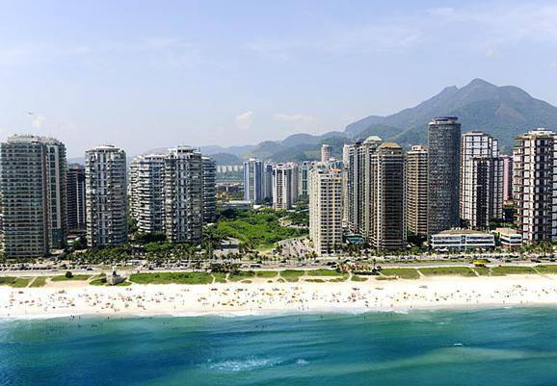
Comparison:
the rich and the poor
Source: Wikipedia
How do you think the lives of children living in Barra Di Tijuca differs to those living in Rochinha favela?
Source: rio.com

Slide 7
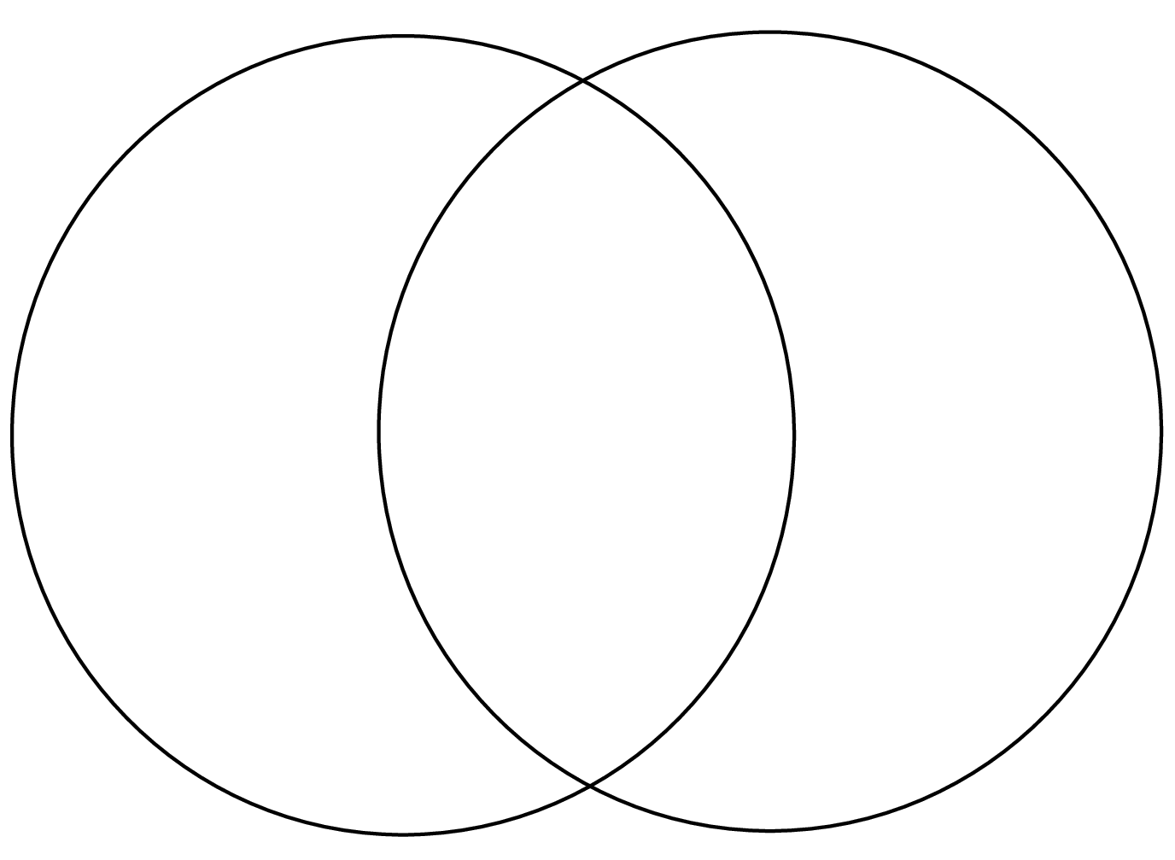
Comparison: the rich and the poor
Using your notes, create a venn diagram showing the similarities and differences between the lives of people living in Rochinha and Barra Di Tijuca.

Slide 8
Choose one/both of the tasks below:
Watch the BBC video again. Complete the table listing the positives and negatives the three characters feel about living in Rochina.
Pause the video at a scene showing the slum - sketch and then annotate to show what improvements could be made to the human geography of the setting.

Slide 9
Lesson four :
A city of two halves
CHALLENGE YOURSELF WITH THIS KAHOOT QUIZ I’VE MADE ESPECIALLY FOR
YOU TO REVIEW WHAT YOU’VE LEARNT SO FAR…
https://kahoot.it/challenge/04797010?challenge-id=cd7e3403-bb41-4861-9484-907bda2e6d52_1611752334071
Game pin: 04797010

Slide 10
Plenary
What have you learnt about the lives of young people living in Rio De Janeiro?
Is life always better for children who live in wealthy areas than those who live in the poorer areas?
How are the lives of the children you have learnt about similar/different to your own life?

