Slide 1


Day 3

Slide 2
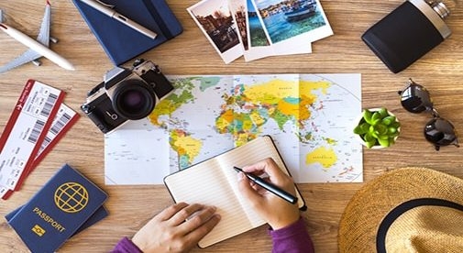
Travel Writing
Yesterday we studied two different introduction texts for entries of countries in The Travel Book.
What ‘Top Tips’ did we discover for writing these sort of introductions?
Strong vocabulary (adjectives)
lists
emphasising the positive

Slide 3

Travel Writing
Some vocabulary ideas for travel writing
breath-taking
jaw-dropping
leaving the modern world behind
chilled out
pampering
nothing but the sound of waves
stunning
dream
clear blue skies
mouth-watering delicacies
Vibrant
there’s something for everyone
friendly locals
colourful/bustling markets
rich in history
lapping waves
powder-white sand
piquant
vibrant, delicious and amazing
Christ the Redeemer
Sugarloaf Mountain
Iguazu Falls
Samba
coxinha de frango
awe-inspiring, dramatic

Slide 4
Travel Writing
Can we find any of these ‘Top Tips’ in the entry below?
What examples of strong vocabulary are in this writing?
Are there any lists?
Does it take a positive tone?
Could you make any improvements to these two sentences?
Germany Introduction
Germany boasts awe-inspiring castles, landmarks, festivals and natural wonders – not to mention 1,200 types of sausage.
It’s one of the most bewitching and forward-thinking countries in Europe and has a history – both modern and ancient – as dramatic and dynamic as its language.
Lonely Planet – The Travel Book (Kids) p75

Slide 5
Travel Writing
Can we find any of these ‘Top Tips’ in the entry below?
What examples of strong vocabulary are in this writing?
Germany Introduction
Germany boasts awe-inspiring castles, landmarks, festivals and natural wonders – not to mention 1,200 types of sausage.
It’s one of the most bewitching and forward-thinking countries in Europe and has a history – both modern and ancient – as dramatic and dynamic as its language.
Lonely Planet – The Travel Book (Kids) p75
Are there any lists?
Does it take a positive tone?
Could you make any improvements to these two sentences?

Slide 6
Travel Writing
Use your plan from yesterday to write your introduction for Brazil’s entry into The Travel Book.
L.O: I can draft and edit a persuasive piece of travel writing
S.C: I included the ‘Top Tips’ in my writing
I thought about the impact my writing has on the audience.
My writing makes the audience
  want to read the page
  want to travel to the country.
‘Top Tips’
Strong vocabulary
lists
emphasising the positive

Slide 7
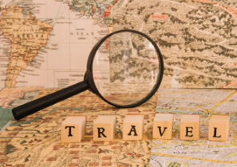
Travel Writing
To get you started…
List your top things to see with adjectives and/or the different physical landscapes of Brazil and describe where they are within Brazil
Brazil Introduction
Brazil boasts…
Or you could start
Blessed by a warm climate, Brazil…
Next you could talk about its language and food and music
It is the only country in South America to speak Portuguese and…
Now you could talk about the trade marks of the country and the positives it has to offer…
If you’re looking for a country full of culture and diversity then…
Are there any lists?
Does it take a positive tone?
Is there strong vocabulary (adjectives)?

Slide 8

L.O:To edit my work.
Top Tips
Give the edit your best polish!
Edit for success
1. Read for does it make sense___
2. Read for punctuation ___
3. Read for spelling ___
4. Read to improve___
Read it out loud.
Read it backwards.
I look forward to reading your work ☺

