Slide 1

Lesson three:
Urbanisation - The Great Tug of War
LO: I can use geographical knowledge to write a persuasive letter explaining why I want to leave the countryside and move to Brasilia.
Success criteria:
I can understand the key geographical terms ‘urban’ and ‘rural’;
I can demonstrate an understanding of ‘push/pull factors’ related to urbanisation;
I can use maps and digital/computer mapping to locate urban and rural areas and describe features;
I can compare urbanisation in Brazil to urbanisation in the UK.

Slide 2
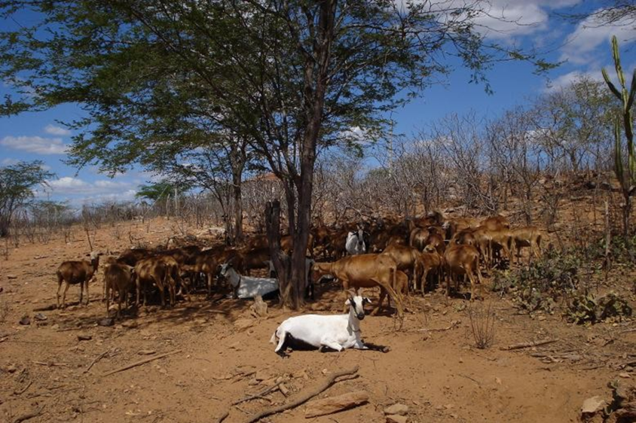
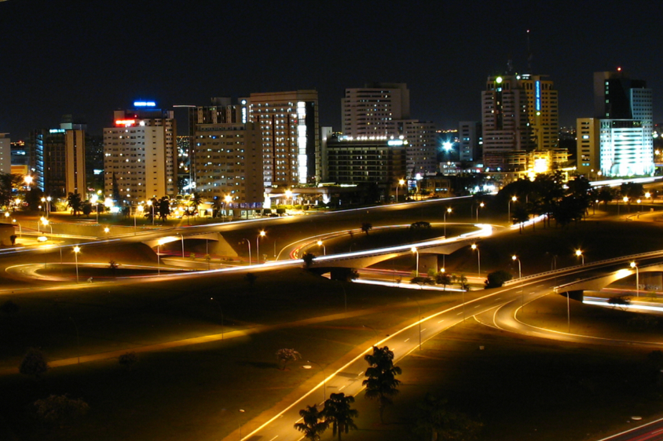
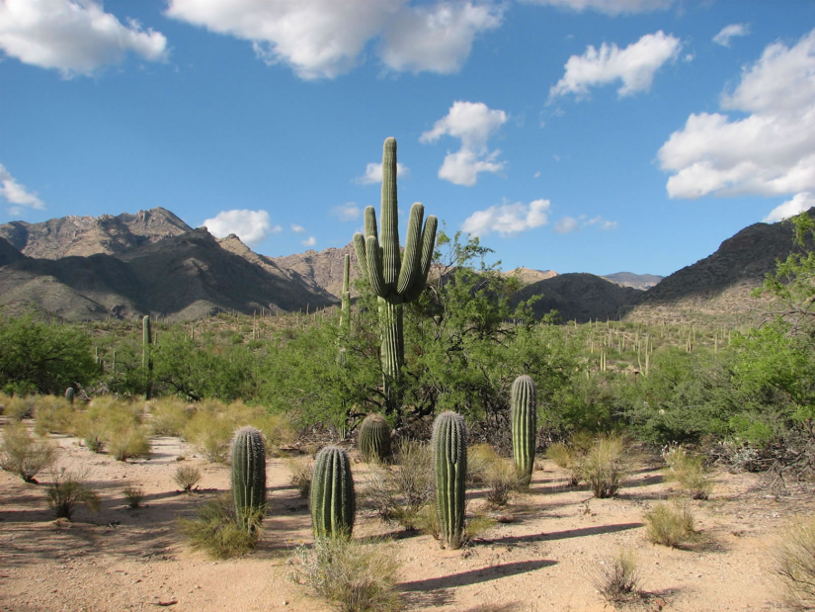
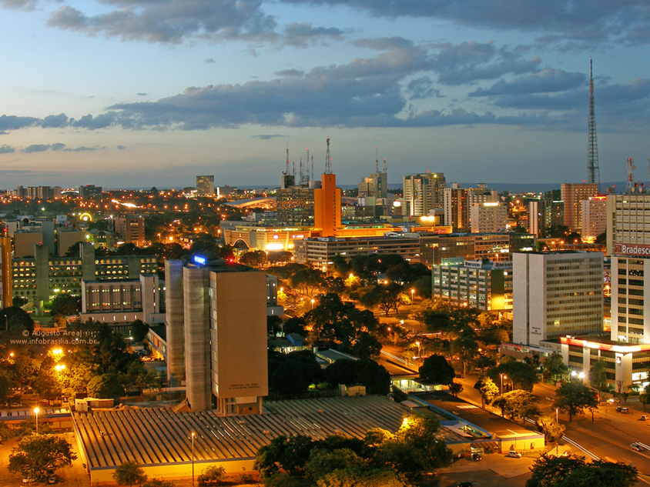
Where would you choose to live?
Source: ecologyintofocus.blogspot (Daniele Bragança)
Source: huffingtonpost.com
The Caatinga
Brasilia
Source: Andre Hirohara, pinterest
Source: brazilianbubble.com

Slide 3


Where would you choose to live?
Source: ecologyintofocus.blogspot (Daniele Bragança)
Source: huffingtonpost.com
You live in rural north of Brazil in The Caatinga. However many of your friends have moved to the urban south to the capital city, Brasilia.
Look back at the statements from our warm-up game and decide whether you want to live in The Caatinga or in Brasilia.

Slide 4
What is a push factor?
Push factors are the reasons why a person moves from a particular area. Very often this is due to factors such as:
Lack of services, safety, crime, crop failure, drought, flooding, poverty, war.

Slide 5
What is a pull factor?
Pull factors are the reasons why a person moves to a particular area. Very often this is due to factors such as:
Higher employment, increased wealth, better services, good climate, more fertile land, lower risk from natural hazards.
Go to the BBC website to learn more:
https://www.bbc.co.uk/bitesize/clips/zsgxfg8

Slide 6
Push/Pull factors:
a definition
Using your knowledge and understanding of a push and pull factor write a definition using your own words on the post it note

Slide 7

Your Task
Imagine that you live in The Caatinga. Write a letter to your friend explaining why you want to move away from your village (push factor) and move to Brasilia (pull factor).

Slide 8
Extension
There are lots of push and pull factors causing people to move away from the rural north. Could there be any reasons that may stop a person from moving?

Slide 9
Let’s evaluate
Once you’ve finished, re-read your letter and evaluate it using the self assessment form.

Slide 10
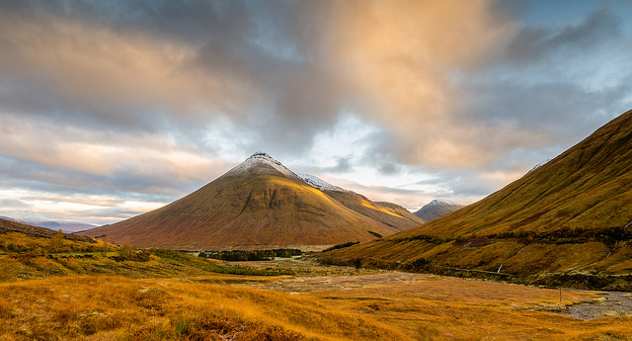



Plenary: compare Brasilia and London
Highlands © Jonathan Combe, Flickr
What are the push and pull factors to a city like London from rural parts of the UK?
How are these similar/different to Brasilia?
London © Barnyz, Flickr
Source: Andre Hirohara, pinterest
Source: brazilianbubble.com

