Slide 1
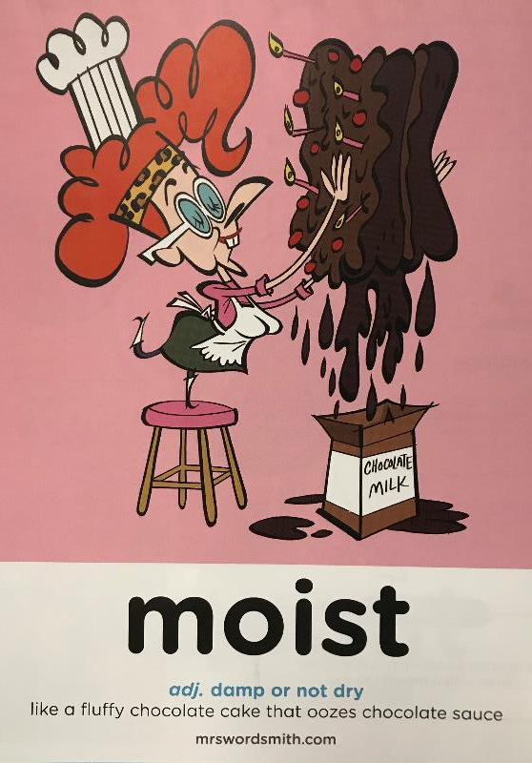

Day 2

Slide 2

pb
Features or Ingredients
facts
physical features of the country e.g. mountains etc
descriptions- adjectives
strong verbs
Travel Writing
Purpose
language
Make the reader want to finish reading the piece of writing
Make the reader want to go to the country
positive writing
food
modal verbs
e.g. will/should not
lists
present tense
pictures
best time to visit
Magpied Vocabulary
Magpied Vocabulary Specific to country
staggering
magnificent
dramatic
otherworldly
treacherous
beauty abundant
authentic
unique
cultural
earthquakes
volcanic
glacier
geothermal
National Reserve
migration
safari
grassland

Slide 3

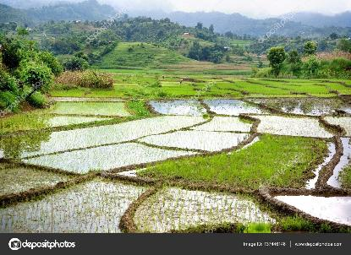

Travel Writing
Speed words
sacred | coveted | vast | unfathomable
endures | serenity | sultry | kaleidoscope
adjective: sacred
connected with God or a god or dedicated to a religious purpose and so deserving veneration.
Paddy fields
adjective: coveted
greatly desired or envied.
adjective: vast;
of very great extent or quantity; immense.
adjective: unfathomable
incapable of being fully explored or understood.
verb : endures
suffer (something painful or difficult) patiently.
adjective: sultry
(of the air or weather) hot and humid.
noun: kaleidoscope
a toy consisting of a tube containing mirrors and pieces of coloured glass or paper, whose reflections produce changing patterns when the tube is rotated.
a constantly changing pattern or sequence of elements.
noun: serenity
the state of being calm, peaceful, and untroubled.

Slide 4
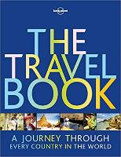
Travel Writing
This piece of writing introduces the page about India in The Travel Book and that it has two jobs:
To make you want to read the page
To make you want to travel to the country.
India Introduction
Crowned by the Himalaya, crossed by sacred rivers, coveted by empires from the Persians to the British Raj, India is vast and unfathomable, a kaleidoscope of cultures and the birthplace of at least two of the world's great religions.
Countless civilisations have risen and fallen among the paddy fields, deserts and jungles, but India still endures.
Asia's most colourful country has its problems - overcrowding, poverty, religious tensions and grinding bureaucracy are daily challenges, but locals take it all as part of the tapestry of life in this chaotic, colourful and unbelievably complex country.
Besides, for every rush-hour crush, there is a moment of utter serenity - dawn breaking over a sacred pool, a tiger breaking cover in a sultry jungle clearing, or a monk chanting to the music of the spheres.
Lonely Planet – The Travel Book p181

Slide 5
Travel Writing
India Introduction
Crowned by the Himalaya, crossed by sacred rivers, coveted by empires from the Persians to the British Raj, India is vast and unfathomable, a kaleidoscope of cultures and the birthplace of at least two of the world's great religions.
Countless civilisations have risen and fallen among the paddy fields, deserts and jungles, but India still endures.
Asia's most colourful country has its problems - overcrowding, poverty, religious tensions and grinding bureaucracy are daily challenges, but locals take it all as part of the tapestry of life in this chaotic, colourful and unbelievably complex country.
Besides, for every rush-hour crush, there is a moment of utter serenity - dawn breaking over a sacred pool, a tiger breaking cover in a sultry jungle clearing, or a monk chanting to the music of the spheres.
Lonely Planet – The Travel Book p181
use of lists to pack in information about the country
emphasis on the positive
There’s a lot of information and imagery in just four sentences

Slide 6
Travel Writing
This piece of writing introduces the page about Sri Lanka in The Travel Book.
Can you identify the features we looked at in the India entry?
Lists that tell you more about what the country has to offer.
A positive about a difficulty the country has.
Great descriptive language.
Sri Lanka Introduction
Blessed by the sun, buffeted by the spice-scented trade winds of the Indian Ocean, and scarred by civil war, Sri Lanka is slowly rebuilding its reputation as the southern gateway to South Asia.
While investigations continue into the bloody final years of the conflict, ordinary Sri Lankans are looking to a new future of peace and prosperity, in which returning tourists will play a major role.
The attractions of this land of sand and cinnamon are the same as they ever were - blissful beaches and barrelling surf breaks, Buddhist stupas, ruined kingdoms, wild elephants, lofty lookouts, graceful tea plantations in the hills and some of the most monumental religious sculptures the world has ever seen.
Now picture all this crammed into a compact tropical island that swims with the flavours, smells and sounds of the Indian subcontinent.
Lonely Planet – The Travel Book p371

Slide 7
Travel Writing
use of lists to pack in information about the country
Sri Lanka Introduction
Blessed by the sun, buffeted by the spice-scented trade winds of the Indian Ocean, and scarred by civil war, Sri Lanka is slowly rebuilding its reputation as the southern gateway to South Asia.
While investigations continue into the bloody final years of the conflict, ordinary Sri Lankans are looking to a new future of peace and prosperity, in which returning tourists will play a major role.
The attractions of this land of sand and cinnamon are the same as they ever were - blissful beaches and barrelling surf breaks, Buddhist stupas, ruined kingdoms, wild elephants, lofty lookouts, graceful tea plantations in the hills and some of the most monumental religious sculptures the world has ever seen.
Now picture all this crammed into a compact tropical island that swims with the flavours, smells and sounds of the Indian subcontinent.
Lonely Planet – The Travel Book p371
emphasis on the positive
There’s a lot of information and imagery in just four sentences

Slide 8
Travel Writing
L.O: I can research information for a persuasive piece of travel writing
You will now research information on Brazil for Brazil’s entry into The Travel Book.
Collect information on Brazil by looking at :
Brazil Facts for Kids | Brazil Attractions | Geography | Food | People (kids-world-travel-guide.com)
Enter your information in the Brazil Research Grid or record the information on your own piece of paper.
You will then use this information tomorrow. Do not write it yet!

Slide 9
Travel Writing
Some vocabulary ideas for travel writing
breath-taking
jaw-dropping
leaving the modern world behind
chilled out
pampering
nothing but the sound of waves
bygone era
stunning
dream
clear blue skies
cobbed streets
mouth-watering delicacies
smiling staff
romantic
vibrant
azure
hearty
rustic
there’s something for everyone
friendly locals
colourful/bustling markets
rich in history
quirky
lively nightlife
panoramic views
off the beaten track
priceless treasures
tranquillity
paradise
lapping waves
powder-white sand
piquant

