Slide 1


Slide 2




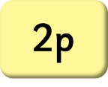



How Much Money Is in My Piggy Bank?

Slide 3
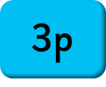
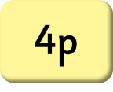

How Much Money Is in My Piggy Bank?

Slide 4

How Much Money Is in My Piggy Bank?

Slide 5
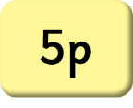

How Much Money Is in My Piggy Bank?

Slide 6
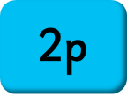
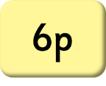


How Much Money Is in My Piggy Bank?

Slide 7


How Much Money Is in My Piggy Bank?

Slide 8


How Much Money Is in My Piggy Bank?

Slide 9
How Much Money Is in My Piggy Bank?

Slide 10


How Much Money Is in My Piggy Bank?

Slide 11

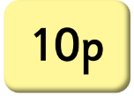

How Much Money Is in My Piggy Bank?

Slide 12
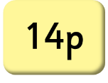
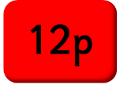
How Much Money Is in My Piggy Bank?

Slide 13

How Much Money Is in My Piggy Bank?
12p
16p
14p

Slide 14


