Slide 1
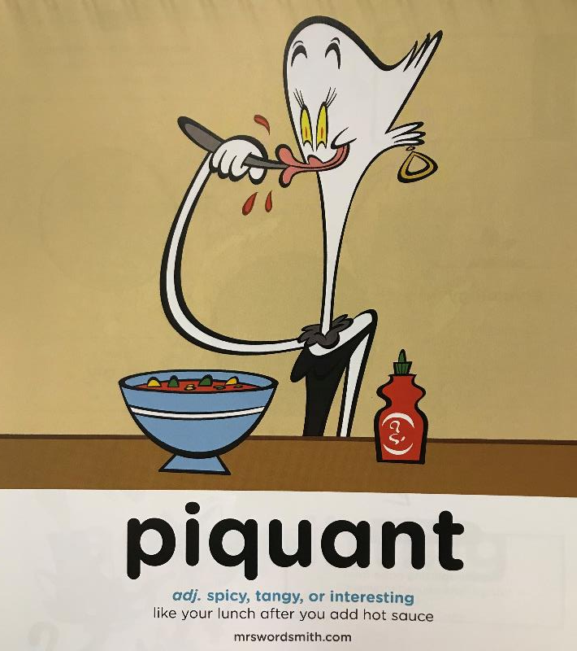

Day 1

Slide 2
I made a journey to Tyre in Phoenicia, hearing there was a temple of Hercules at that place, very highly venerated. I visited the temple, and found it richly adorned with a number of offerings, among which two pillars, one of pure gold, and the other of emerald, were shining with great brilliancy at night.
Herodotus – 440 BCE
When I woke up the next morning the ship’s engines had stopped. I jumped out of my bunk and peered through the port-hole. This was my first glimpse of Dar es Salaam and I have never forgotten it.
Roald Dahl – 1986
We had not climbed far before we were stopped by a sudden burst of prospect, so singular and beautiful that it was like a flash of images from another world.
Dorothy Wordsworth - 1874
As, half-way through the delicious scrambled eggs and bacon, a confiding butterfly, black and cream and dark-blue, settled on my wrist, I reflected that heaven could wait. Here, on the green and scarcely inhabited slopes of Shek-O, was good enough.
Ian Fleming – 1963
What do you know about any of the authors of these quotes?
What is in common between these quotes?

Slide 3
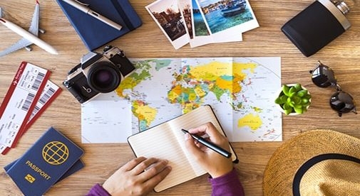
Travel Writing

Slide 4

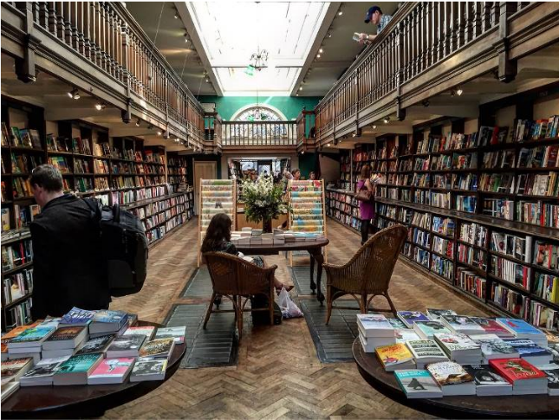
Travel Writing
Millions of travel books are sold every year. There are entire bookshops that specialise just in travel books. Nowadays publishers put travel writing in books and publish it on the web and in apps as well.
Daunt Books in London
© Original plan copyright Hamilton Trust, who give permission for it to be adapted as wished by individual users.

Slide 5
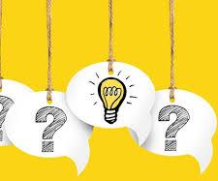
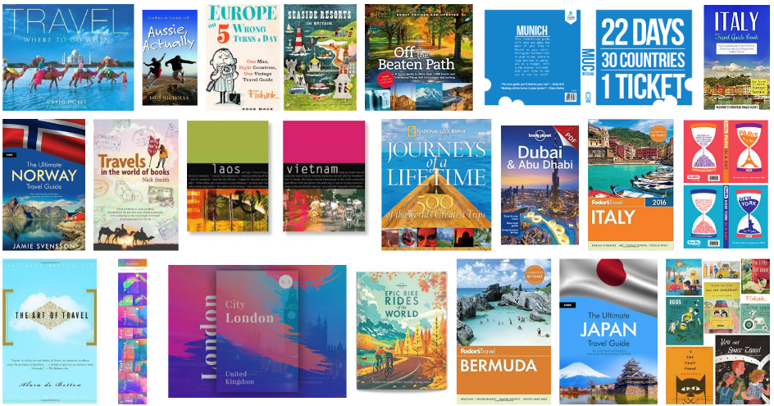
Travel Writing
What might we expect to find in these books?
What information might there be?
What pictures or diagrams?
What style of writing?
© Original plan copyright Hamilton Trust, who give permission for it to be adapted as wished by individual users.

Slide 6
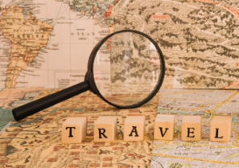

Travel Writing
L.O:To identify some features of travel writing
What might we expect to find in these books?
What information might there be?
What pictures or diagrams?
What style of writing? Tense? Person? Formal or informal?
Make a list of the features that you expect to find
Identify the purpose of the writing
Magpie some vocabulary that could be used in any travel text
Magpie country specific vocabulary
© Original plan copyright Hamilton Trust, who give permission for it to be adapted as wished by individual users.

