Slide 1
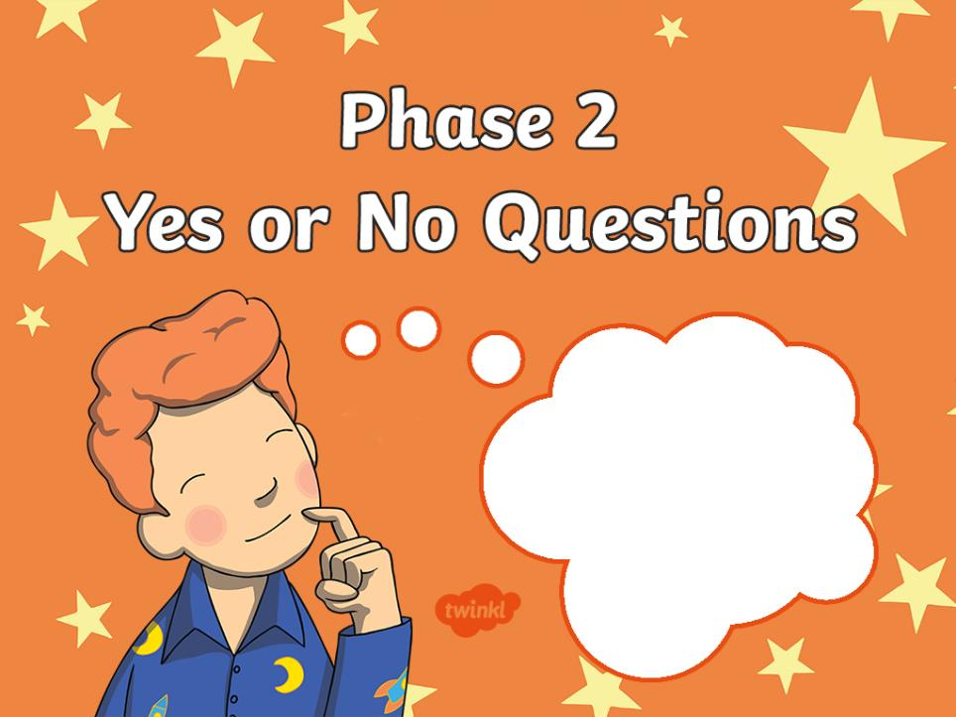


Slide 2

Has a hill got a top?
NEXT
YES
NO

Slide 3

Has a rocket got a tip?
YES
NO

Slide 4
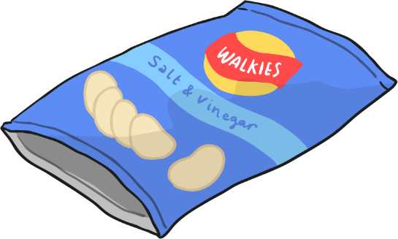
Can a packet get a lip?
YES
NO

Slide 5
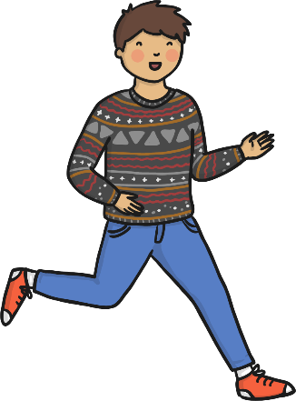

Can a man kiss a dog?
YES
NO

Slide 6


Can a dog get in a bag?
YES
NO

Slide 7
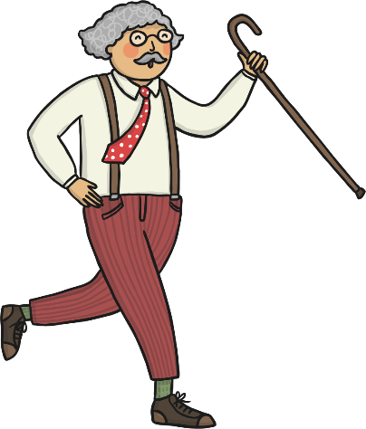
Can a man huff and puff?
YES
NO

Slide 8
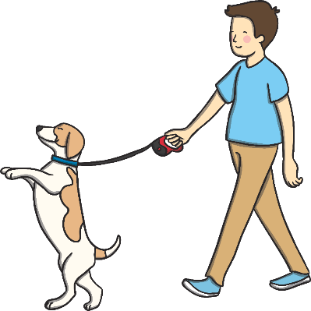

Can a dog beg?
YES
NO

Slide 9
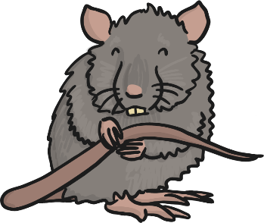

Can a rat get a ball?
YES
NO

Slide 10


Can a ball roll off a mat?
YES
NO

Slide 11

Can a pan get hot?
YES
NO

Slide 12
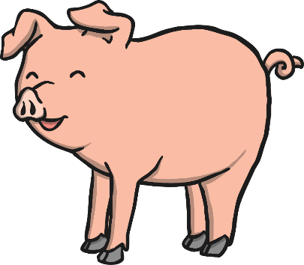
Can a pig hop?
YES
NO

Slide 13


Is a rock a pet?
YES
NO

Slide 14
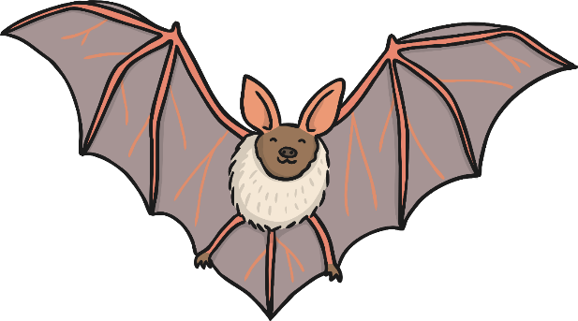
Can a bat run?
YES
NO

Slide 15

Will a dog run?
YES
NO

Slide 16


Will a bug sit in a pot?
YES
NO

Slide 17
WELL DONE!
You completed the Phase 2
Yes or No Quiz!

