Slide 1

Lesson one:
Where in the world am I?
LO: I can use research skills to identify key features of a place in the world
Success criteria:
I can research to find out the answers to set questions;
I can identify key features of a place and what information to share with others;
I can identify the differences between human and physical features.

Slide 2
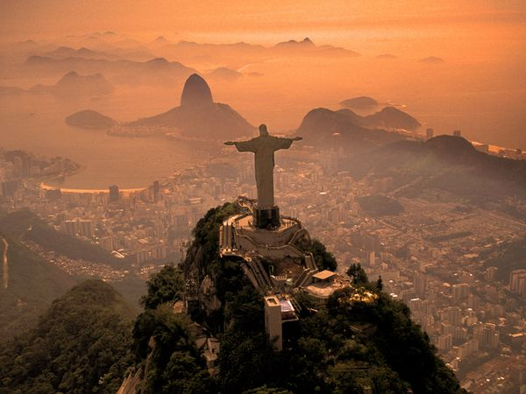
?
Source: Christian Heeb, National Geographic

Slide 3
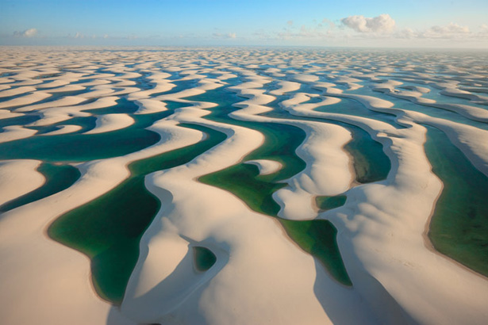
?
Source: George Steinmetz, National Geographic

Slide 4
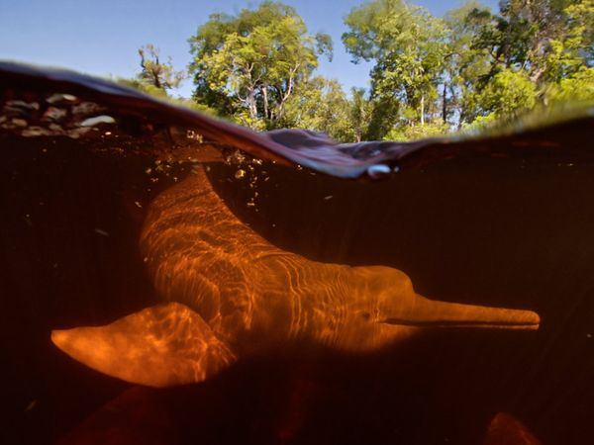
?
Source: Kevin Schafer, National Geographic

Slide 5
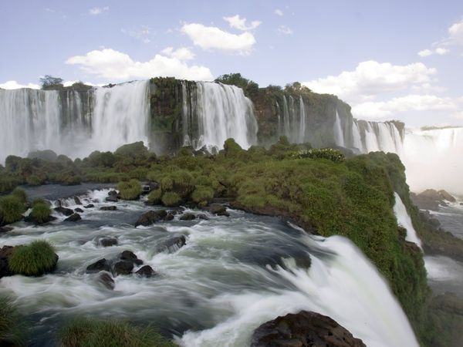
?
Source: Sharmy Francis National Geographic

Slide 6
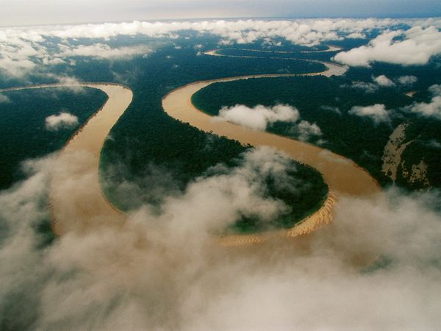
?
Source: National Geographic

Slide 7
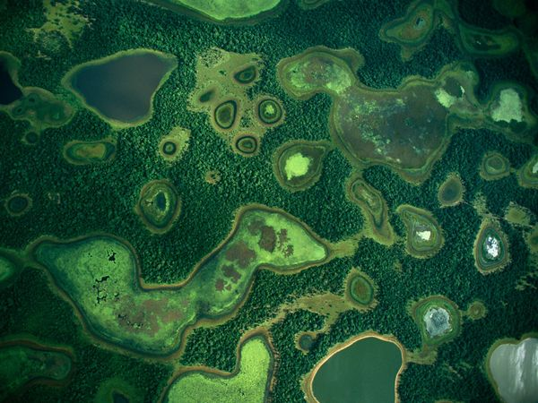
?
Source: Joel Sartore, National Geographic

Slide 8
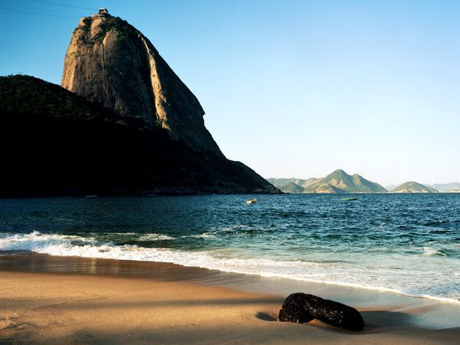
?
Source: National Geographic

Slide 9
Watch a tourism video on Brazil…
Where do you think this is?
What do you think it is like there? Watch the video in the video resource area in our class pages…
http://vimeo.com/13653677

Slide 10

Where is Brazil?
Using Google Earth or an atlas to locate Brazil

Slide 11
Research for our class working wall
Stage 1(5 min) – Choose one or two of the four task cards (on the next slides) that you would like to focus on
Stage 2 (15 mins to research) – Google Earth/internet research on each of your chosen task areas.
Stage 3 (15 min) – create an A4 landscape poster - by hand or on the computer - for each task card for our class working wall
Stage 4 – Check the poster information is correct, includes key geographical terms…and submit to school.

Slide 12
The rivers and mountains of Brazil
The longest river in South America is located in Brazil. This is called the Amazon River. The Amazon River is 6516km in length.
Brazil has impressive mountain ranges. The Serra do Espinhaço mountain range covers the largest area. The Tumucumaque, Imeri and Pacaraima mountain ranges have the highest peaks.
Using an atlas or Google Earth, draw the Amazon River and mountains onto your blank map of South America/Brazil and add a key explaining its key features.
Remember that you are feeding this information back to other researchers for our class work wall.

Slide 13
The cities of Brazil: Can you locate the cities and oceans?
The capital city of Brazil is Brasilia with a population of approximately 2.5million.
Using Google Earth or an atlas, can you locate the following cities on your map of Brazil? Brasilia, Rio de Janeiro, Sao Paulo, Salvador and Manaus.
Can you find out the name of the ocean bordering Brazil’s coastline?
Lots of cities in Brazil are located by the coast, what do you think is the reason for this?
Remember that you are feeding this information back to other researchers for our class work wall.

Slide 14
The location of Brazil: How good are your map skills?
Brazil is located in South America.
It is bordered by 10 countries.
Using Google Earth or an atlas can you try to locate the 10 countries that border Brazil and write them on your map of South America?
Remember that you are feeding this information back to other researchers for our class work wall.

Slide 15
The geographical regions of Brazil
There are six major ecosystems in Brazil known as:
Tropical rainforest (Amazonia), The Cerrado (tropical savannah grasslands), The Pantanal (wetlands), The Pampas (grasslands), The Caatinga (semi-arid forest), The Mata Atlantica (coastal forest).
Using the map and information sheet, locate the different ecosystems found in Brazil.
Remember that you are feeding this information back to other researchers for our class work wall.

Slide 16
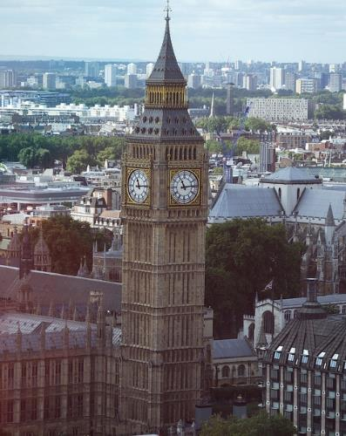
Human or physical?
Big Ben, London, England
Big Ben © James Cullen, Flickr
Notes:
https://www.flickr.com/photos/27043160@N04/14999727242/in/photolist-oRtwjW-oRvpfz-oz1D44-oz2vTZ-4Ep8Kc-pvMnLs-8tT41f-s7pbty-cLQtim-jEmKUg-6PPvDP-3bjUF-o1MVNj-f6CjE8-94qxwn-8U4NK-dyxGMs-aoCwsD-bBm9EX-orDDRL-fQoBW3-35h2yF-4RWcjQ-fD24Nz-bK5WDF-borehE-cJ79fW-6bgX6z-B4inX-qpv9dZ-DVFKV-fAHckk-7xpoVD-49xq7b-bmJM1R-okrkEd-okrmcf-o3YqT7-o3Ys3G-o3YDmx-9HNJTf-3rQDaG-8SMyWz-8dgS7X-boDdJH-sv6M9-hXT3vY-8z5wEU-8z5vmY-nWXUQv

Slide 17
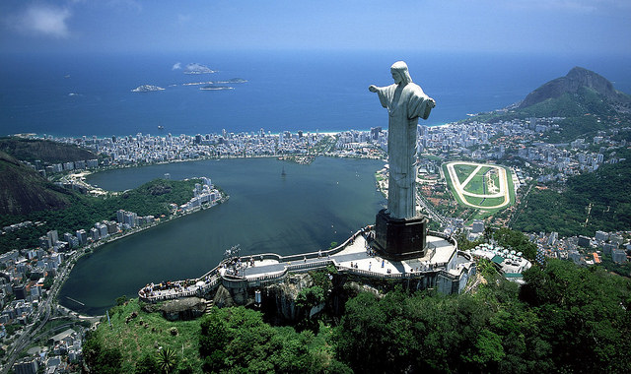
Human or physical?
Christ the Redeemer statue Rio de Janeiro, Brazil
Christ the Redeemer ©
Sam Valadi, Flickr
Notes:
https://www.flickr.com/photos/132084522@N05/16757549024/in/photolist-rwNPv3-21fg2-fD1eMB-kxT9z-6FvGrH-ds2uqT-5RrkXz-5RvDaq-qDp9pJ-5RvC2C-a7zSu-5RvEzu-5RriPt-5RvEJC-5RvC6E-5RrifZ-5RrkNz-oKxHAp-5Rrmta-5RvEi7-5RvCkN-6oYNYn-8GTBtd-5Rv9TJ-5RvCho-5Rrkxg-5RrmbP-5RvEFY-5Rrjst-5RrkUe-5RrkRn-5RvCVN-5Rrmwe-5Rrjii-5RvED5-5RvF5o-5RvFpW-5RvFid-5RvFeh-5Rrjft-5RvEYw-5RvDmL-5RvF2N-8GTDry-8GQtbr-87gP8F-5RvDwo-5RvCNQ-5RvCZG-5RrktK

Slide 18
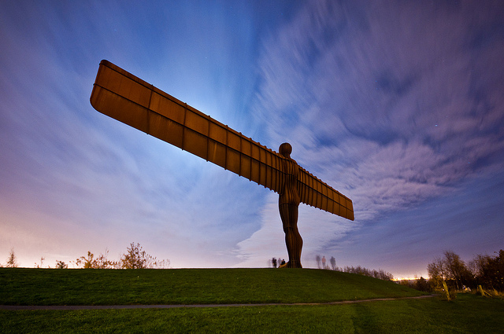
Human or physical?
The Angel of the North
England
The Angel © Vaidotas Mišeikis, Flickr

Slide 19
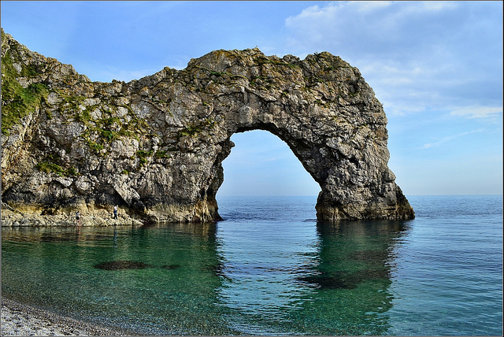
Human or physical?
The Jurassic Coast
Dorset, England
Durdle Door © Robert Pittman, Flickr

Slide 20
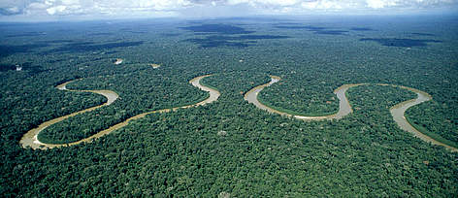
Human or physical?
The Amazon Rainforest
South America
Source: Animal Blawg, Encyclopedia Britannica

Slide 21
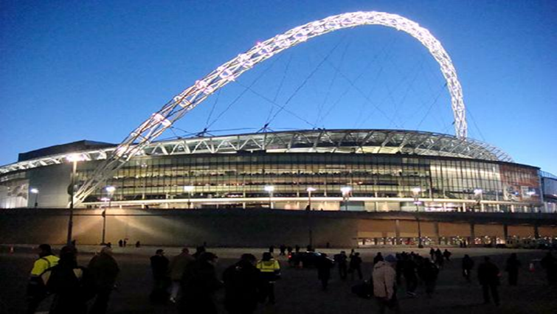
Human or physical?
Wembley Stadium
London, England
Source: theatresonline.com

Slide 22
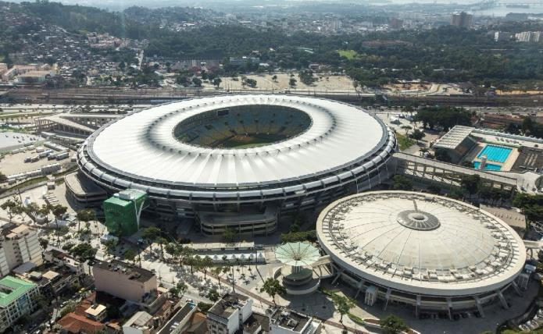
Human or physical?
The Maracana Stadium
Brazil, South America
Source: Wikipedia

Slide 23
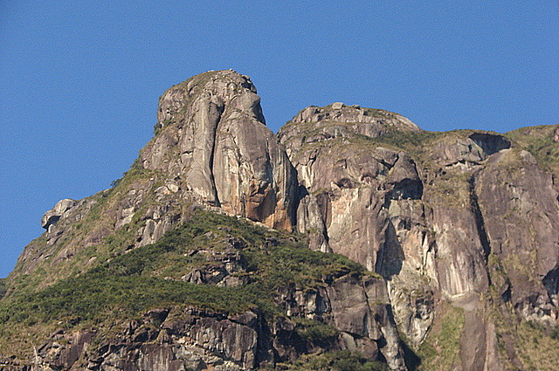
Human or physical?
Serra do Mar, Brazil
Serra do Mar / Mountain Range of the Sea © Márcio Cabral de Moura, Flickr

Slide 24
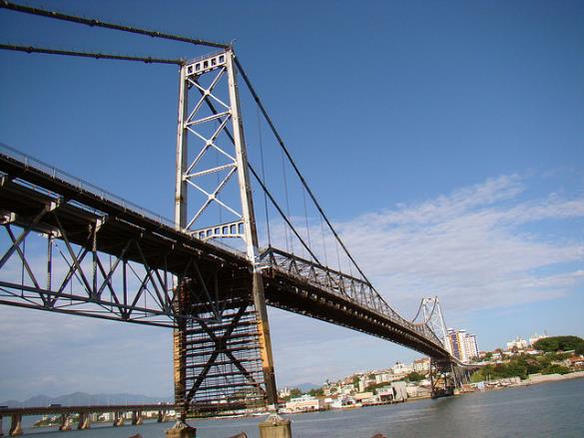
Human or physical?
Hercilio Luz Bridge
Brazil, South America
Ponte Hercílio Luz © Rodrigo Soldon, Flickr

Slide 25
Write a dictionary definition with examples for:
A human feature:
A physical feature:

Slide 26
Definitions:
A human feature:
A man-made feature in the environment. For example: buildings, bridges, tunnels, railroad tracks, dams, monuments, piers, cultivated land.
A physical feature:
Natural landforms and bodies of water. For example: cliffs, rivers, waterfalls, caves, mountains.

Slide 27
What is the difference between a human and a physical feature?
Look at the last few slides explaining ‘Human and Physical Features’
Write a definition of each and note down examples.
Remember that you are feeding this information back to other researchers for our class work wall.

Slide 28

What do you know about Brazil?
What else would you like to find out about Brazil?
Fill in the post it note for our working wall…

