Slide 1







Phase 3
Yes or No Questions

Slide 2

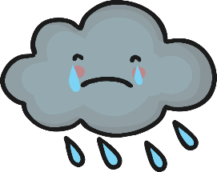




Slide 3



Slide 4




Slide 5



Slide 6



Slide 7

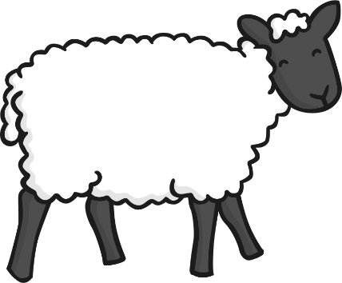

Slide 8

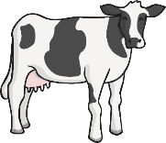


Slide 9



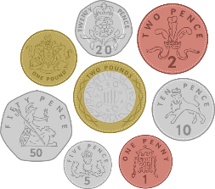


Slide 10
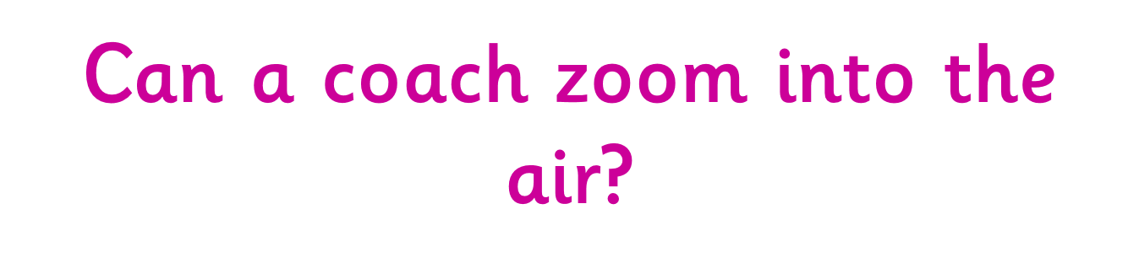





Slide 11



Slide 12



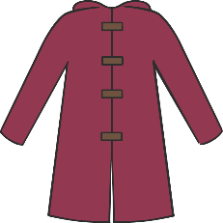

Slide 13


Well Done!
You completed the Phase 3 Yes or No Quiz!

