Slide 1


Slide 2
Aim
I can ask and answer questions in French.
I can take part in role play, speaking in French.
Success Criteria
I can greet and respond.
I can ask the question ‘C’est combien …?’ (regarding items in a shop)
I can answer the question, using the phrase ‘C’est …euros’
  https://www.youtube.com/watch?v=s63adSjywus

Slide 3

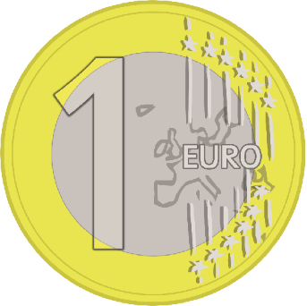
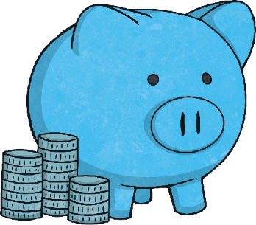
French Money
In France, the currency is the Euro.

Slide 4

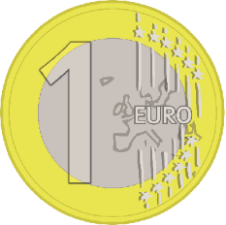
French Money
= 1 centime
1 €

Slide 5
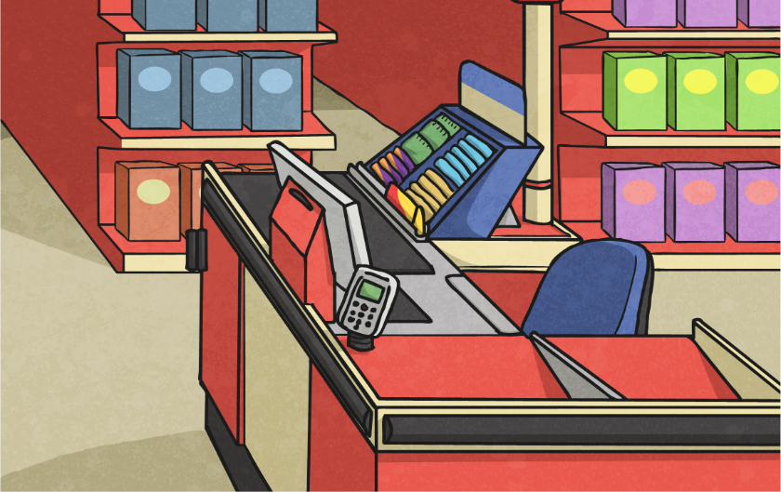








French Money
These are the different coins:
un centime
deux centimes
cinq centimes
un euro
dix centime
vingt centimes
cinquante
centimes
deux euros

Slide 6

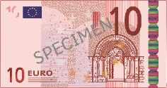
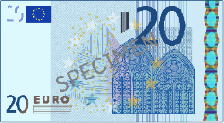
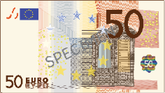
French Money
Here are the most common Euro notes:
5 Euros
10 Euros
20 Euros
50 Euros

Slide 7
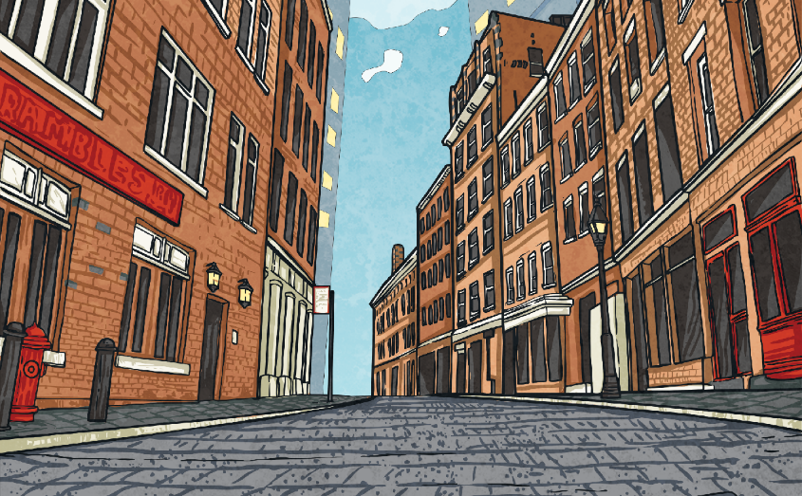




French Money
Money Match
When a money amount is written, the Euro amount is separated with a comma. So 2 Euros and 20 cents would be written as: 2,20 €
This money amount could be
paid with the following:
9,30 €

Slide 8
French Money
Use the replica Euro coins/notes, to make
the following amounts:
6,10 €
7,25 €
21,05 €

Slide 9







C’est combien ?
How Much is That?
Click play buttons throughout to hear phrases and words.
There are 2 ways this could be said:
2,30 €
C’est deux euros trente.
or
C’est deux euros
et trente centimes.
For the rest of this lesson we will use the first way.

Slide 10
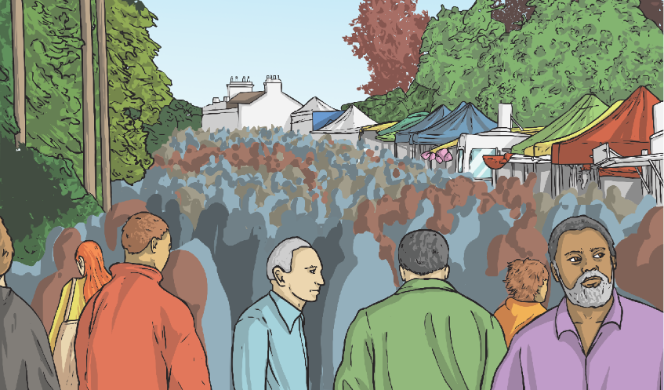
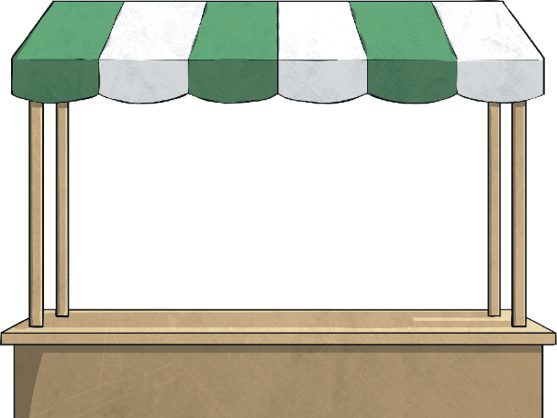





C’est combien ?
How Much is That?
C’est un euro quinze.
C’est trente euros cinq.
C’est neuf euros dix.
1,15 €
9,10 €
30,05 €

Slide 11


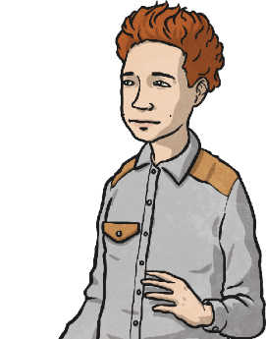




Allons aux magasins !
Let’s Go to the Shops!
Pretend you are going to the shops. You buy an item and give the money shown. The shopkeeper gives you your change.
3,50 €
un gâteau
C’est combien ?
C’est trois euros
cinquante.
Voici cinq euros.
Voici votre monnaie:
un euro cinquante.

Slide 12



Allons aux magasins !
Let’s Go to the Shops!
Pretend you are going to the shops. You buy an item and give the money shown. The shopkeeper gives you your change.
3,50 €
un ballon de football
C’est combien ?
C’est trois euros
cinquante.
Voici cinq euros.
Voici votre monnaie:
un euro cinquante.

Slide 13
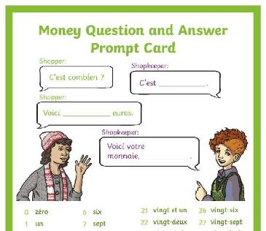
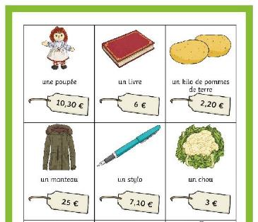
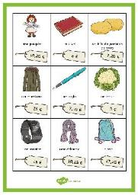
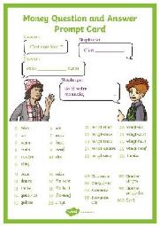
Allons aux magasins !
Let’s Go to the Shops!
Now take it in turns to be the shopper/shopkeeper. Take a Shopping Item Card and use money to pay. Use the Money Question and Answer Prompt Sheet to help your conversation

Slide 14
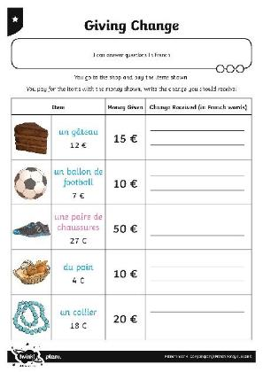


Allez-y !

Slide 15

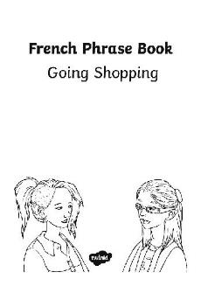
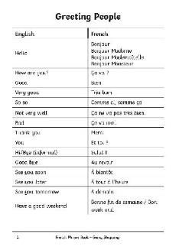
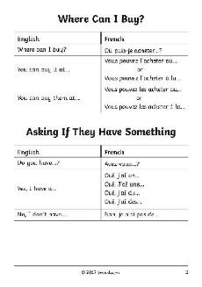
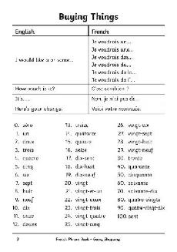
Allez-y !
Now you are ready to go shopping! Pretend to be first the shopkeeper then the shopper - use your phrase book to help you.

Slide 16
Aim
I can ask and answer questions in French.
I can take part in role play, speaking in French.
Success Criteria
I can greet and respond.
I can ask the question ‘C’est combien …?’ (regarding items in a shop)
I can answer the question, using the phrase ‘C’est …euros’

Slide 17


