Slide 1
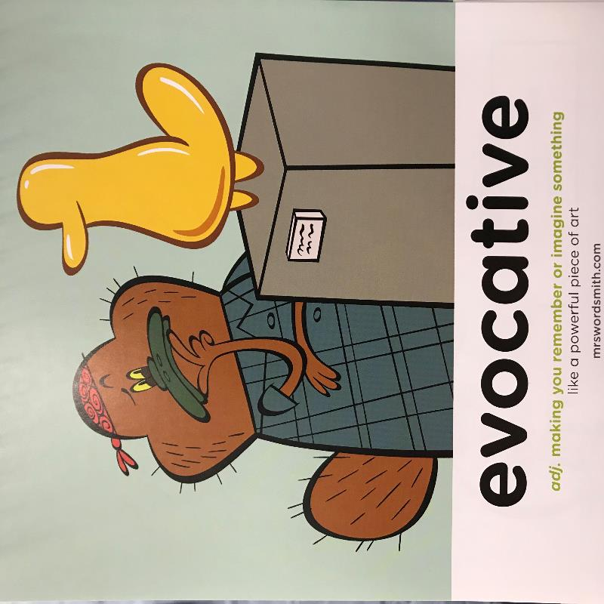

Week 3 Day 3

Slide 2

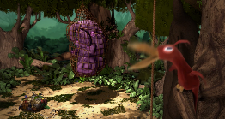
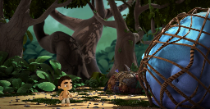
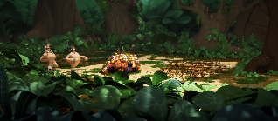
7 Plot Beats
Tuesday
The chameleon decides he will help Toki collect animals. Their adventure through the forest collecting the animals on their journey.
4. Plan
1.35- 3.04
Toki, the animals and the chameleon are caught. The tribe are alerted by the bird.
5. Battle
The dilemma…
Use your ideas from last week but as a start. Improve them and make sure they match with your current writing.
3.04-3.54
Write up to the point where the tribe find the empty clearing.

Slide 3
1.Magpie
2.Structure
3.Imagination
“Good artists copy, great artists steal.” Picasso
7 Plot Beats
1. Problem
2. Desire
3. Opponent
4. Plan
5. Battle
6. Knowledge
7. New level
Monday
Tuesday
Wednesday

Slide 4
L.O: I can write a story for the last two Plot Beats for the story ‘Ride of Passage’.
S.C:
Use texts to magpie and edit to suit your scene.
Use a range of adjectives /similes to describe the setting, characters and emotions.
Include a moral for the story.

Slide 5
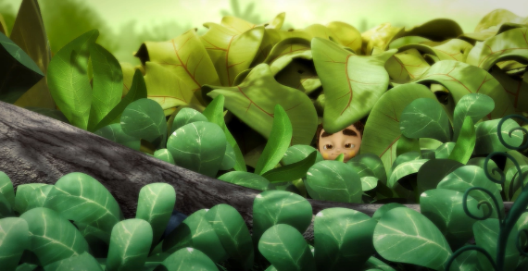
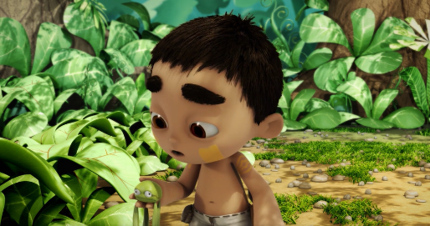
7 Plot Beats
Wednesday
6. Knowledge
3.55-4.11
As Toki looks at the tribe in clearing he realises…
He places the frog down…
7. New level

Slide 6
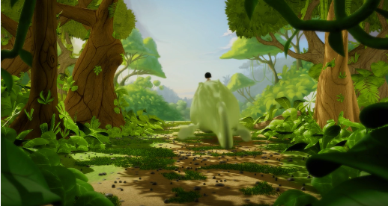
7 Plot Beats
Wednesday
6. Knowledge
7. New level
4.11- end
Friendship with the chameleon is more important than the tribe and how important he is in the tribe.
They ride off into the sunset…

Slide 7
End lines:
‘She felt her eyelids closing. She began to drift over endless waves of prairie grasses, and Pa’s voice went with her, singing.’
Little House on the Prairie by Laura Ingalls Wilder
‘Oh, there would be difficulties, hundreds of them. But she would cope. She gathered up the letter and box, and left for the train.’
The Ruby in the Smoke by Philip Pullman
‘So Lyra and her daemon turned away from the world they were born in, and looked towards the sun, and walked into the sky.’
Northern Lights by Philip Pullman
‘And together they walked back through the gateway to the Muggle world.’
Harry Potter and the Chamber of Secrets by J.K.Rowling

Slide 8
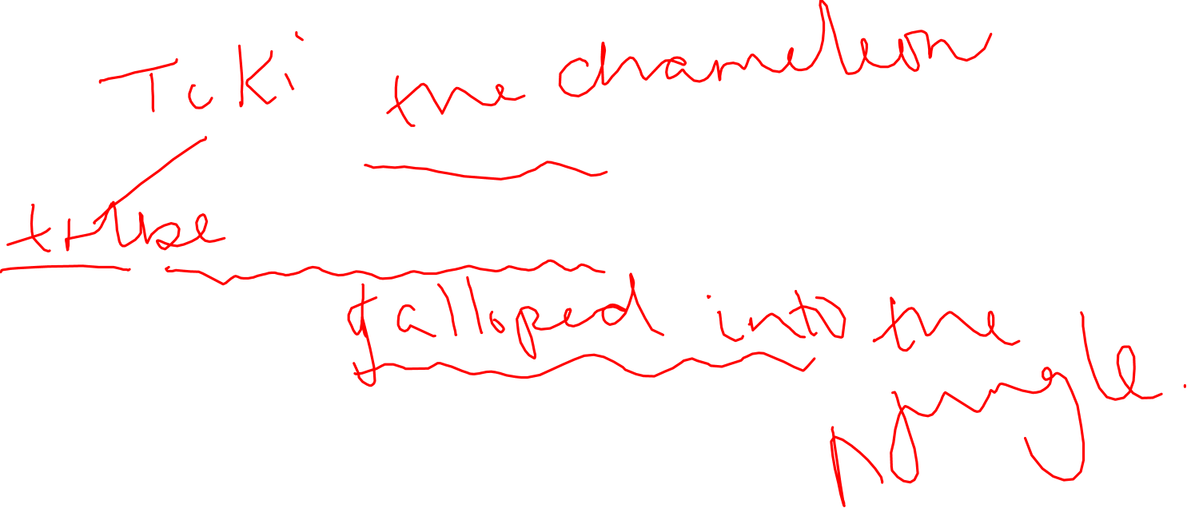
7 Plot Beats
7. New level
‘So Lyra and her daemon turned away from the world they were born in, and looked towards the sun, and walked into the sky.’
Northern Lights by Philip Pullman

Slide 9
Please go and finish your story ☺
Then come back to be reminded of your editing criteria!
L.O: I can write a story for the last two Plot Beats for the story ‘Ride of Passage’.
S.C:
Use texts to magpie and edit to suit your scene.
Use a range of adjectives /similes to describe the setting, characters and emotions.
Include a moral for the story.

Slide 10

L.O:To edit my work.
Top Tips
Give the edit your best polish!
Edit for success
1. Read for does it make sense___
2. Read for punctuation ___
3. Read for spelling ___
4. Read to improve___
5. Use checklist
(non-negotiables)___
Read it out loud.
Read it backwards.
Make sure you have met them and identify them.

