Slide 1


Slide 2
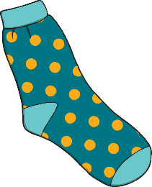
sock

Slide 3
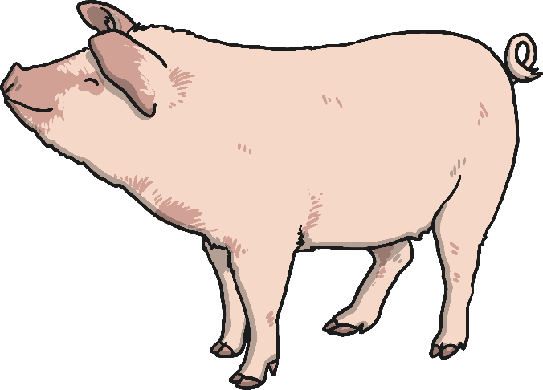
pig

Slide 4
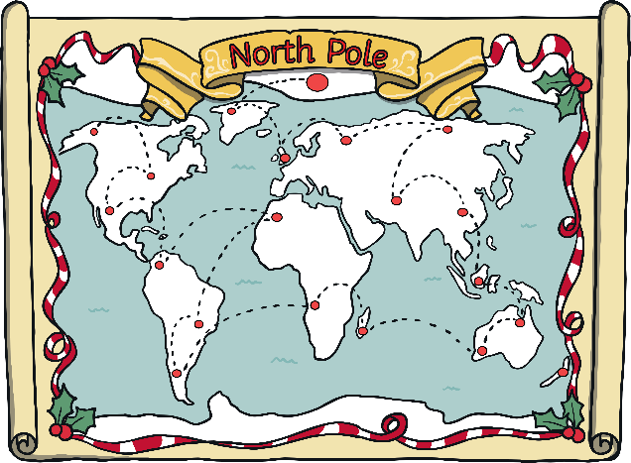
map

Slide 5
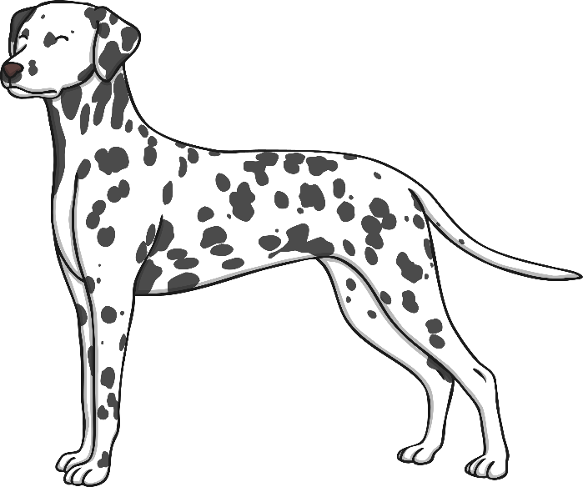
dog

Slide 6

sun

Slide 7
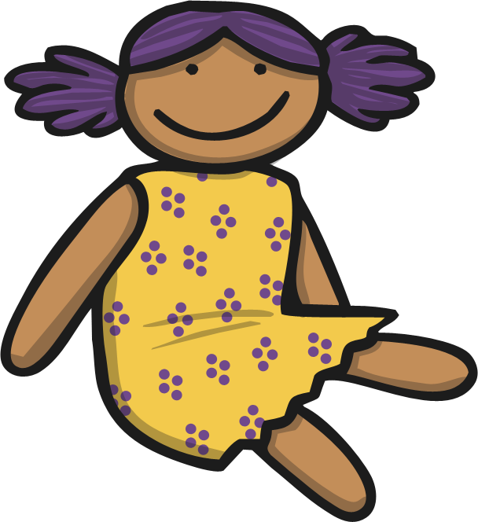
doll

Slide 8

hand

Slide 9

grass

