Slide 1


Slide 2
ow
ai
ee
igh
ar

Slide 3






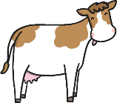


Digraphs
A digraph is a sound which has two letters.
Write the name of each object that has the ‘ai’ sound.

Slide 4






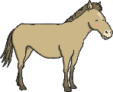
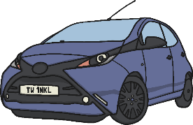


Digraphs
A digraph is a sound which has two letters.
Write the name of each object that has the ‘ar’ sound.

Slide 5






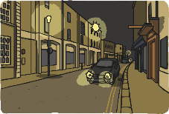



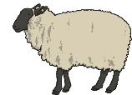

Digraphs
A digraph is a sound which has two letters.
Write the name of each object that has the ‘ee’ sound.

Slide 6




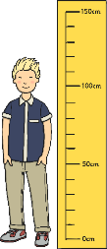


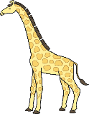


Trigraphs
A trigraph is a sound which has three letters.
Write the name of each object that has the ‘igh’ sound.

Slide 7

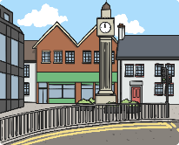
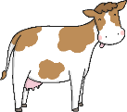










Digraphs
A digraph is a sound which has two letters.
Write the name of each object that has the ‘ow’ sound.

Slide 8
Phase 3 Tricky Words
Read the tricky words below.
you they all are my her he she we me be was
Write sentences using your tricky words.
Don’t forget to use a capital letter and full stop.

