Slide 1
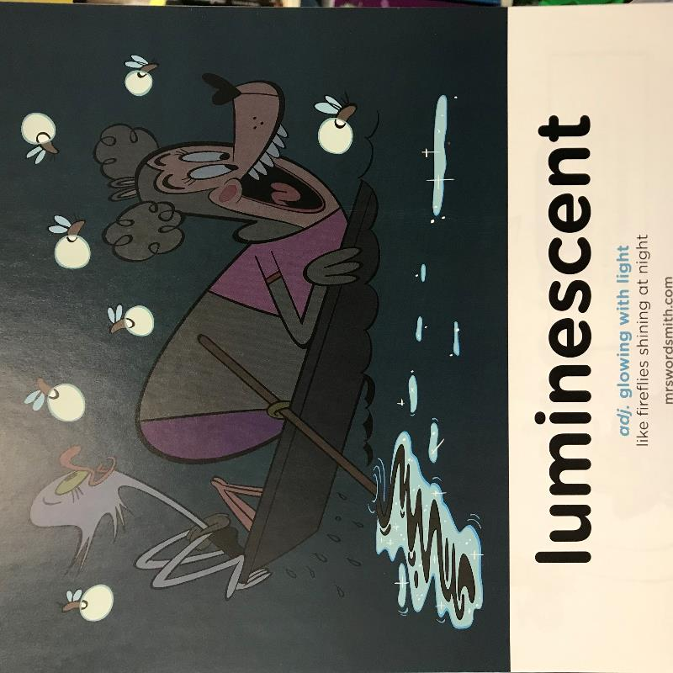

Week 3 Day 2

Slide 2
1.Magpie
2.Structure
3.Imagination
“Good artists copy, great artists steal.” Picasso
7 Plot Beats
1. Problem
2. Desire
3. Opponent
4. Plan
5. Battle
6. Knowledge
7. New level
Monday

Slide 3
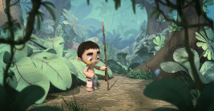
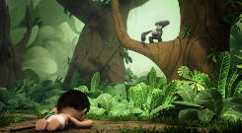
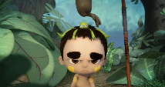
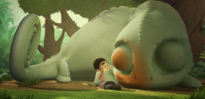
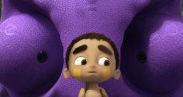
7 Plot Beats
Monday
Toki needs to get an animal head to become part of the tribe and the bigger the head the more respected you are.
Setting description and character description.
Problem
2. Desire
3. Opponent
Beginning- 0.48
Toki as only found a small monkey…this isn’t what he wants. But its better than nothing. The monkey steals his frog. He is feeling….
0.48 -1.03
Toki wants to get the biggest animal head to become part of the tribe and the most respected.
1.03 -1.35
The chameleon isn’t the opponent…
The monkey and frog disappear…

Slide 4
Magpied ideas form you!
The tribal leader had said the words animal heads a lot. These words were ringing in Toki’s ears as he pushed his way through the thick undergrowth. He needed an animal head to become a member of the tribe. He needed a large animal head to be respected. Now was the chance to prove himself.
All was silent…and then he saw it…a frog laying on the ground. He picked it up and placed it in his net. This was the first animal he’d been able to catch all day. He wiped the sweat from his brow. It felt like he’d travelled all over the forest chasing animals but every time, each one was just out of his reach. What was he doing wrong? He’d got everything right but he still couldn’t get an animal head that would make the tribe respect him.
As Toki stepped into a clearing that was streaming with dappled light he saw the small slimy frog lying helplessly in the net. He reached in and grabbed the frog gently and threw it onto his head of brown floppy hair. It fit him like an ill fitted hat. What a disappointment. Out of no where his frog has been whisked from his head by a noisy grey monkey. His howls sounded like laughter to Toki. He couldn’t take it, he ran forward and tripped and fell head first.
Suddenly, the noise stopped and his frog and the monkey had disappeared from sight and everything turned darker. He felt like he was being watched… Then out of nowhere a face appeared. Toki slowly turned to see a giant purple face with bulging active eyes watching him.
The chameleon opened its mouth and Toki anticipating he was about to be eaten closed his eyes. There was a thud and Toki opened his eyes and gasped. In front him lay his frog and the monkey. Perhaps this chameleon was a friend not a foe.

Slide 5
1.Magpie
2.Structure
3.Imagination
“Good artists copy, great artists steal.” Picasso
7 Plot Beats
1. Problem
2. Desire
3. Opponent
4. Plan
5. Battle
6. Knowledge
7. New level
Tuesday

Slide 6
L.O: I can write a story for steps 4 and 5 of the Plot Beats for the story ‘Ride of Passage’.
S.C:
Use texts to magpie and edit to suit your scene.
Use a range of adjectives /similes to continue the narrative and interweave the descriptions of the setting, characters and emotions.
Use speech and speech markers.
This describes the action of the speaker.
E.G.
“What are you doing here?” Dave narrowed his eyes.

Slide 7
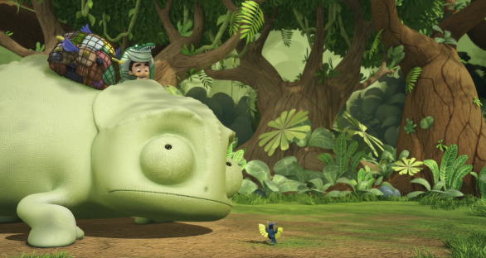
7 Plot Beats
Tuesday
The chameleon decides he will help Toki collect animals. Their adventure through the forest collecting the animals on their journey.
4. Plan
1.35- 3.04
5. Battle

Slide 8
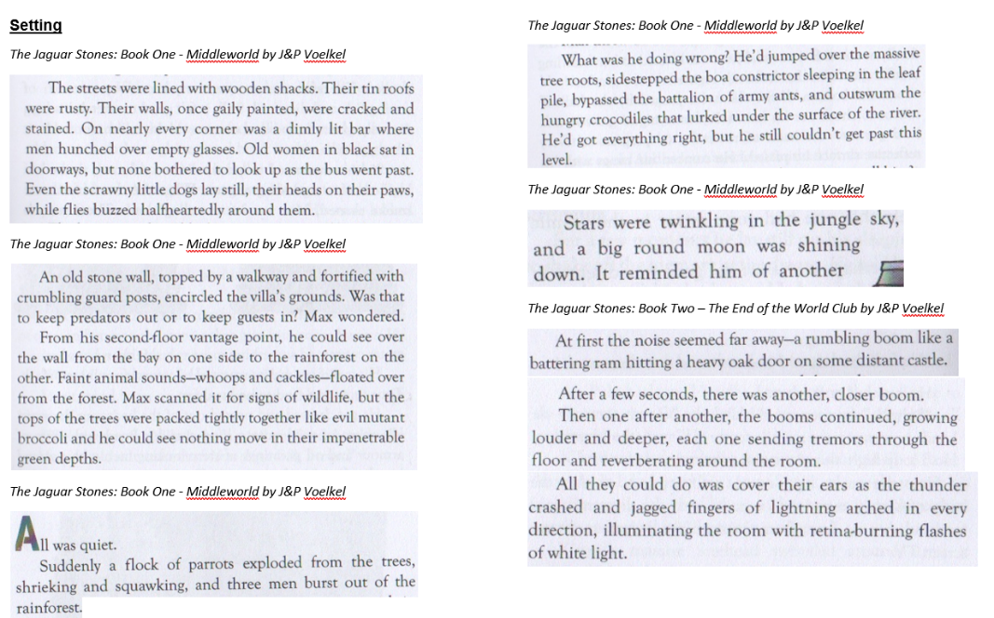

Slide 9
Character description:
‘Lord Asriel was a tall man with powerful shoulders, a fierce dark face, and eyes that seemed to flash and glitter with savage laughter. It was a face to be dominate by, or to fight: never a face to patronize or pity. All his movements were large and perfectly balances, like those of a wild animal, and when he appeared in a room like this, he seemed a wild animal held in a cage too small for it.’
Northern Lights by Philip Pullman
‘Behind Fed sat a girl and her little brother. They had the same slanted eyebrows and the same brown skin, the same long eyelashes. The girl had been shy, hugging her parents until the last possible moment at the airfield; now she was staring down at the water, singing under her breath, her brother trying to eat his seatbelt.’
‘The Explorer by Katherine Rundell
The animal on the branch let out a mew like a cat. It was grey-brown with a cream face, a dog-like snout and immense black eyes. Its arms were long and chicken-bone thin, ending in curved claws. It was small enough to cup in your hands.’
The Explorer by Katherine Rundell
‘Harry managed not to shout out, but it was a close thing. The little creature on the bed had large, bat-like ears and bulging green eyes the size of tennis balls. Harry knew instantly that this was what had been watching him out of the garden hedge that morning.’
Harry Potter and the Chamber of Secrets by J.K.Rowling

Slide 10
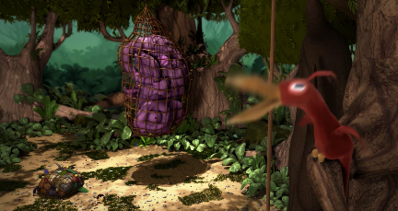
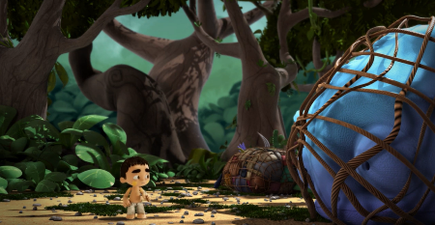
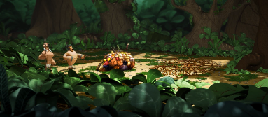
7 Plot Beats
Tuesday
4. Plan
5. Battle
Toki, the animals and the chameleon are caught. The tribe are alerted by the bird.
3.04-3.54
The dilemma…
Use your ideas from last week but as a start. Improve them and make sure they match with your current writing.
Write up to the point where the tribe find the empty clearing.

Slide 11
L.O: I can write a story for steps 4 and 5 of the Plot Beats for the story ‘Ride of Passage’.
S.C:
Use texts to magpie and edit to suit your scene.
Use a range of adjectives /similes to continue the narrative and interweave the descriptions of the setting, characters and emotions.
Use speech and speech markers.
So you should now have your story written for stages 4 and 5, the Plan and the Battle.

