Slide 1


Slide 2

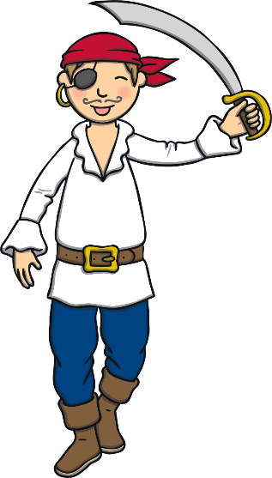
Ahoy matey’s! I’m Captain Jim Barnacle and I will be your pirate teacher.
If you want to be a proper pirate then you need a pirate name.
First of all, I’ll introduce you to a few o’ me pirate matey’s!

Slide 3
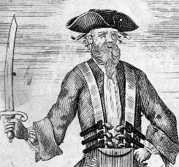
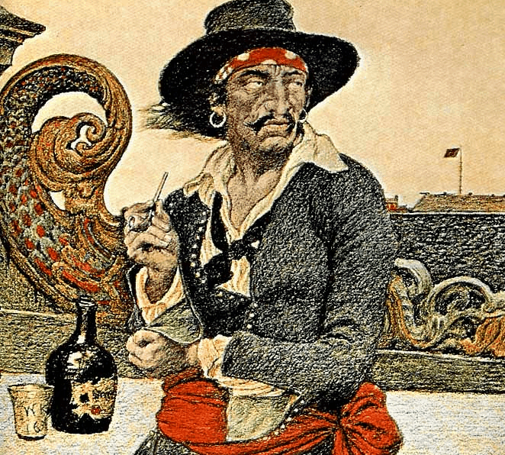
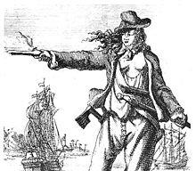

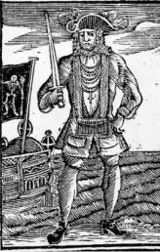
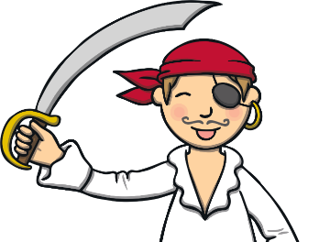
Blackbeard
Captain William Kidd
Anne Bonny
Black Bart
Here are a few of my pirate friends. What do you think of their names?

Slide 4
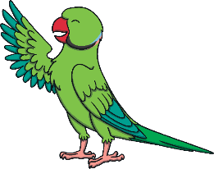
What’s Your Pirate Name?
Find the first letter of your name to make the first part of your pirate name.
A = Swashbuckler
B = Ship Mate
C = Mad-Eyed
D = Captain
E = Fancy-Pants
F = Matey
H = Jolly
I = Cheeky
G = Peg-Leg
J = Plunderin’
K = Hookhand
L = Two-Toe
M = Sailor
N = Sparrow
O = Scurvy-Legs
P = First Mate
Q = Big
R = Crazy
S = Tiny
T = Sea-Dog
V = Anchor-Arm
W = Ships Mate
U = Skipper
X = Strong-Armed
Y = Sea-Legs
Z = One-Eyed

Slide 5

What’s Your Pirate Name?
Now find your pirate surname by finding the month you were born in.
January = Cutlass
February = Black Beard
March = Stinky Jim
April = Custard Pie
May = Shark Bait
June = Sharp Sword
July = Stinkalot
August = O’Greedy
September = Lobster Legs
October = Stormy Seas
November = Squid Legs
December = Patchy
“Tell ye matey’s your pirate name!”

Slide 6


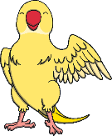
Talk like a Pirate
Well done matey’s, you now have your own pirate names! Before you can become a true pirate, ye need to learn to talk like a pirate.
Can you say these pirate words and phrases with me?

Slide 7
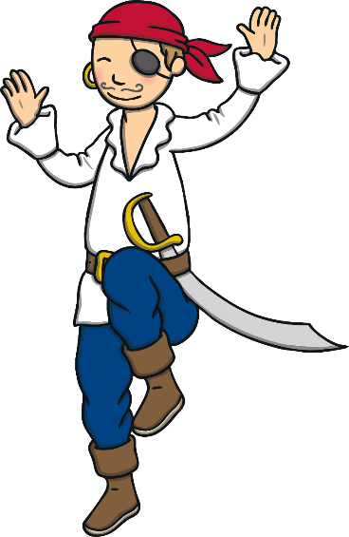
Yo ho ho!
Walk the plank!
Batten down the hatches!
Avast ye!
All hands hoy!
Shiver me timbers!
Ahoy matey!

Slide 8


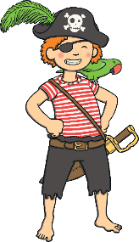
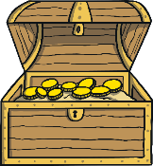
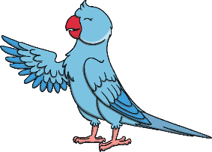
Congratulations!
You are now a fearsome pirate! Well done me hearties! Let’s sail the stormy seas together!
You are now a fearsome pirate!
Click me to receive your ye certificate!

