Slide 1


Slide 2

Can you read the sentences and choose the matching picture?
Which option would
you like?
Read the sentence.
Then, click on the
matching picture.
with sound buttons
without sound buttons

Slide 3





She can fix the rocket.
Well done!

Slide 4



A cat sat on the rooftop.
Well done!

Slide 5




He got wet in the rain.
Well done!

Slide 6



I hear an owl hoot.
Well done!

Slide 7




The boat can zoom on the river.
Well done!

Slide 8



The buzzing bee is in my hair.
Well done!

Slide 9

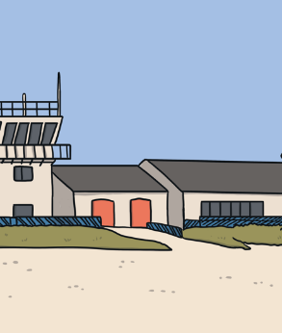


All the jets are in the air.
Well done!

Slide 10






She put the coin in the jar.
Well done!
finish

Slide 11
She can fix the rocket.
Well done!

Slide 12
A cat sat on the rooftop.
Well done!

Slide 13


He got wet in the rain.
Well done!

Slide 14
I hear an owl hoot.
Well done!

Slide 15
The boat can zoom on the river.
Well done!

Slide 16
The buzzing bee is in my hair.
Well done!

Slide 17
All the jets are in the air.
Well done!

Slide 18
She put the coin in the jar.
Well done!

