Slide 1

English comprehension

Slide 2
What are the top tips for comprehension
1. Don’t panic.
Read the text carefully, underline the key parts.
2. Read the question carefully and do what it asks you to do, (go to the line of paragraph it tells you to).
3. Look in the text for the answer and reference or quote the text to support your answer.
4. DON'T PANIC
Look back in the text.
5. If you cannot find the answer go on to the next question.

Slide 3
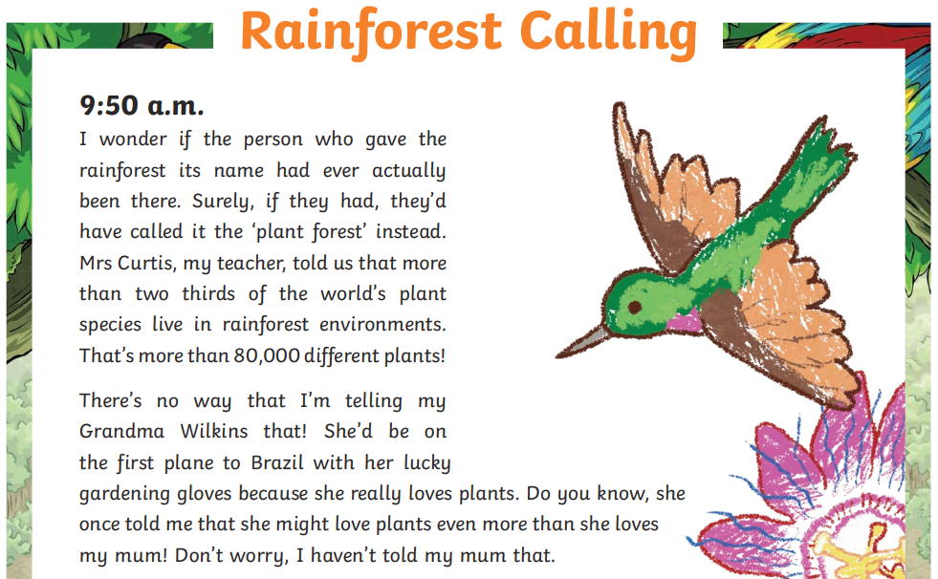

Slide 4
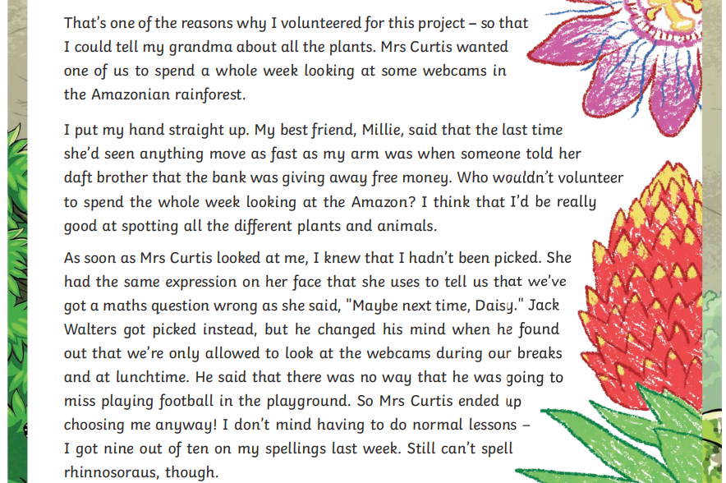

Slide 5
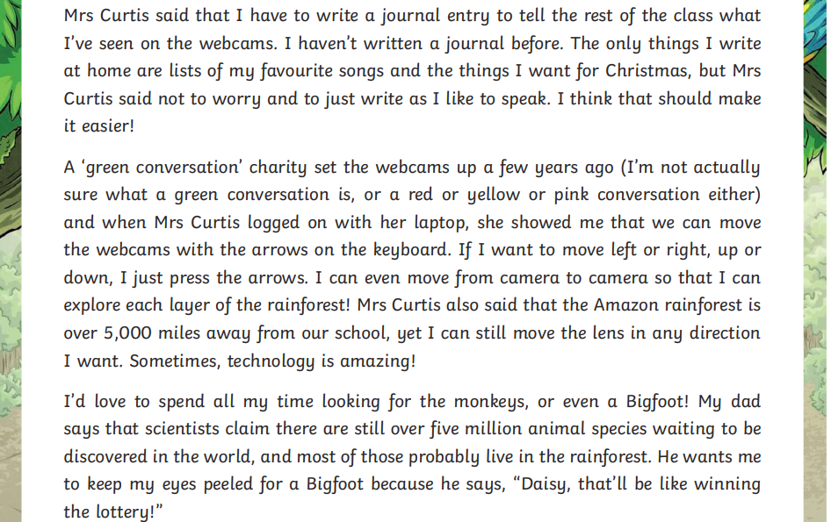

Slide 6
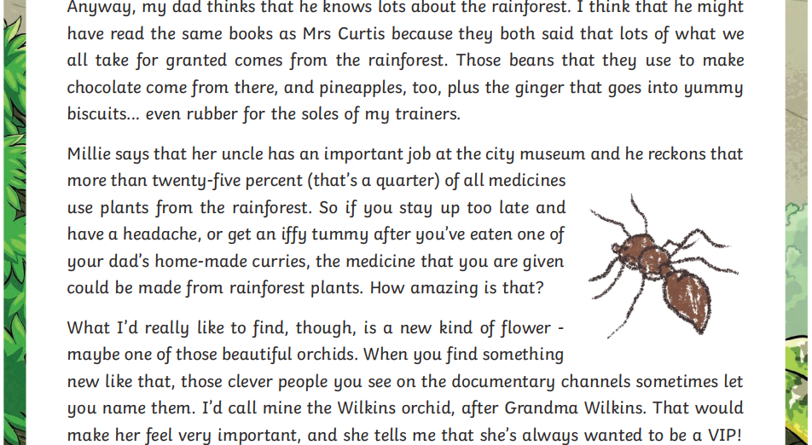

Slide 7
Your work
L.O:To answer comprehension questions carefully.
Your turn
Choose the questions you would like to do A or B. Answer them either on the sheet or on a piece of paper.
Then create your own questions.

