Slide 1

germination
germination
1
Flowering
2
spores dispersed
seed dispersal
5
roots
Non-flowering
roots
4
3
spores
flowering / pollination
leaves
leaves

Slide 2
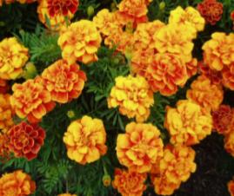
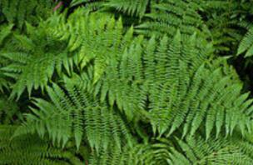
Compare the life cycle of a flowering and non-flowering plant.
Non-flowering
They are plants.
Spore are single celled.
The spores do not contain nutrients to help them grow.
Flowering
They are plants.
Seeds are multicellular.
Containing the nutrients in the seed for it to grow.
They are both plants.
The seeds/spores can de dispersed by the wind.
The seeds/spores have a protective coating.
The seeds/spores can survive harsh conditions.
The seeds/spores need to be dispersed away from the parent plant so they have a better chance of growing.

Slide 3
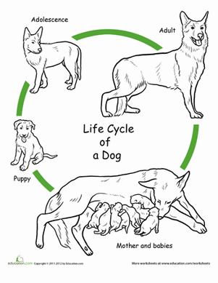
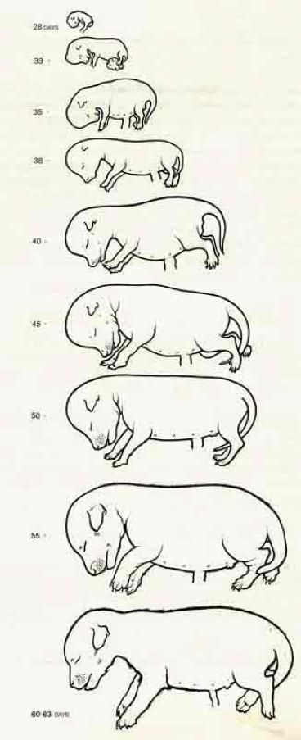
What is the lifecycle of a dog?
adolescence
adult
What happens at each stage?
baby
germination
foetus

Slide 4
What is the lifecycle of a dog?
What happens at each stage?
Adolescent grows and develops.
adolescence
An independent adult will look after itself and will usually have its own offspring.
adult
Baby is reliant on its mother for food and will be fed milk by its mother and protected.
baby
Gestation: this is when the foetus grows inside the mother where it is completely reliant upon the mother.
germination
foetus

Slide 5
L.O: To identify similarities and differences between the lifecycles of plants and animals.
S.C: Identify and explain the similarities.
Identify and explain the differences.
Compare the lifecycle of a mammal and either a flowering or non-flowering plant.
or
and
Record your responses to the statements below on a piece of paper.
Identify and explain the similarities between the lifecycles of plants and animals.
2. Identify and explain the differences between the lifecycles of plants and animals.
After this there is another task on the next page.

Slide 6
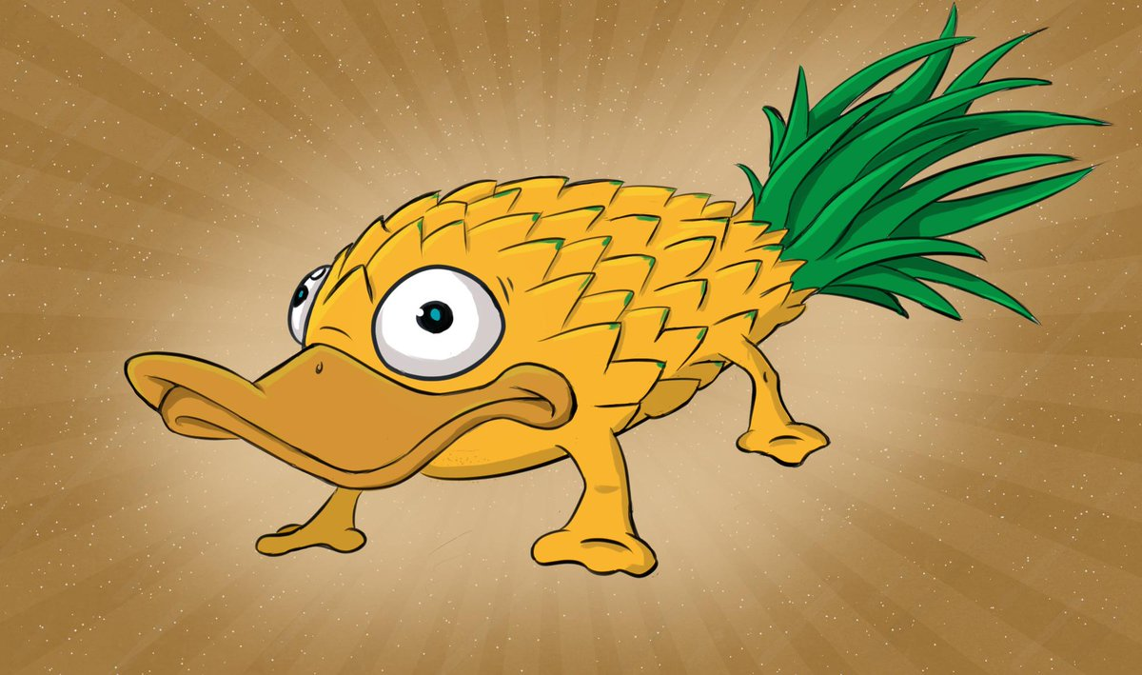
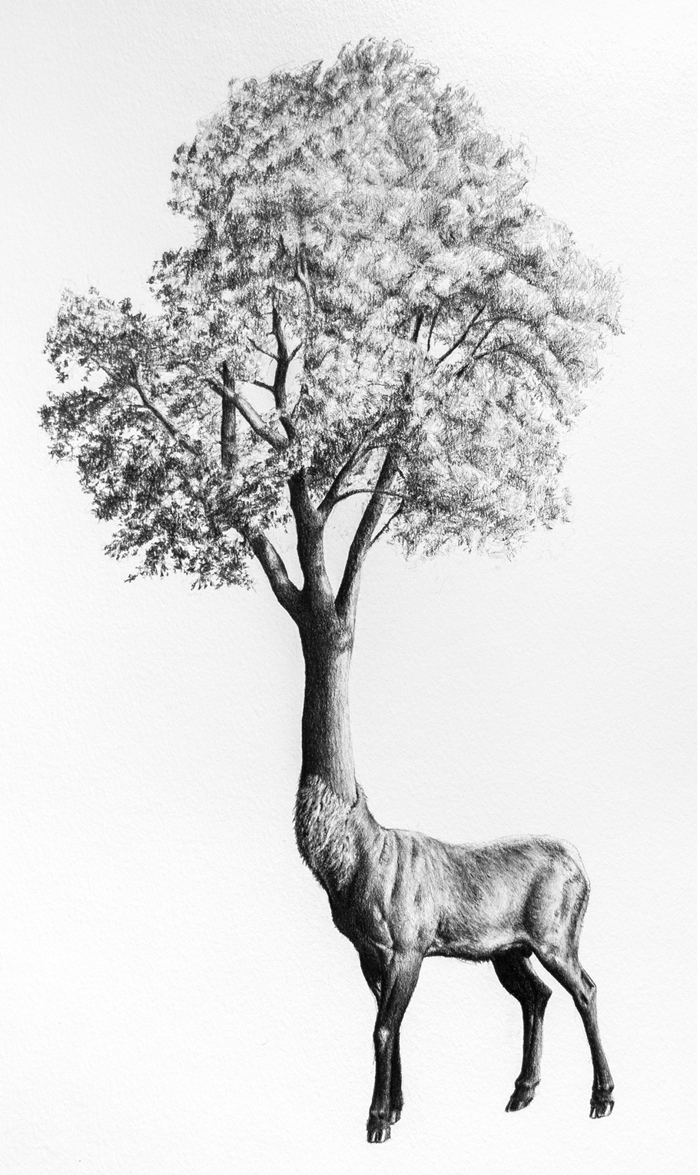
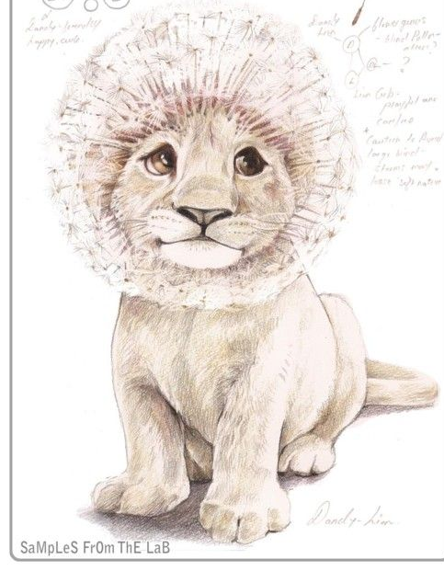
You can show your understanding by creating your own animal/plant hybrid – a planimal!
This is a similar idea to when we created your creatures in the autumn term. Do you remember creating on the following: the salabird (salamander/bird), frogerfly (amphibian/butterfly), parrofly (parrot/butterfly), hoppit (frog/mammal), pouchird (marsupial/bird) or butterphant (butterfly/elephant)?
This time you are going to create a creature that is half animal and half plant and write a lifecycle for it. On the next slide I have outlined the other animal lifecycles we looked at in the autumn to jog your memory.
Here are some ideas… I’m sure you have lots of your own and it doesn’t have to be one of these
Remember to:
Label your planimal to explain the different parts
Write its lifecycles and identify which parts belong to which species, the plant or the animal.

Slide 7
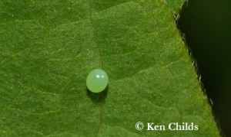
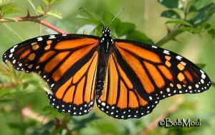
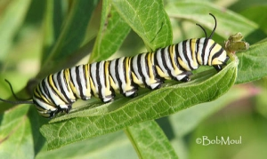
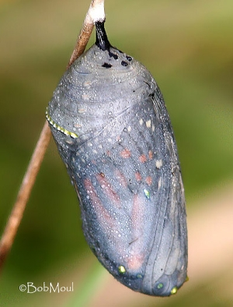
Life cycle of a bird
Life cycle of a frog / salamander / axolotl
egg
egg
adult
nestling
Adult
fledgling
Metamorphosis
Tadpole
Life cycle of a butterfly
Metamorphosis is a process by which animals undergo an abrupt and obvious change in the structure of their body and their behaviour.
Egg
Butterfly
Caterpillar
Chrysalis

