Slide 1


Day 2

Slide 2
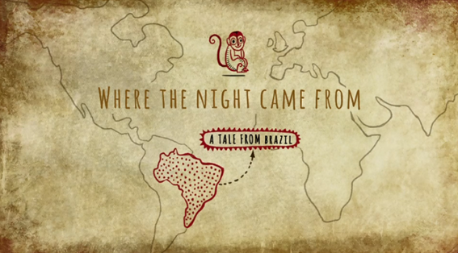
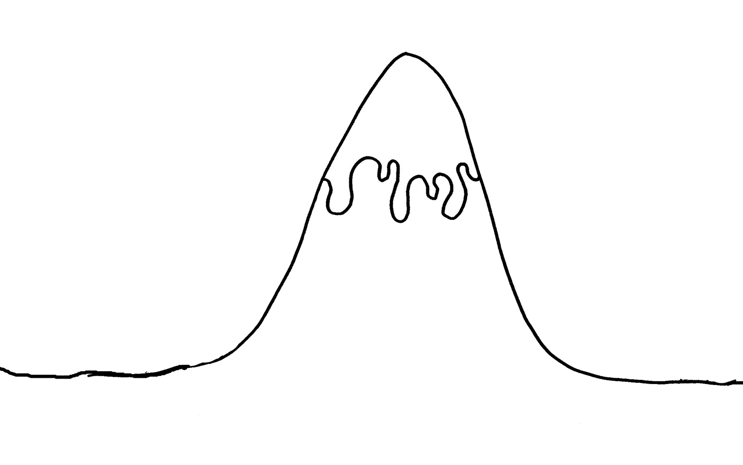
Answers to yesterdays work…
Where the Night Came From.
https://www.bbc.com/teach/class-clips-video/where-the-night-came-from/zn2kjhv
L.O:I can match the story mountain story structure to a story from another culture.
Did the story Where the Night Came From match the story mountain structure?
There lived a Prince with 3 servants who loved to fish. The Prince met the daughter of the King of the Ocean. She came and lived with him on land. They lived happily for many years.
The longer she lived on land the weaker she became. She needed the darkness of the ocean
The Prince sent his servants to the King of the Ocean to get the darkness. The servants do get the darkness and are told not to open it but they do! The Princess falls asleep but is woken up and asked to fix the problem as everyone on land is scared as they have never seen the darkness. She turns the 3 servants into monkeys to chase away the darkness every day.
Problem
Build up
Fix problem
When the Earth was very young, the sun shone all the time.
Ending
Introduction
Now every day the darkness is chased away by the monkeys and that’s why you hear them in evenings.

Slide 3
Answers to yesterdays work…
L.O:I can identify the key features of a story from other culture.
What is its features or ingredients?
Build up
Description of the setting and characters.
Problem
Plan/Solution
Ending-Moral-what have they learned?
Emotions / show-not-tell
What is the purpose of a story from another culture?
Modal verbs
A story that is enjoyable to read with a moral at the end.
Conjunctions
Vocabulary linked to that culture, sayings or descriptions
Speech

Slide 4
Do all stories follow this story mountain structure?
Problem
Build up
Fix problem
?
or
Ending
Introduction

Slide 5

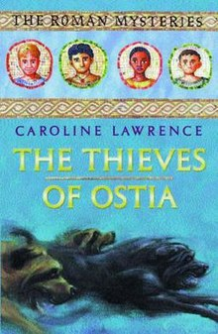
“Good artists copy, great artists steal.” Picasso
1.Magpie
2.Structure
3.Imagination

Slide 6



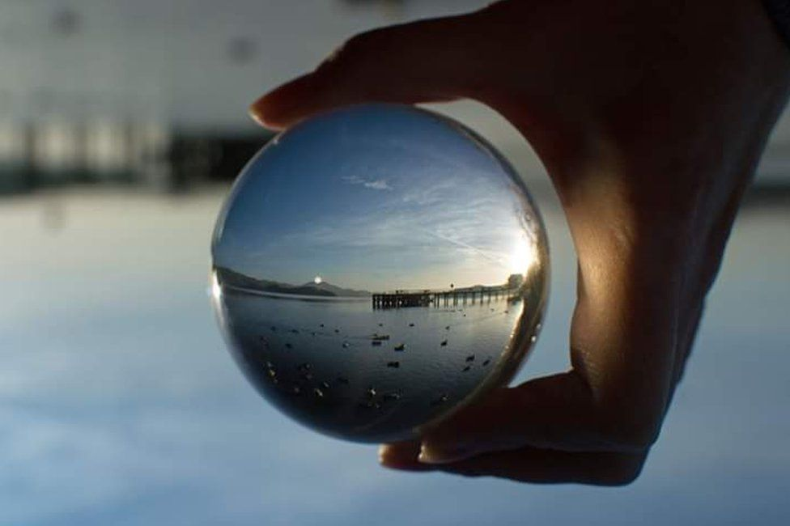
7 Plot Beats
1. Problem
2. Desire
3. Opponent
4. Plan
5. Battle
6. Knowledge
7. New level
threshold

Slide 7
Where the Night Came From.
https://www.bbc.com/teach/class-clips-video/where-the-night-came-from/zn2kjhv
Did the story Where the Night Came From match the...7 Plot Beats?
7 Plot Beats
1. Problem
2. Desire
3. Opponent
4. Plan
5. Battle
6. Knowledge
7. New level

Slide 8
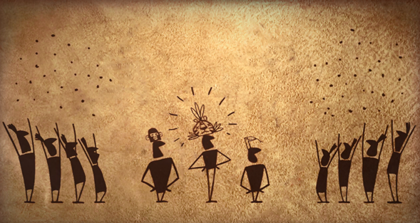
Ride of Passage.
Please scroll down to find the video.
https://www.literacyshed.com/the-other-cultures-shed.html

Slide 9
https://www.literacyshed.com/the-other-cultures-shed.html
Ride of Passage.
Can you retell the story?

Slide 10
L.O:I can match the 7 Plot Beats to a story from another culture.
Does Ride of Passage follow the...7 Plot Beats?
7 Plot Beats
1. Problem
2. Desire
3. Opponent
4. Plan
5. Battle
6. Knowledge
7. New level

Slide 11
If you would like an extra challenge…
Choose a story you have read. Does it match the 7 Plot Beats?
7 Plot Beats
1. Problem
2. Desire
3. Opponent
4. Plan
5. Battle
6. Knowledge
7. New level

