Slide 1
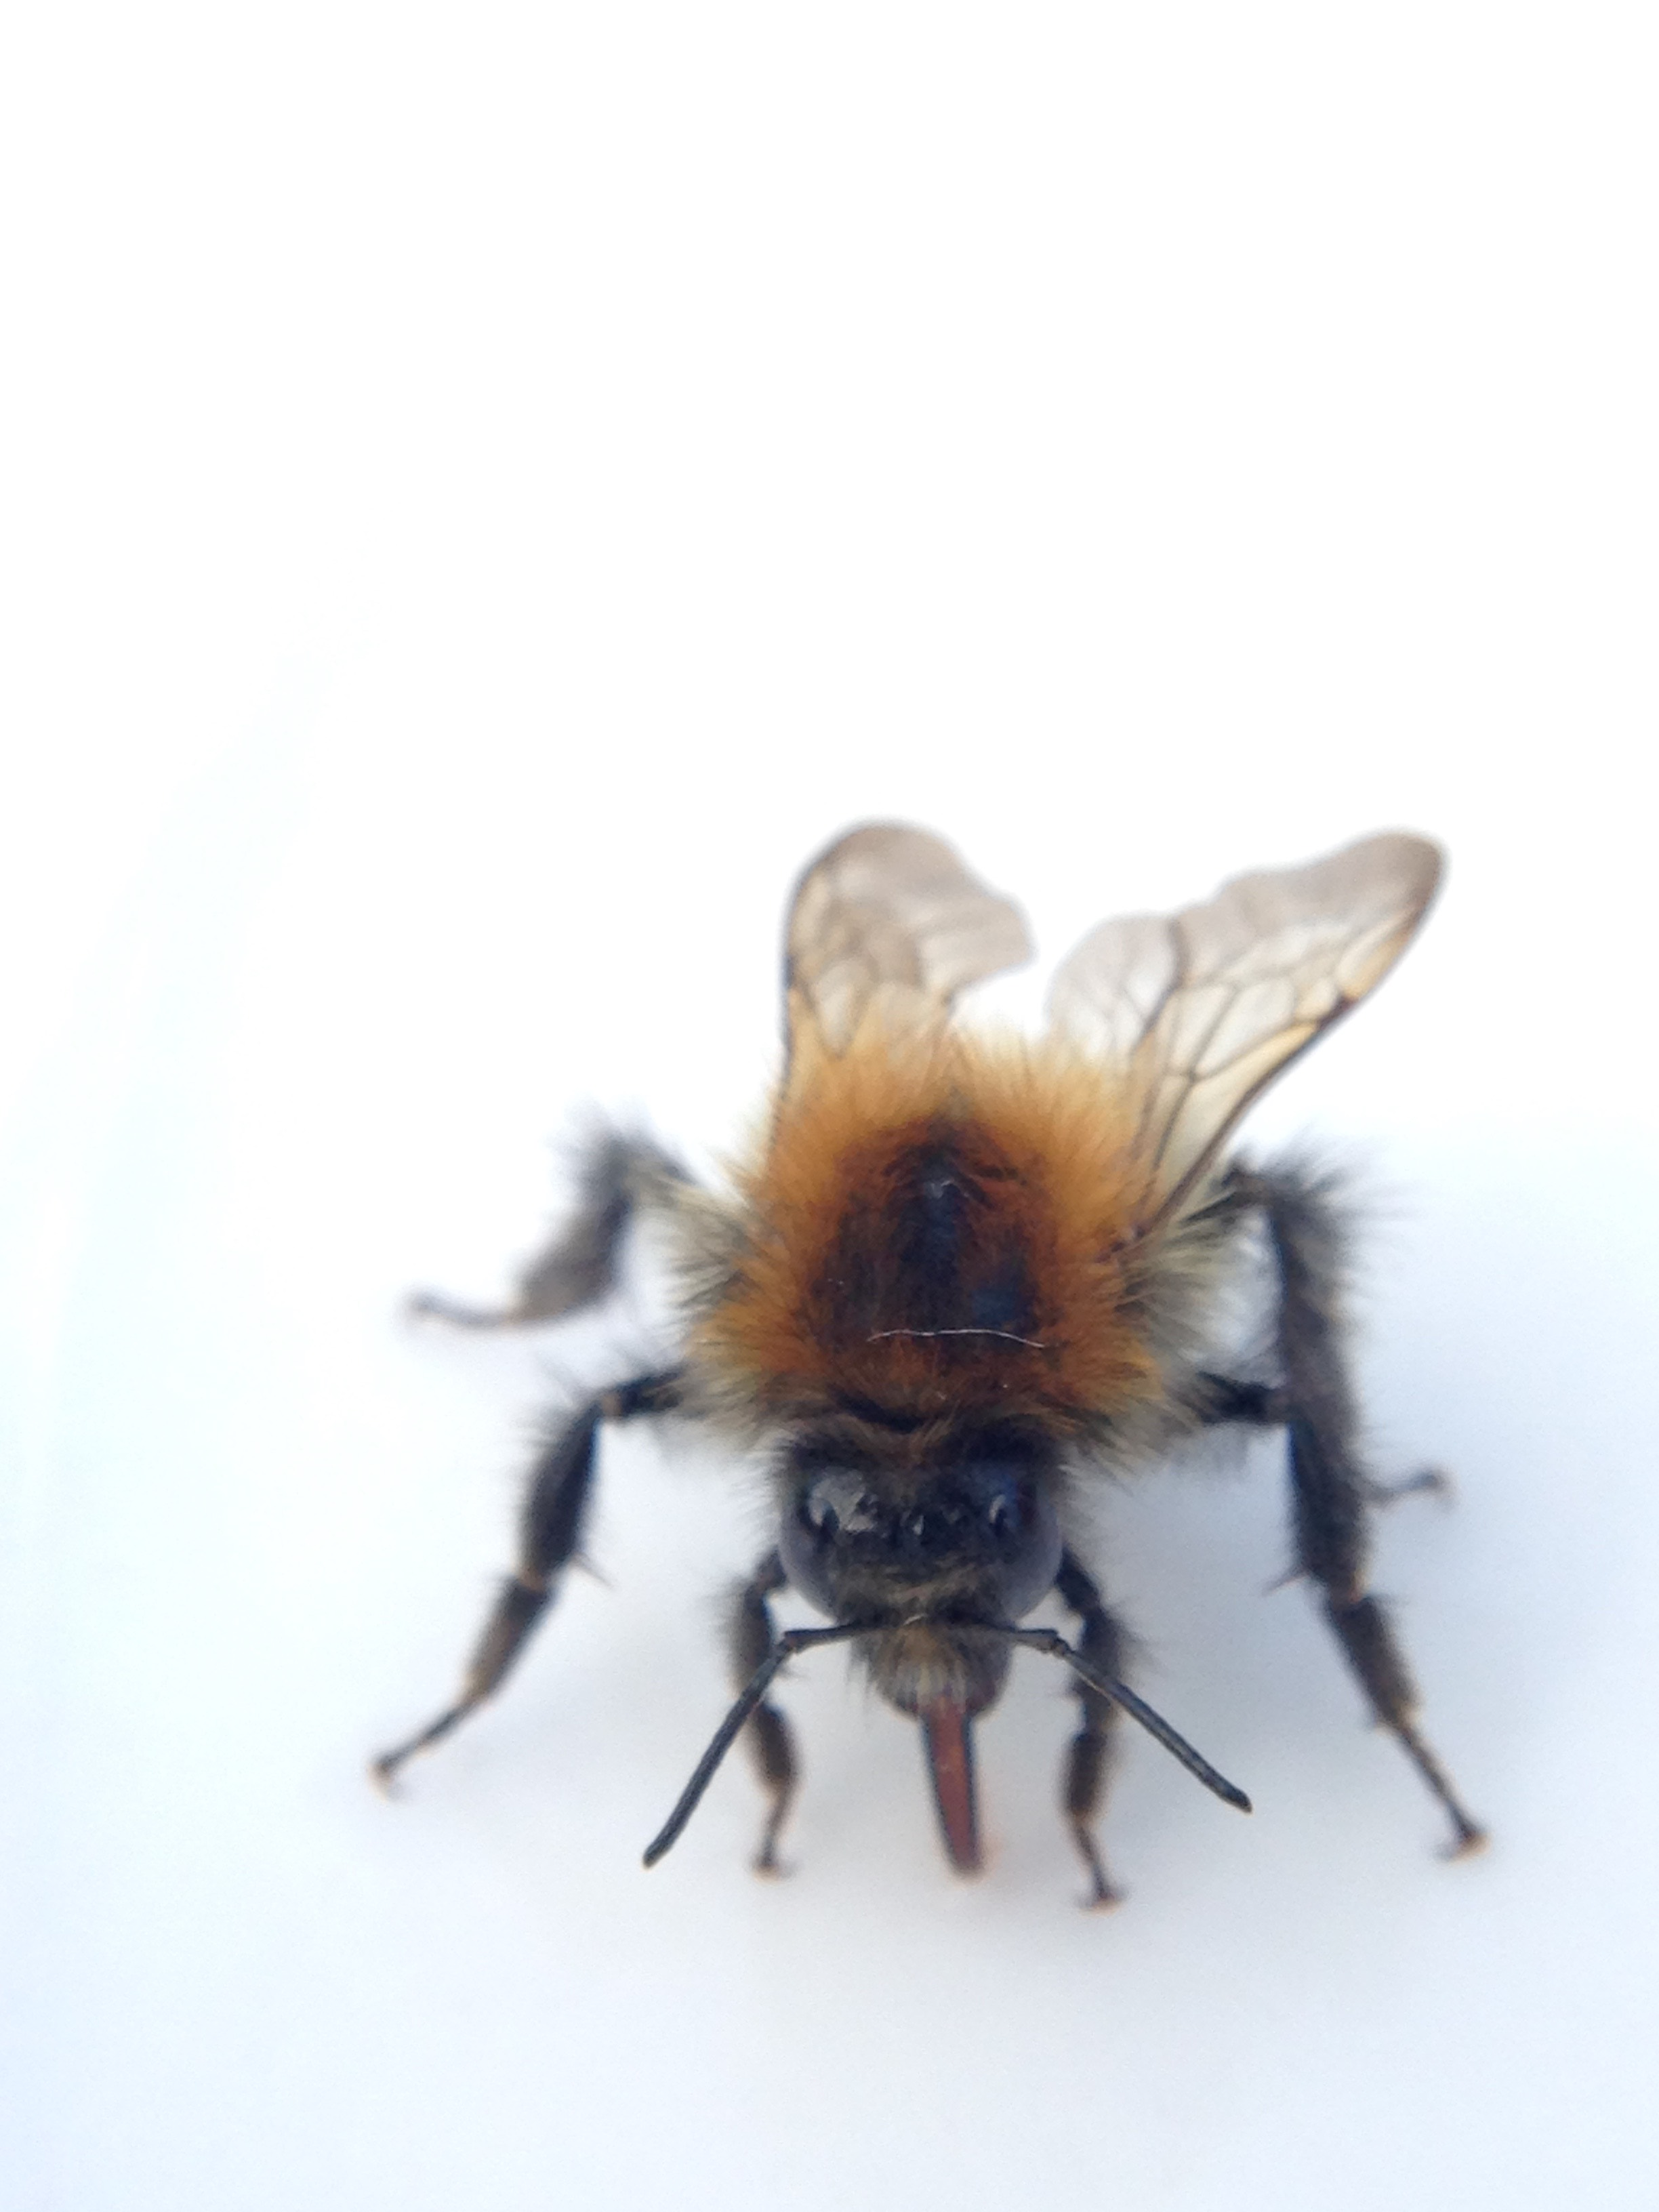
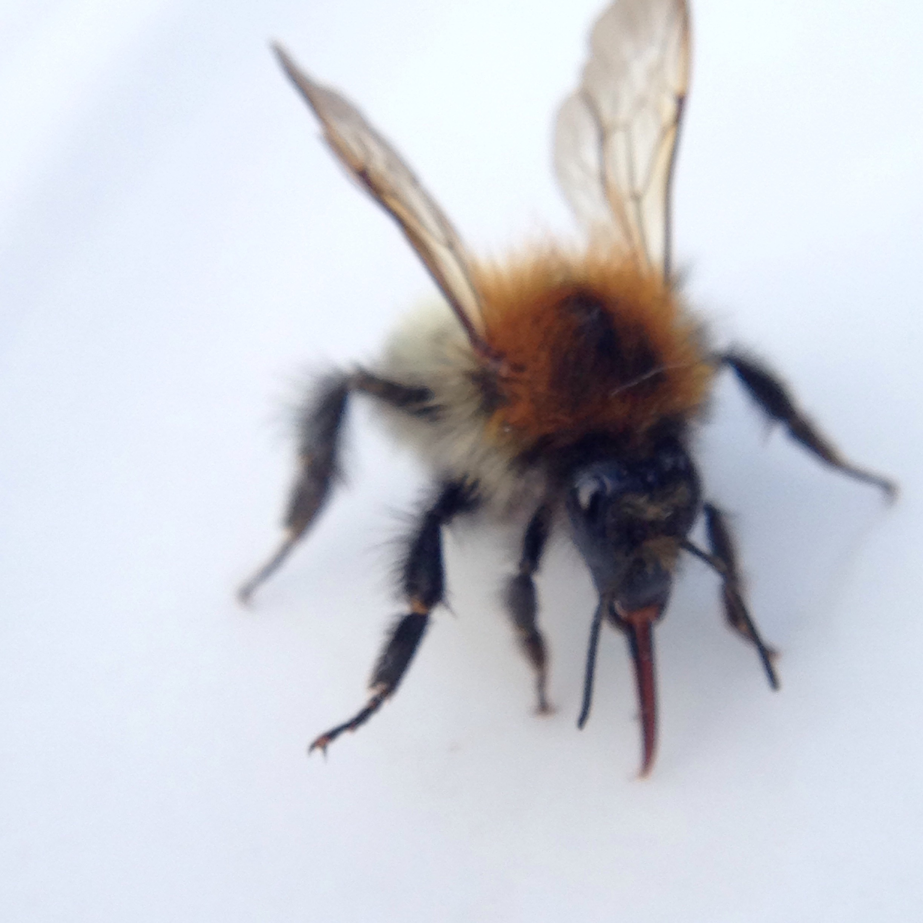

Tree bumble bee drinking nectar
Tongue called a proboscis used for slurping up liquids and also for tasting. When extended, the proboscis is about a quarter-inch long, the length needed to reach nectar deep inside flowers.

Slide 2

What is germination?
Can you look the word up?
Germination is the process by which a plant grows from a seed. The most common example of germination is the sprouting of a seedling

Slide 3
After germination what happens to the seed?
https://www.bbc.co.uk/bitesize/clips/zb4rkqt

Slide 4
What is a lifecycle?
Can you remember we discussed this when we learnt about lifecycles of different animals?
Look it up if you can’t ☺

Slide 5
What is a lifecycle of a flowering plant?
You will need to gather all the information you have learnt about flowering plants over the last two weeks.
How many stages in its lifecycle do you think it has?
https://www.bbc.co.uk/bitesize/clips/zs9c87h

Slide 6
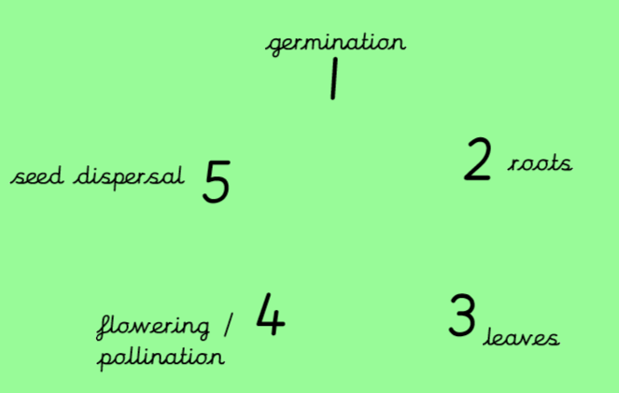
What is a lifecycle of a flowering plant?
Using your knowledge over the last week can you explain what happens at each of these stages?

Slide 7
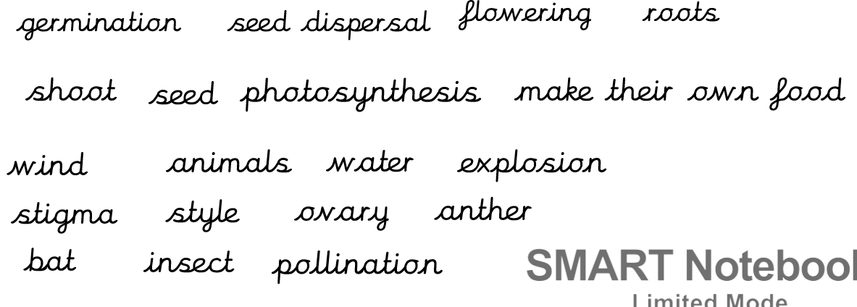
Please complete the plant lifecycle of a dandelion. Choose the challenge sheet of your choice. There is key vocabulary to help you explain each stage.
L.O: Describe the life cycle of a plant.
S.C: To name the stages.
To explain each stage.
To include key vocabulary.
Challenge question:
Are all plant lifecycles the same?

Slide 8
Some vocabulary you have learnt so far!

Slide 9
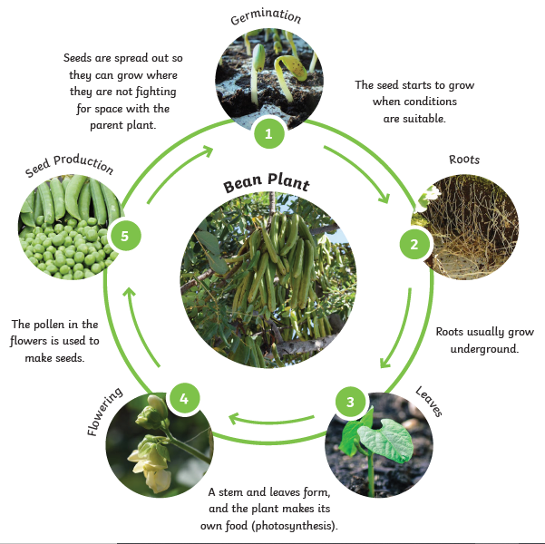
Lifecycle of a flowering plant
Seeds are dispersed by wind, water…
All the energy comes from the seed itself when it starts to grow.
Roots gather up water and nutrients from the soil.
The plant has flowers to attract insects and animals so that it can pollinate. Pollen is taken from the…

