Slide 1
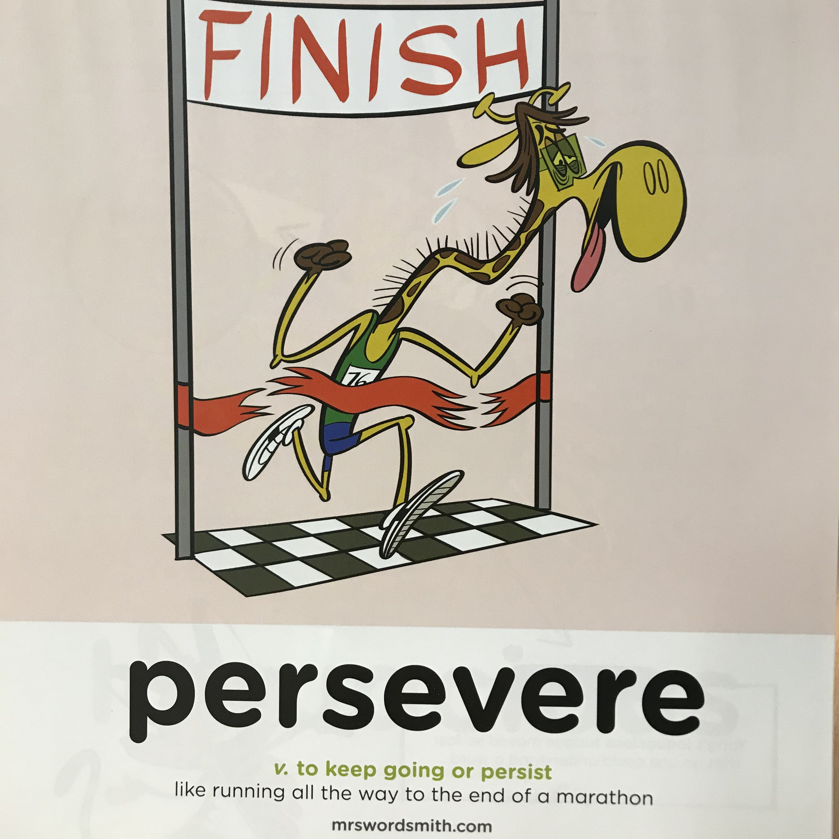


Slide 2
Day 1
Stories from other cultures

Slide 3
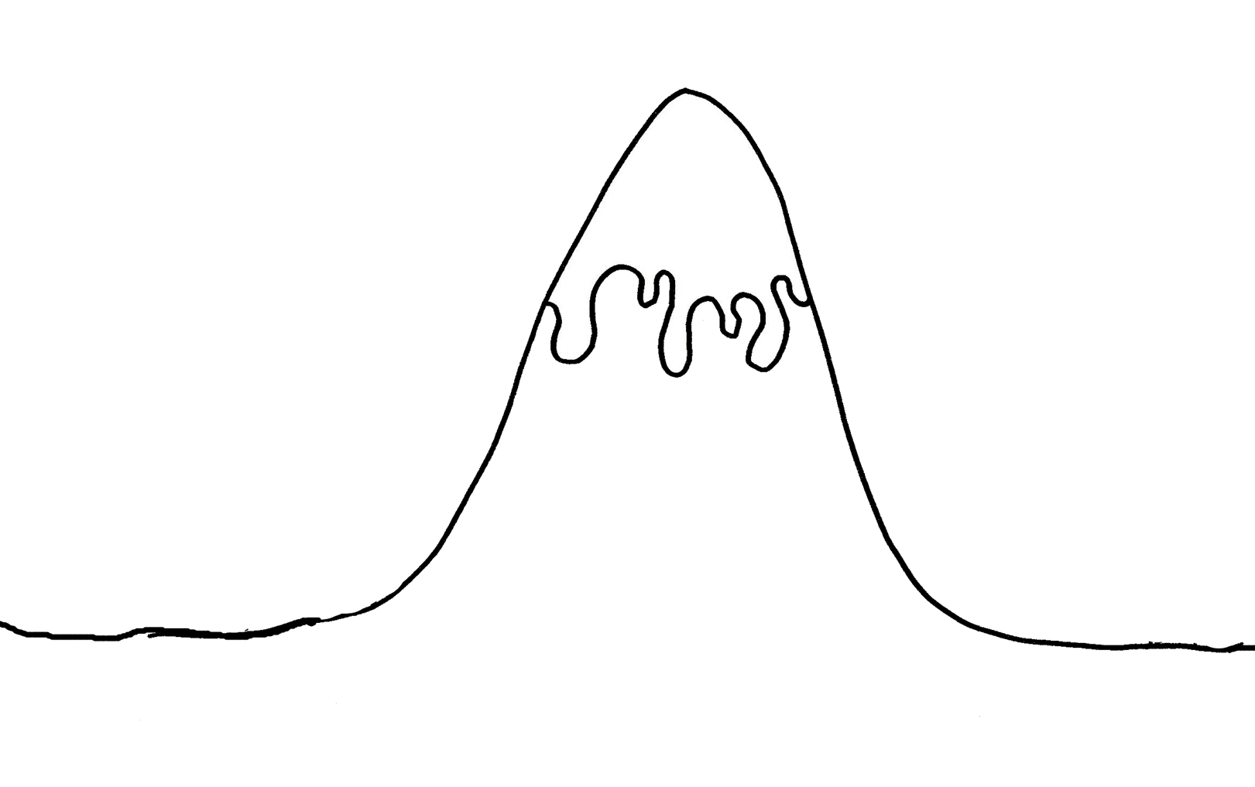
What's the traditional way to plot a story?

Slide 4
Story Mountain
Problem
Build up
Fix problem
Introduction
Ending

Slide 5
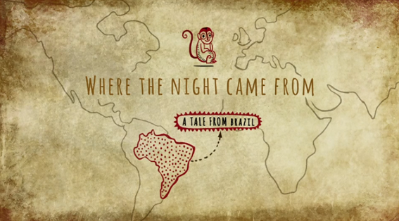
Where the Night Came From.
L.O:I can match the story mountain structure to a story from another culture.
https://www.bbc.com/teach/class-clips-video/where-the-night-came-from/zn2kjhv

Slide 6
L.O:I can identify the key features of a story from other culture.
What is its features or ingredients?
What is the purpose of a story from another culture?

